Slide 1
Early Warning System in Reading
Empowering Educators with Data
Presented By: The CNMI SLDS Program & DBDriven
July 2023
Aqua Resort

Slide 2
1995

Slide 3
What happened in 1995?

Slide 4
Always Present (rode the bus)
Talkative
Failing Language Arts
New 7th Grader
Also in
1995…
Notes:
This is me as I entered middle school.
I rode the bus so I was at school everyday and was on time
I was talkative and was sent out of class almost every day
I earned a “C” in Language Arts

Slide 5
Poster Activity
(George)
Share one thing you enjoy about your work in the school or district office that involves supporting students?
Share any memorable experiences you've had that supported students in their academic journey.
8 min
Notes:
Data sources: Academic, behavior, attendance, socioeconomic, standardized tests, IEPs, and survey.
Data Uses: Identify at-risk students, tailor instruction, develop intervention strategies, monitor progress, Parent-Teacher Conference, School-level decision-making, evaluate program effectiveness,

Slide 6
Early Warning System in Reading
Notes:
As educators, we use different types of data to identify and support students in need.
However, we need a way to focus on what we can change in the classroom and not on what we cannot change.

Slide 7
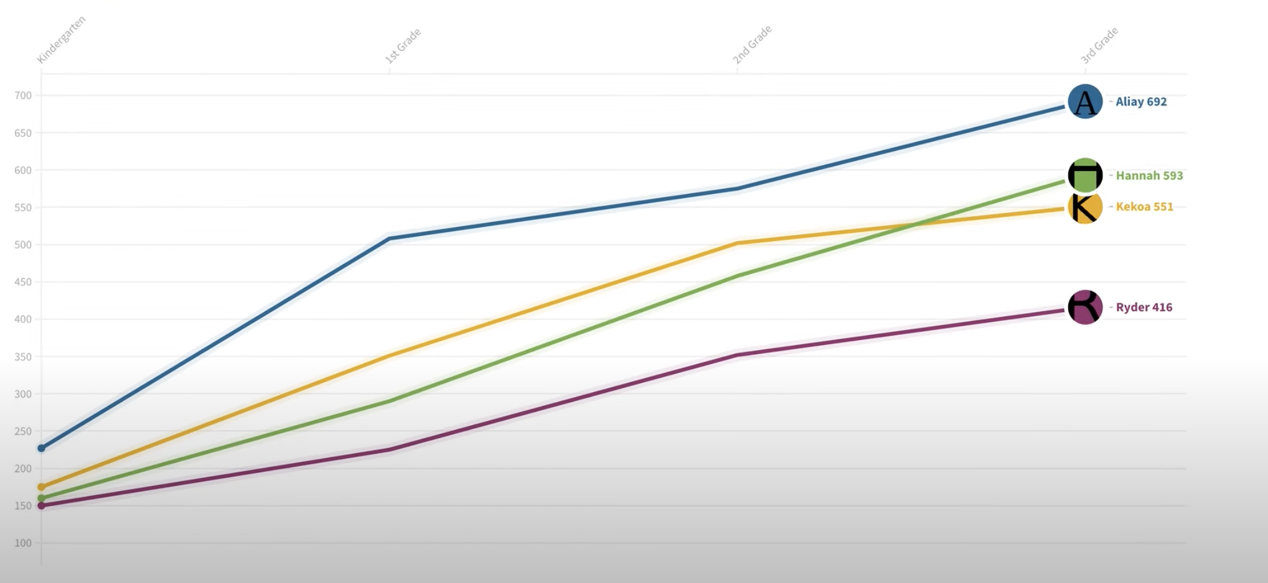
Kindergarten 1st grade 2nd grade 3rd grade

Slide 8
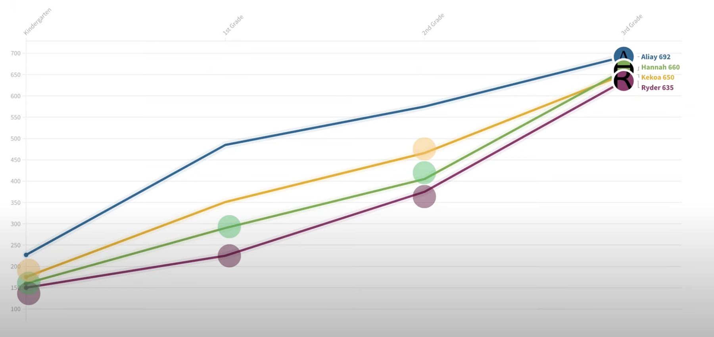
Kindergarten 1st grade 2nd grade 3rd grade

Slide 9
Early Warning System in Reading
A system designed to identify struggling readers early on.
Uses data to track students' reading performance.
Helps educators intervene and provide support.
Aims to prevent reading difficulties from becoming worse.
Ensures students get the help they need to succeed in reading.
STUDENT
Current and Longitudinal
Attendance
Assessments
Retention
Behavior
Course Performance
Mobility

Slide 10
Indicators
Cut scores for each Indicator

Slide 11
Mock Data Team Activity
(George)
Choose a reporter for your team.
Instructions:
Review the mock student data
Identify who you have concerns about and should be “flagged.” Flagged students are not on track to reading proficiently by 3rd grade.
What should their goal be? What interventions should they get? (Ex: assigned high-dosage tutoring? Special education services?)
20 min
Notes:
Two major things:
Which students do you think should be flagged
Which person from your group will report back afterwards

Slide 12
6 min Break
Notes:
As educators, we use different types of data to identify and support students in need.
However, we need a way to focus on what we can change in the classroom and not on what we cannot change.

Slide 13
Tally for Activity
Link for the activity: https://docs.google.com/spreadsheets/d/1l_QisJmJXHe-ai3Pu1pX1IB8tmBGAHr0dfyy4ePlBKE/edit#gid=2037905436

Slide 14
Early Warning System in Reading
ABC + 3
STUDENT
Current and Longitudinal

Slide 15
Early Warning System in Reading
ABC + 3
STUDENT
Current and Longitudinal
Attendance
Assessments
Retention
Behavior
Course Performance
Mobility

Slide 16
Behind every data set there are individual stories and experiences that give them meaning and relevance.
Notes:
As educators, we use different types of data to identify and support students in need.
However, we need a way to focus on what we can change in the classroom and not on what we cannot change.

Slide 17
These stories breathe life into the data.
Notes:
As educators, we use different types of data to identify and support students in need.
However, we need a way to focus on what we can change in the classroom and not on what we cannot change.

Slide 18
Always Present (rode the bus)
Failing Language Arts
New 7th Grader
Had two friends
Talkative
Born & raised in California
Separated Parents
Three Elementary School
1995
Notes:
If you need a little more inspiration, I want to remind you that this girl wasn’t talkative or naughty just to annoy her teachers. She was experiencing culture shock but didn’t have the vocabulary to describe how isolated she felt.

Slide 19
Ms. Q
(Fear, Respect & physical health)
Auntie Maggie Concepcion+
(Acceptance)
Mr. Williams
(Stern, but Kind)
Notes:
If you need a little more inspiration, I want to remind you that this girl wasn’t talkative or naughty just to annoy her teachers. She was experiencing culture shock but didn’t have the vocabulary to describe how isolated she felt.

Slide 20
Individual Post-It
(Ferdy)
Write a reflection on how your work either at the school or central office contributes to the success of the early warning system in reading.
2 min

Slide 21
eMPowerED Platform
Technical solution for the early warning system
Notes:
As educators, we use different types of data to identify and support students in need.
However, we need a way to focus on what we can change in the classroom and not on what we cannot change.

Slide 22
CNMI PSS
In Partnership
July 28th, 2023

Slide 23
Topics
Introduction
REPORTING
p20w
K12 SLDS
EWS

Slide 24
Today’s Objectives
Introduce ourselves and meet you
Communicate project terminology, goals, schedules, and expectations
Provide everyone with a basic understanding of the technologies, components and architecture used in CNMI’s Statewide Longitudinal Data System (SLDS), Early Warning System (EWS), Reporting & PreK – 20 Workforce (P-20W) solutions

Slide 25
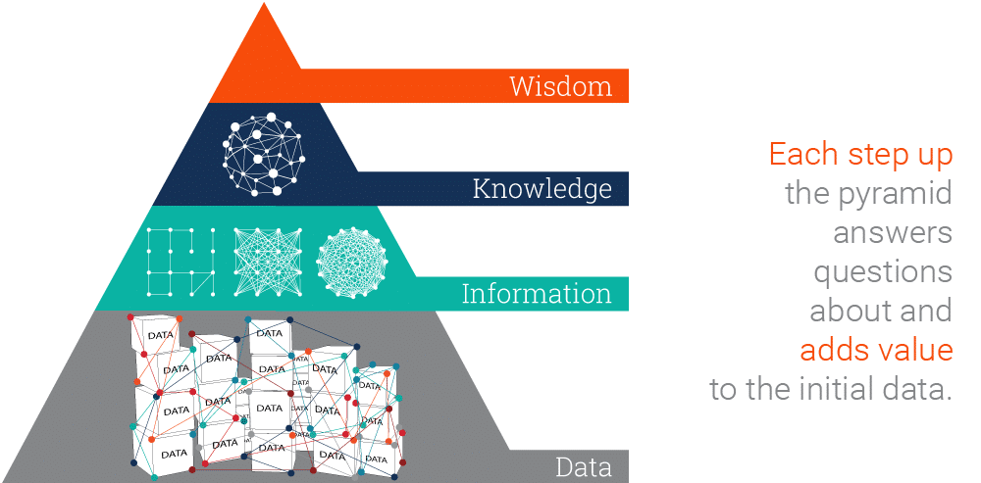
Moving Up the DIKW Pyramid

Slide 26
PSS SLDS
What is an Educational Longitudinal Data System?
1.) An education longitudinal data system (LDS) is a data system that collects and maintains detailed, high quality, student- and staff-level data;
2.) links these data across entities and over time, providing a complete academic and performance history for each student;
3.) makes these data accessible through reporting and analysis tools
Consolidates and maintains PSS data into one system
Provides a complete PK-12 data record (longitudinal)
Allows for reports and data analysis

Slide 27
Data Refresh
Legend
DB Connection or Automated Sync
Manual Effort
ChildPlus
MSAA
365x (Nightly)
SBA
1x (Yearly)
2x (Semesterly)
Infinite Campus
Source | Frequency | Method
Infinite Campus | 365x (Nightly) | EdFi Sync
Child Plus | 365x (Nightly) | DB Connect
Achieve3000 / Smarty Ants | 365x (Nightly) | SFTP - Vendor
Renaissance | 12x (Monthly) | SFTP – Vendor
TS Gold | 5x () | Vendor Secure Email
MSAA | 1x (Annually) | SFTP - DBDriven
SBA | 1x (Annually) | SFTP – DBDriven
WIDA | 4x (Quarterly) | SFTP – DBDriven
AP Program | 1x (Annually) | SFTP – DBDriven
JD Edwards | 6x? (Monthly – phase out 2023) | SFTP – DBDriven
ACT Aspire
365x (Nightly)
ELEOT
4x (Quarterly)
Achieve 3000
Smarty Ants SFTP
McREL
365x (Nightly)
1x historical load
DBDriven SFTP
K-12 SLDS DW
Renaissance SFTP
Cognia
12x (Monthly)
TS Gold Secure File
WIDA
On Request (Self Service)
4x (Quarterly)
AP Program
JD Edwards
1x (Annually)
1x (Annually)

Slide 28
Early Warning System (EWS)

Slide 29
EWS Project Overview
GOAL
Provide educators with measurable and actionable data for individual students and student groups
OBJECTIVE
Provide accurate and early identification of students in need of enhanced support
Capture intervention activities
Provide meaningful feedback to evaluate the effectiveness of programs and interventions
SCHEDULE

Slide 30
EWS Key Features
Design Interactive Web Application 1 Internal and 3 External Data Sources Interventions and Feedback Report Panel IC, Child Plus, STAR Reading/Math Solution provides four different pages with visuals appropriately designed for each District, School, Classroom and Student | Security User Access Authentication and Authorization Required Multi-level SSO Capability Sign-on with CNMI PSS Google Email Accounts EWS Authorization and Permissions Validation Enforces user access and permissions as defined within IC Users cannot see data outside of their group/role assignment Enforces FERPA security requirements
Users/Roles Public School Teachers K-5 Grade Teachers (phase I) 6-12 Grade Teachers (phase II) School Administrative Staff Principal, Asst Principal Counselor Title 1 Teacher, SpED Teacher, ELL Teacher District Administrative Staff | Functionality 9 Scored and Weighted Indicators Early Warning or On Track Status Intervention and Feedback Panel enables user data entry at the individual student level Leverages K12 SLDS Data Warehouse Integrate multiple data sources to build robust data sets Capability to ingest future data sets as required

Slide 31
Key Features – Indicators, Attributes
Early Warning Indicators
Student Attributes
SpED
ELL
Preschool Experience (e.g. Head Start)
Attendance | 3 or more absences within 90 days
Behavior | 1 or more incidents within 90 days
STAR Early Literacy | Urgent Intervention score
STAR Reading | Urgent Intervention score
STAR Math | Urgent Intervention score
ELA | Composite Score of 1 or 2
Math | Composite Score of 1 or 2
Mobility | Attendance at 2 or more schools (ignores summer attendance)
Retention | Retained one or more times

Slide 32
Questions

Slide 33
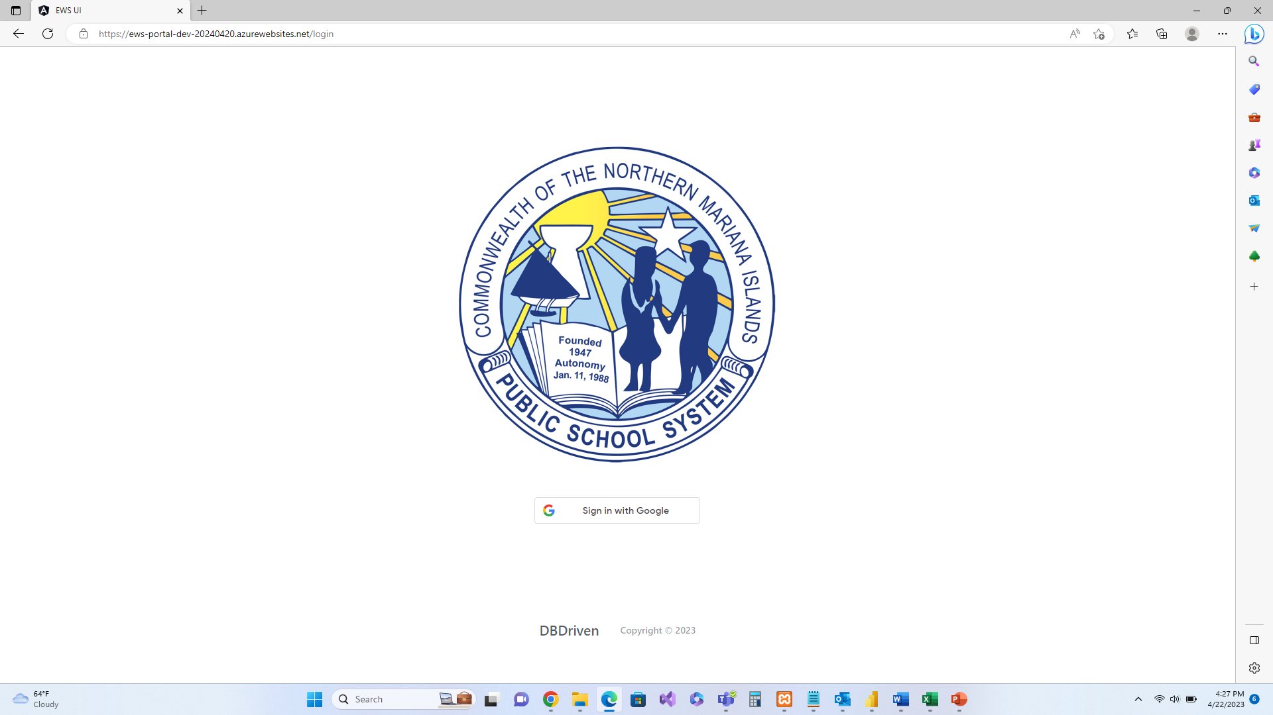
Demonstration

Slide 34
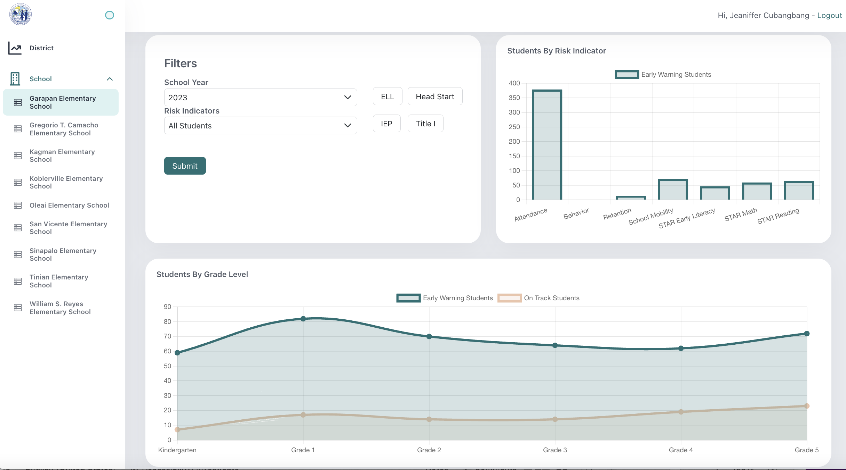
Early Warning System – District & K-5 Log in
bit.ly/cnmiewsuat
Notes:
https://bit.ly/cnmiewsuat

Slide 35
Early Warning System 6-12 Requirements Gathering
Identify the purpose of early warning system for the middle and high schools
Determine what threats or events you want to monitor and the objectives you aim to achieve with the system.
Identify indicators that will accurately predict at-risk students, and identify relevant data from various sources
Depending on the nature of the system, data may include environmental, weather, social, economic, or sensor data.
Determine appropriate thresholds for triggering early warnings.
These thresholds indicate the level of risk at which alerts should be generated.
bit.ly/3QaPh6F
Notes:
https://padlet.com/cubangbang/ews-requirements-gathering-okkgiemrjvxz7bqf
https://bit.ly/3QaPh6F

Slide 36
Early Warning System 6-12 Requirements Gathering
On-time promotion/ graduation
Course credits
Source: IC
< 8 credits 9th grade,
<16 credits 10th grade
bit.ly/3QaPh6F
Notes:
https://padlet.com/cubangbang/ews-requirements-gathering-okkgiemrjvxz7bqf
https://bit.ly/3QaPh6F

Slide 37
Sample Goals and Indicators
Improve Academic Outcomes:
Reduce Dropout Rates
Enhance School Climate
Personalized Learning
Increase Parent and Family Engagement
Targeted Support Services
Promote Graduation Readiness
Reduce Disciplinary Incidents
Prepare for Transitions
Promote Social and Emotional Learning (SEL)
Academic Performance Indicators:
Course Grades in math, science, English, and social studies.
Standardized Test Scores
Chronic Absenteeism
Behavioral Indicators: Discipline Office Referrals
Course Enrollment and Completion:
Course Failures
Course Credits
Family and Community Factors: Parental Involvement
Transitions and Mobility:
Early Literacy and Numeracy:
Reading Proficiency
Math Proficiency
Social and Emotional Factors:
Social Isolation
Emotional Distress

Slide 38
Your feedback is important!
bit.ly/sldsdataeval
Notes:
bit.ly/sldsdataeval

Slide 39
Backup Slides (Break in Case of Emergency)

Slide 40
Single Sign-on with CNMI PSS Google Email Accounts

Slide 41
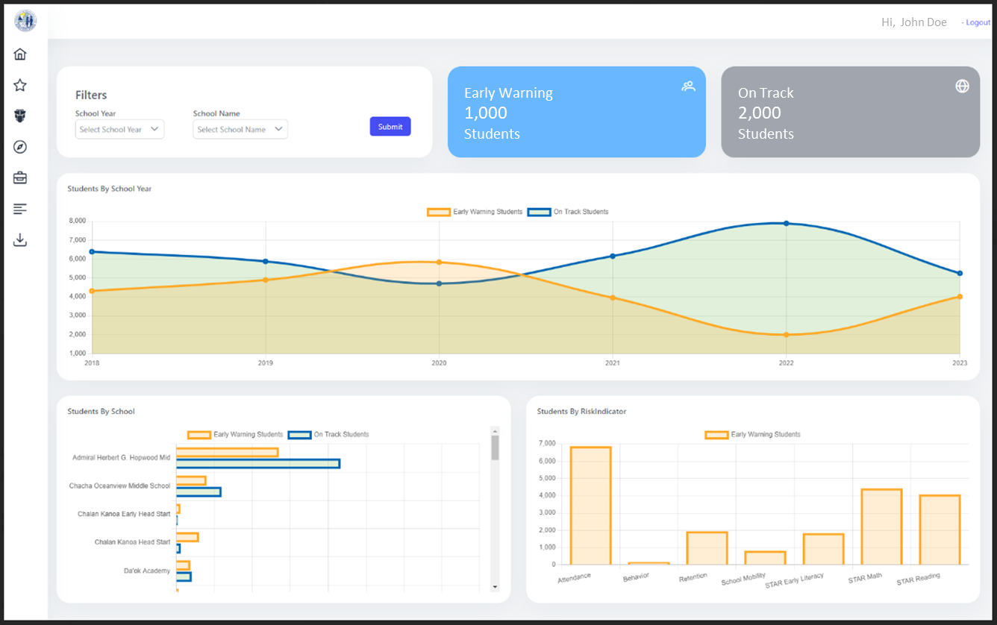
District Dashboard (*mock-up)
*Mock-up is an example product not based on actual data or final product for CNMI

Slide 42
District Dashboard - School View

Slide 43
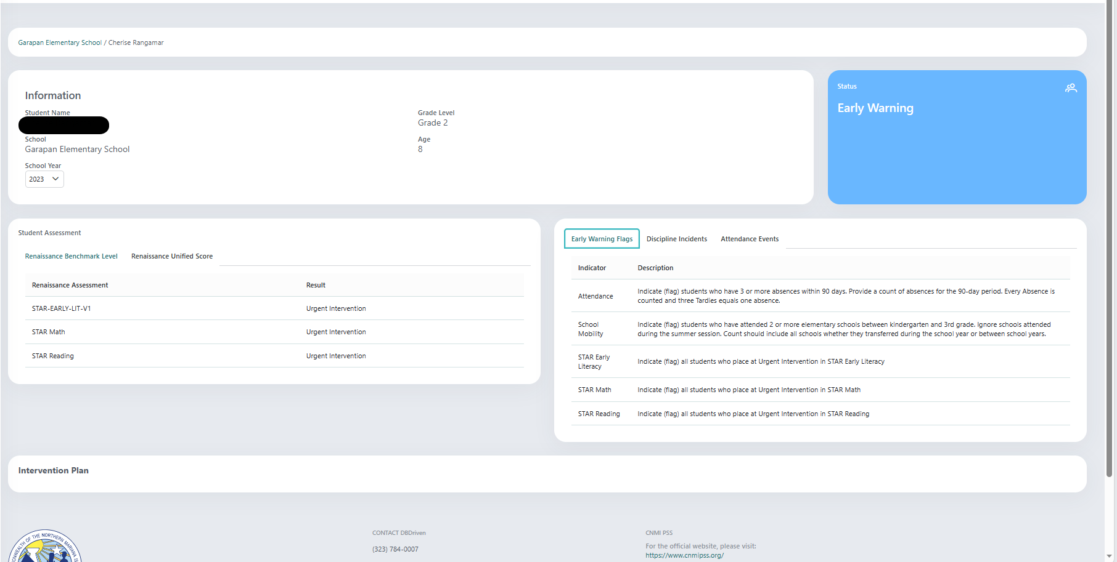
District Dashboard - Student View

Slide 44
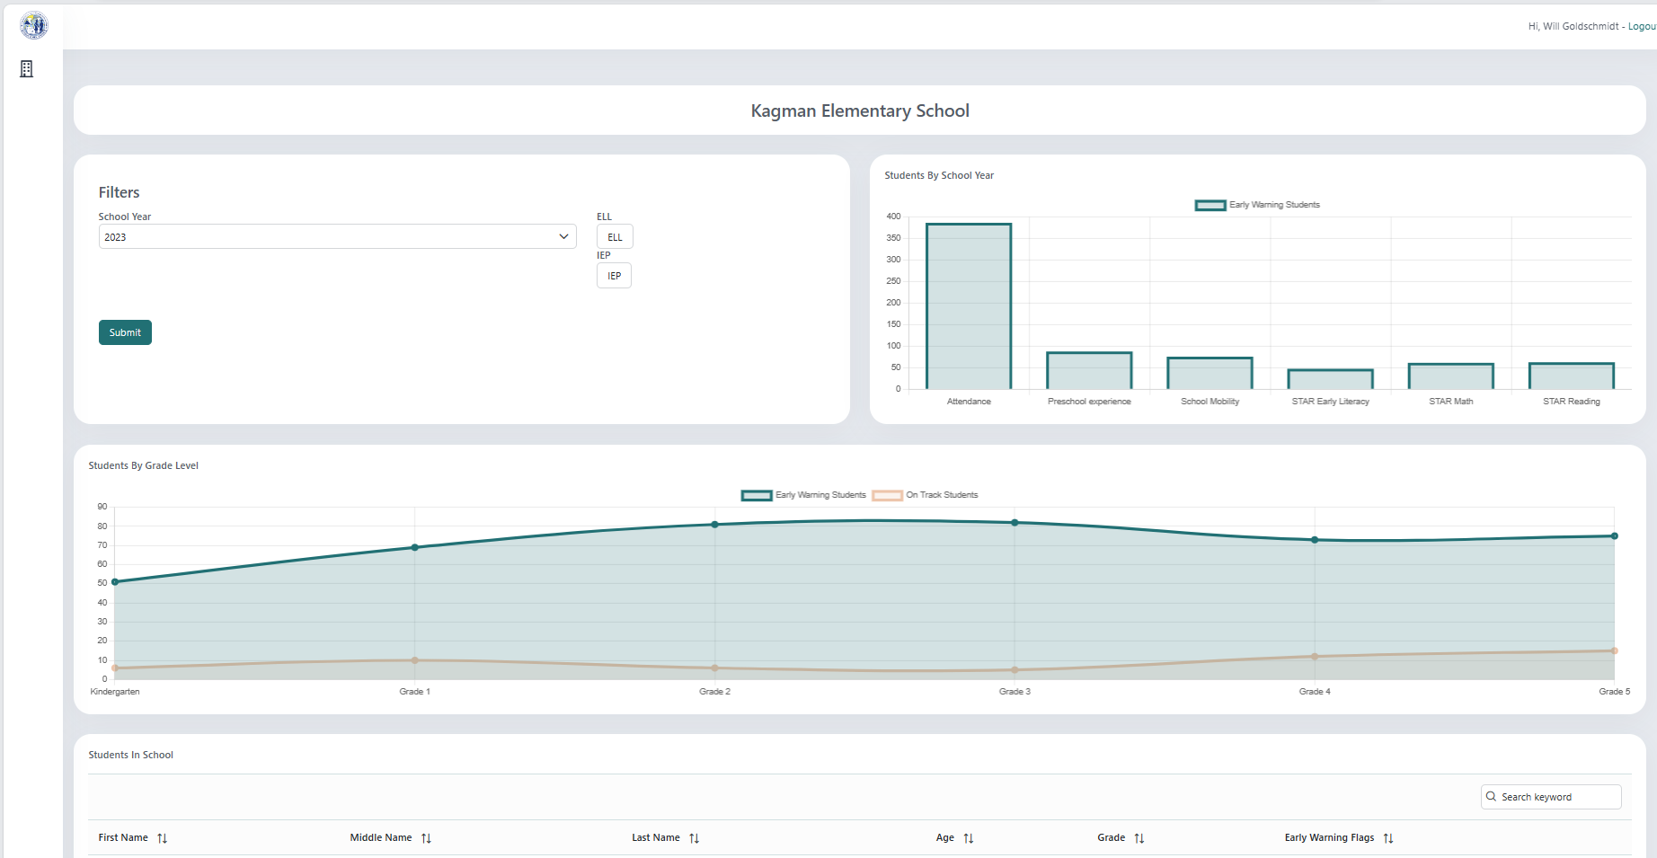
School Dashboard

Slide 45
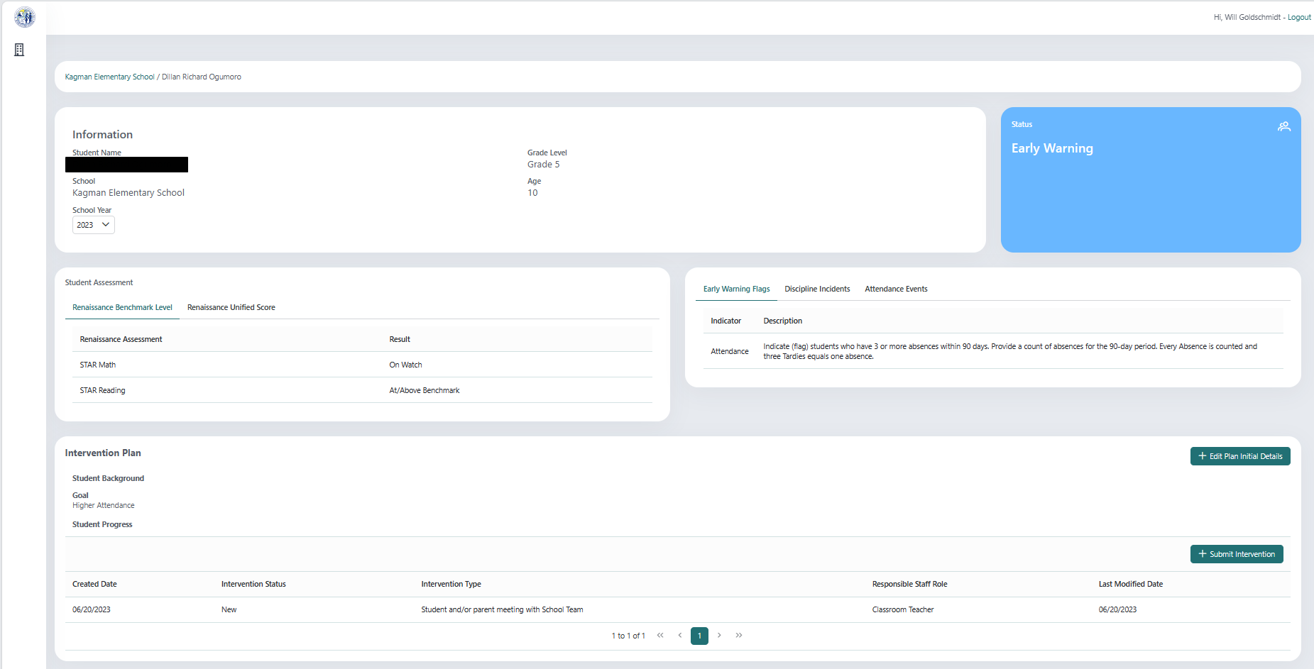
School Dashboard - Student View

Slide 46
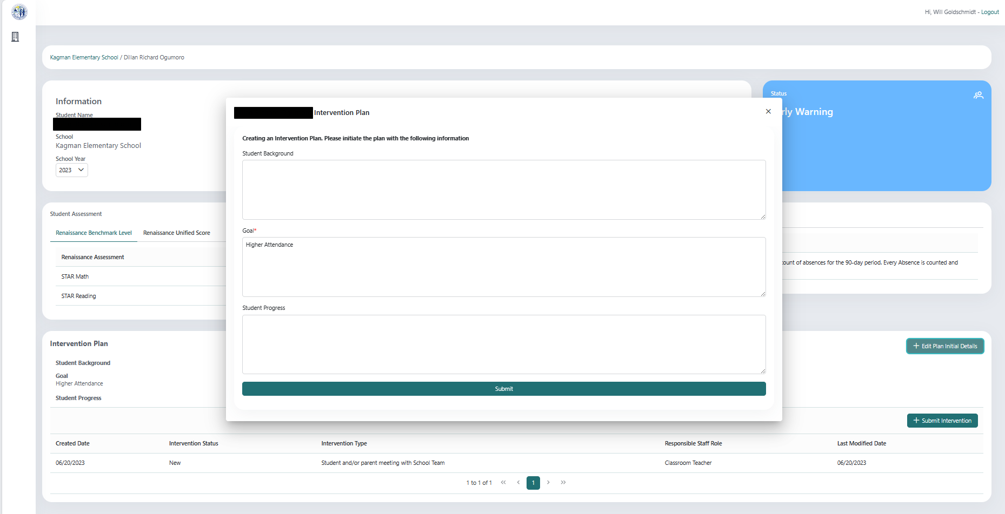
School Dashboard - Student View, Intervention Plan

Slide 47
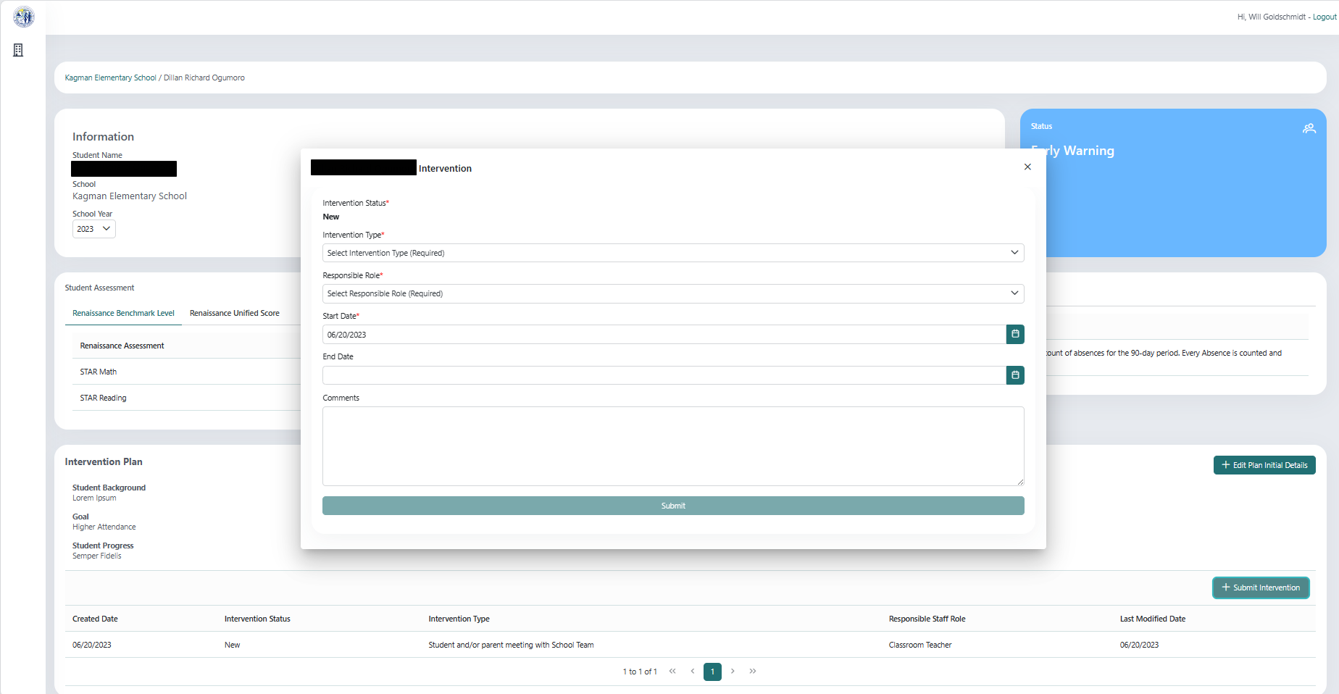
School Dashboard - Student View, Intervention

Slide 48
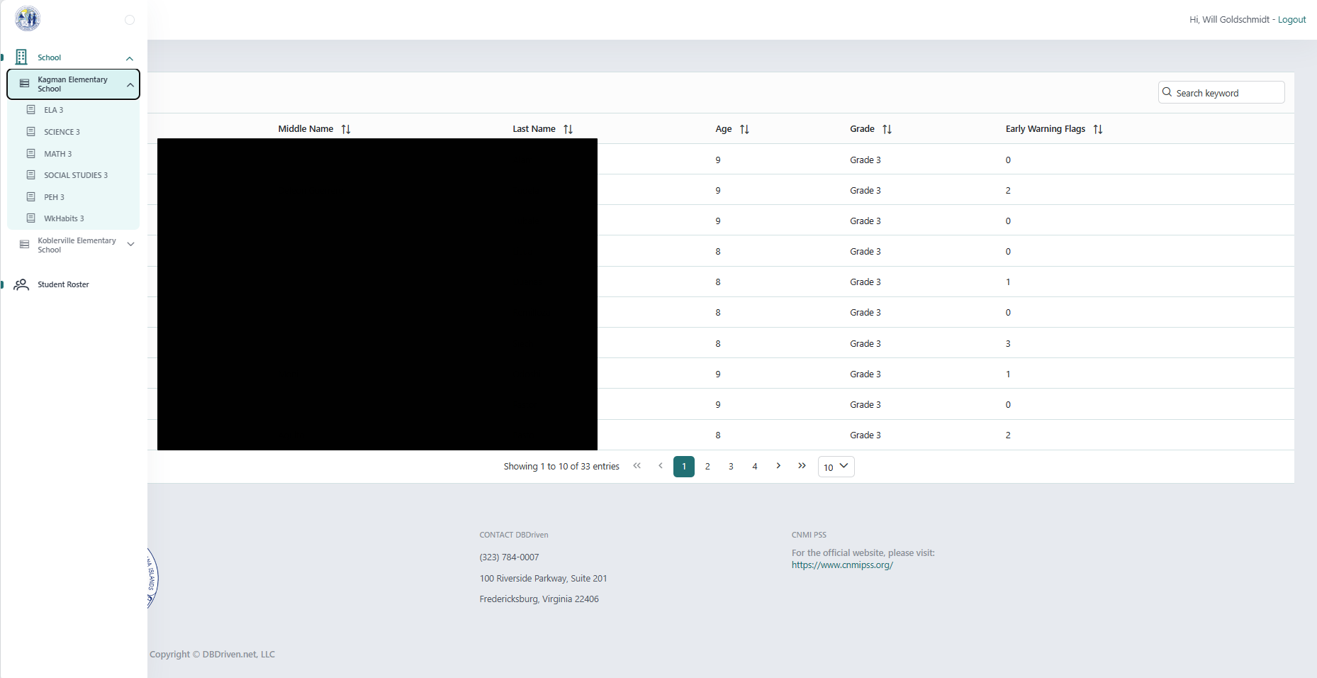
Teacher Dashboard

Slide 49
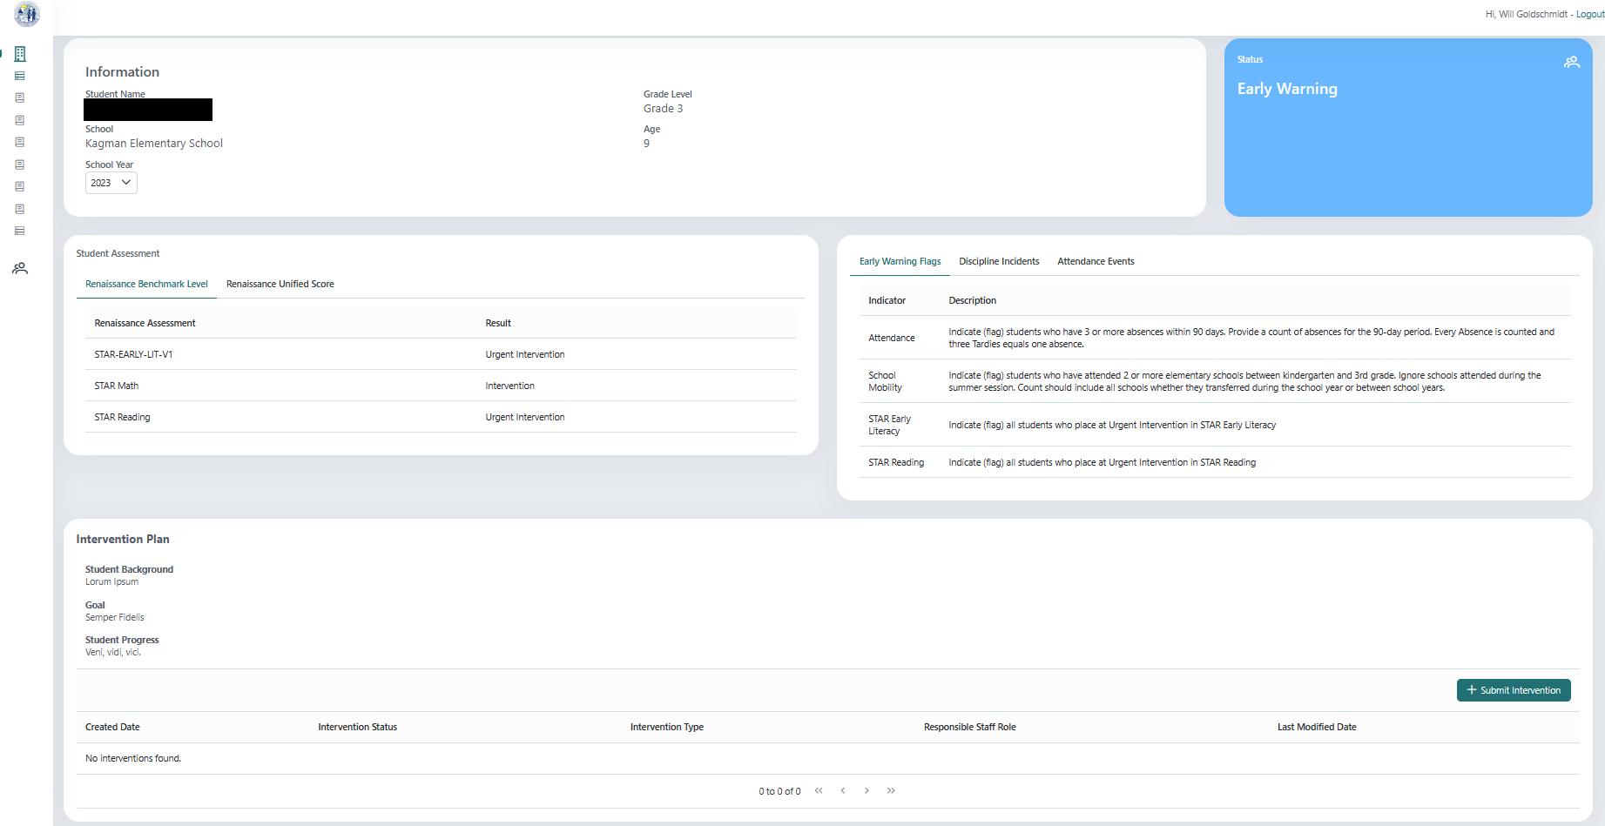
Teacher Dashboard - Student View

Slide 50
Break Time

Slide 51
3 groups rotate every 20 minutes

Slide 52
Business Intelligence
Enterprise level reporting using the K12 SLDS and Microsoft’s PowerBI
Public PowerBI
School Report Card
Facts & Figures
Academic Achievement
Private PowerBI
Administrative Dashboard
Generate EdFacts

Slide 53
Lunch Time

Slide 54
PowerBI Public Reports
Facts & Figures (Stewards: Ruth, Probio, Louie Dean)
The annual Facts & Figures Report is prepared by PSS Accountability, Research and Evaluation office through the Office of Records & Data Management in collaboration with data stewards and records custodians from schools, programs and offices. Facts and figures are compiled to provide a snapshot of schools, programs and offices.
Academic Achievement (Steward: Tigilau)
The Academic Achievement Report includes detailed assessment results, allowing individuals to quickly analyze the learning outcomes in the district at the highest level to ensure appropriate benchmarking and the ability to assess performance levels and trends, with the ability to segment that data by relevant grade levels, disciplines, and subgroups.
School Accountability Report Card (Steward: Celine)
The School Report Card is an accountability system built from an overall measure of school performance, the reporting of this overall measure and its components, and actions that are tied to a school’s score on this overall measure. The School Report Card displays that school’s performance on indicators recommended by the accountability task force. PSS combines indicators of academic achievement, academic growth, progress in achieving English language proficiency, attendance, and graduation (graduation for high schools only). Users can search to see the reports for any school.
Links are not for public distribution
Notes:
Click the link to open and cache the report.

Slide 55
Padlet for Feedback
What are your
initial thoughts
on this report?
When and how would you use this information?
bit.ly/datausetools
What information would you, your parents or the public
need to understand the purpose of this report?​

Slide 56
Data Use Tools
School Accountability Report Card
Facts & Figures
Academic Achievement
Initial thoughts
Use
Purpose
PADLET
bit.ly/datausetools
bit.ly/sldsengage
Web version of this organizer: bit.ly/datatoolbreakout
Notes:
A web form is available at https://bit.ly/datatoolbreakout

Slide 57
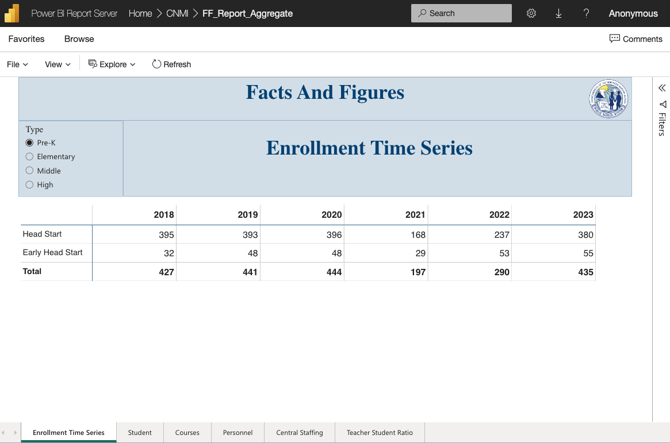
Facts & Figures Report – Landing Page

Slide 58
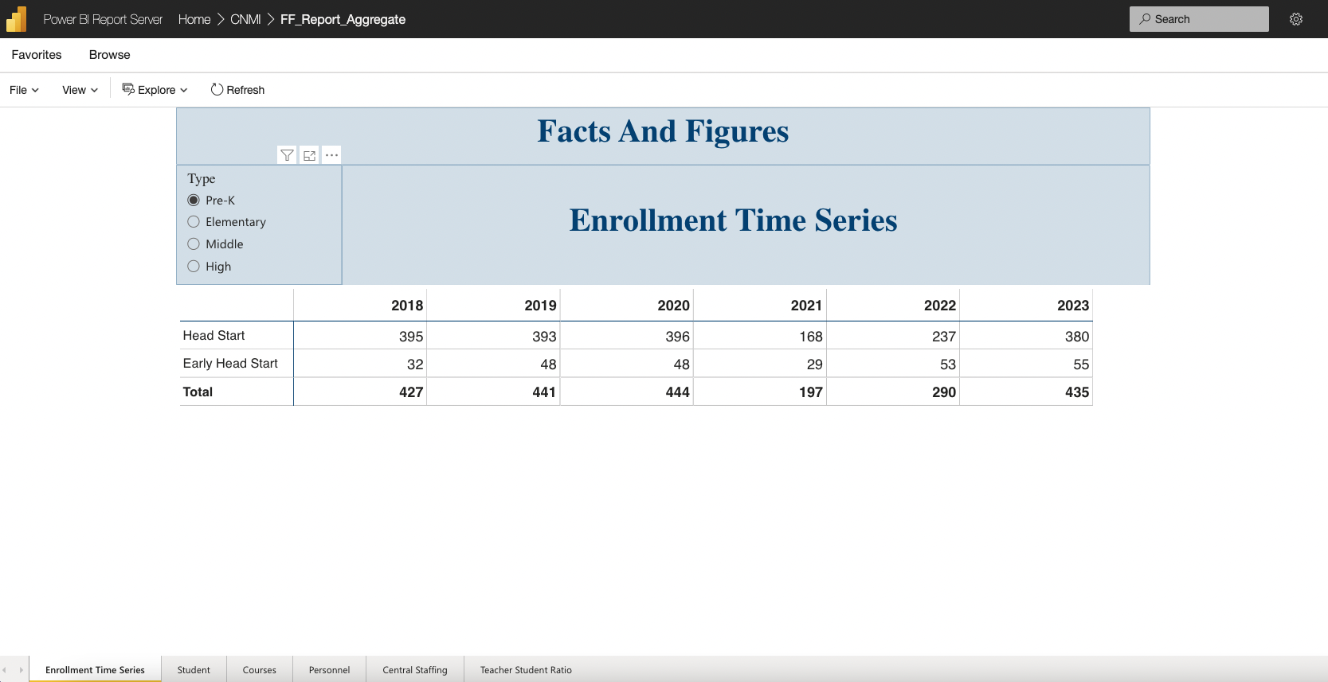
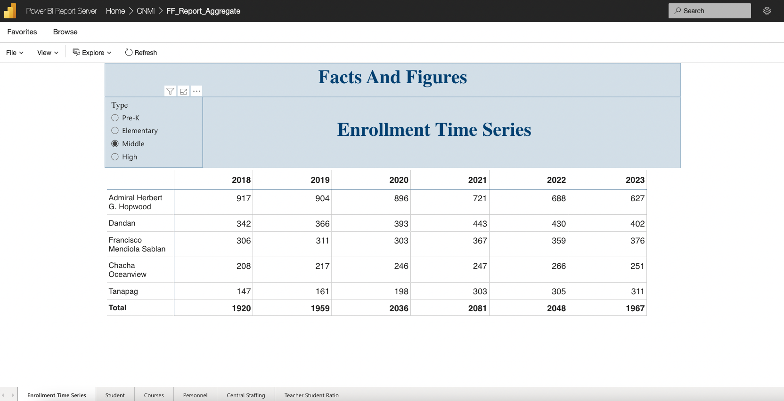
Enrollment Time Series
Middle
Pre-K
High
Elementary

Slide 59
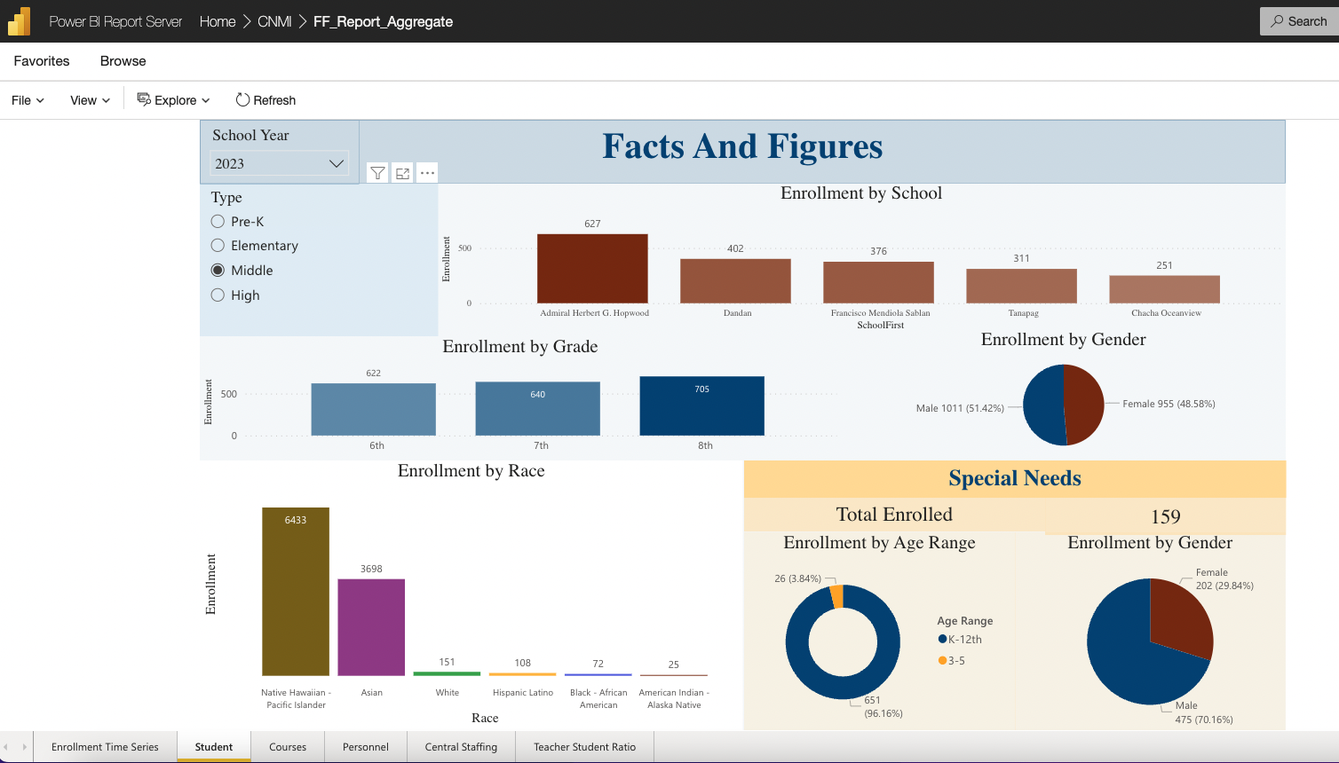
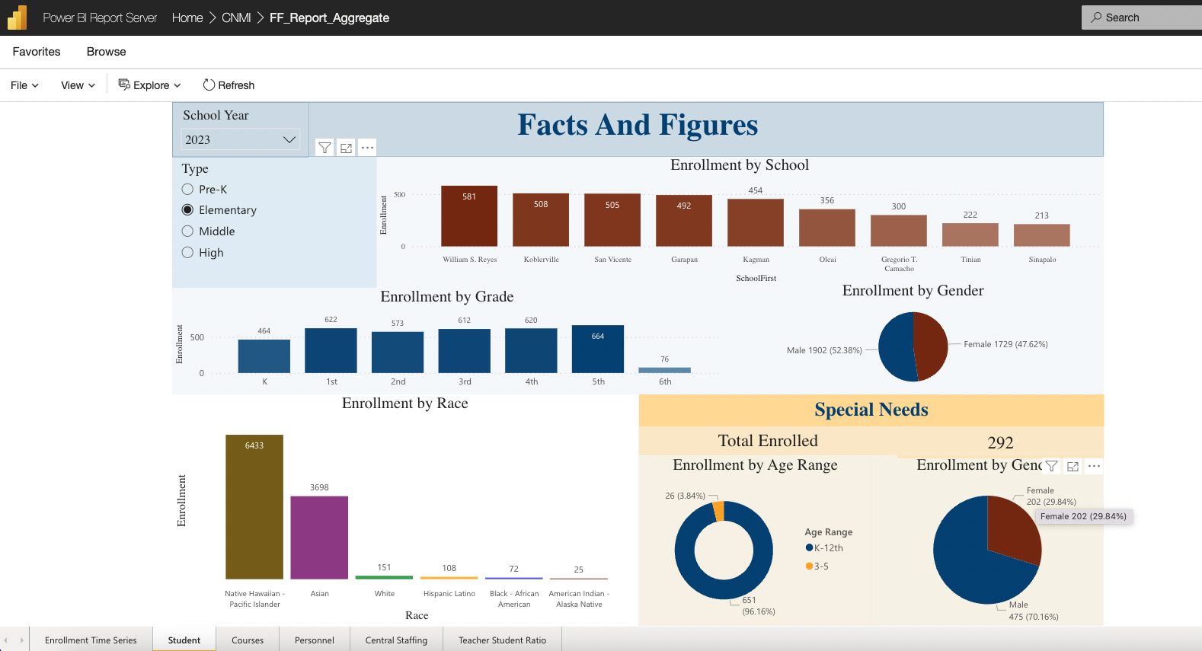
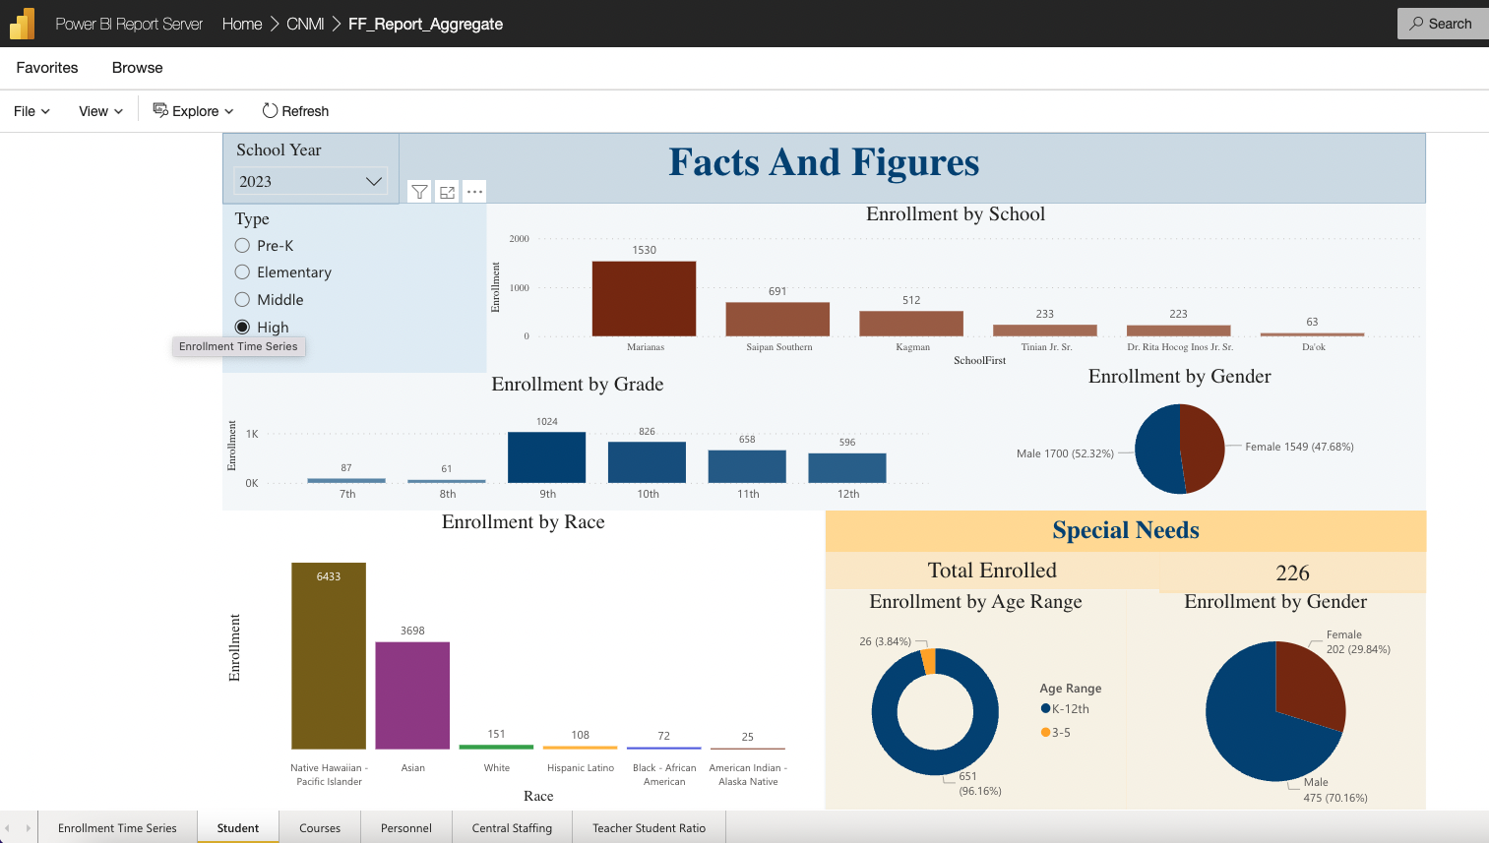
Student
Middle
Pre-K
High
Elementary

Slide 60
Courses

Slide 61
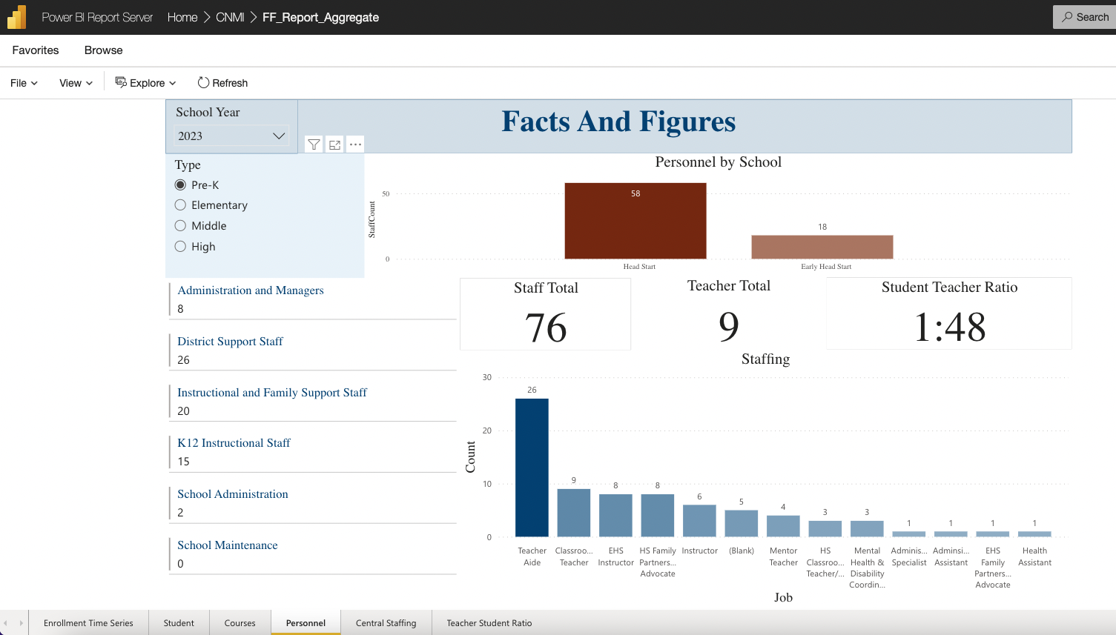
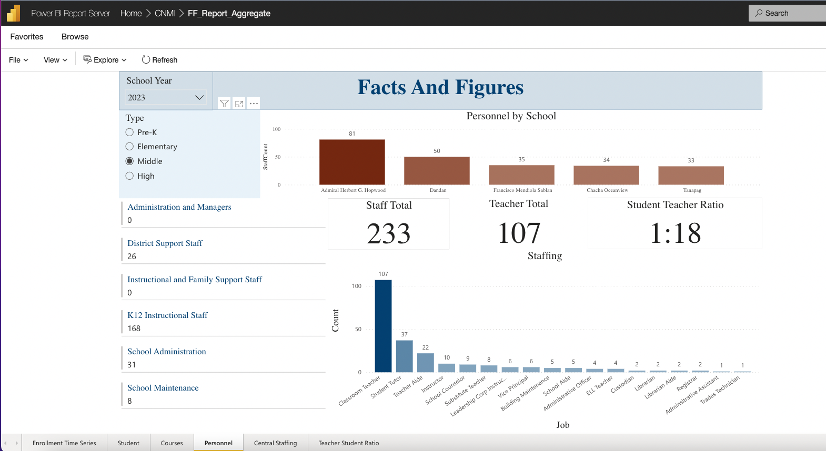
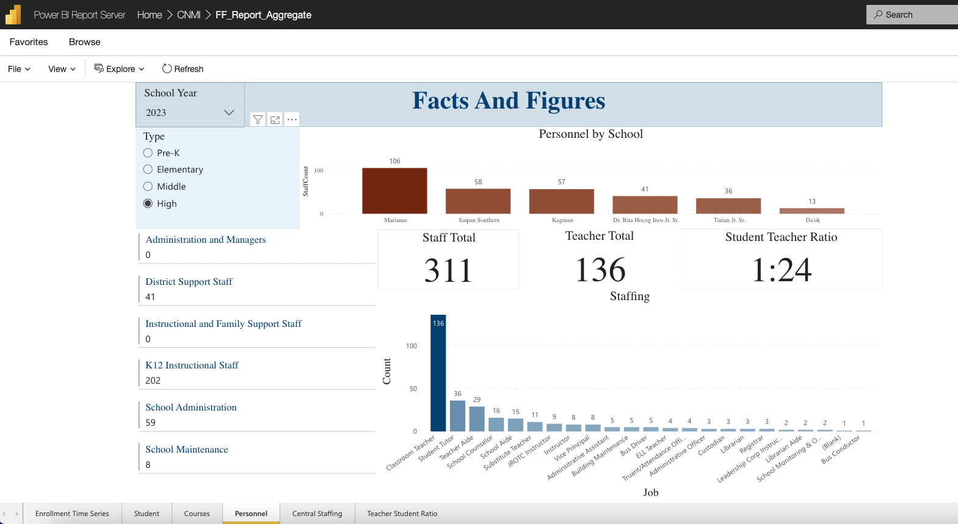
Personnel
Middle
Pre-K
High
Elementary

Slide 62
Central Staffing

Slide 63
Teacher Student Ratio

Slide 64
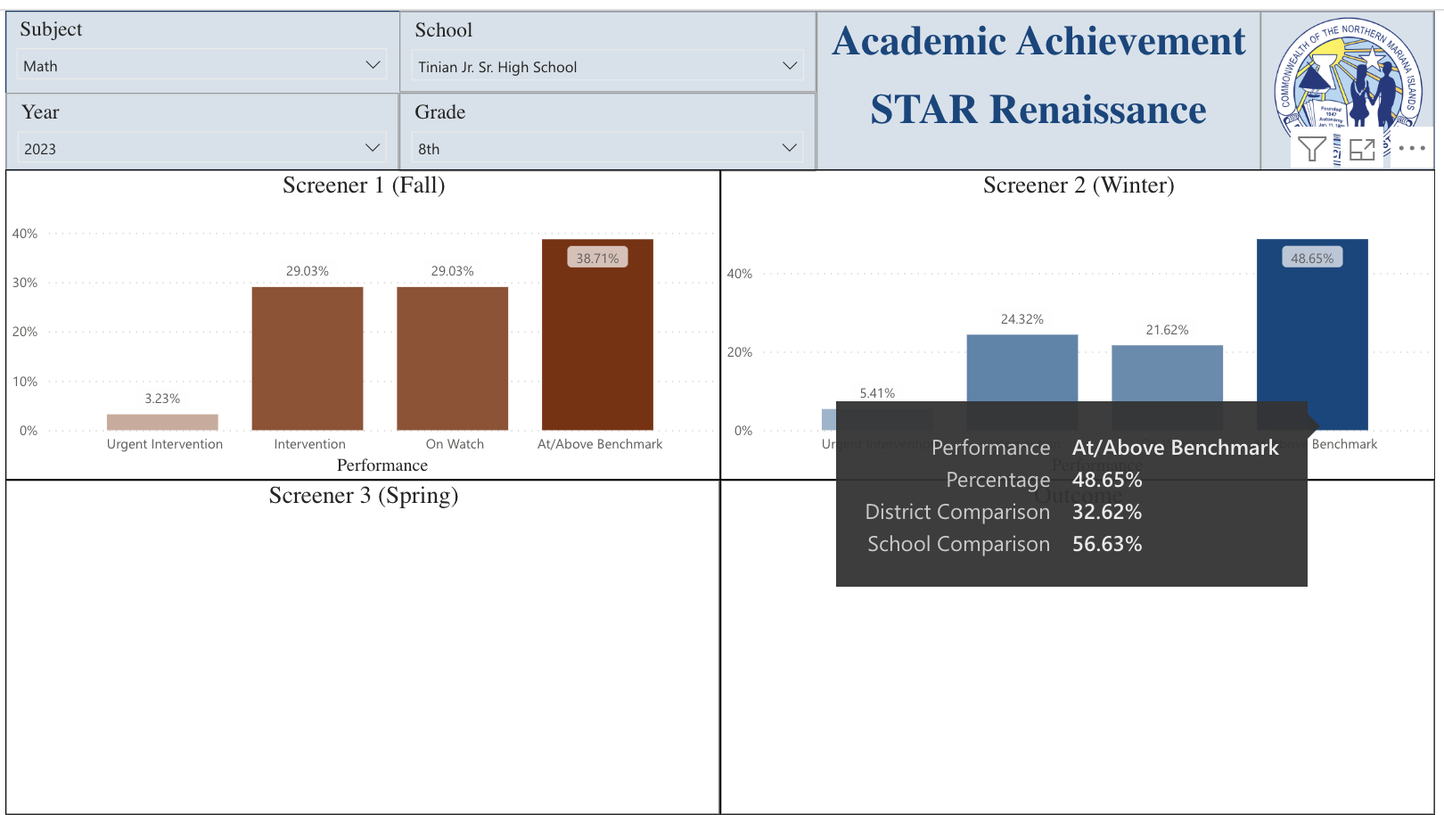
Academic Achievement

Slide 65
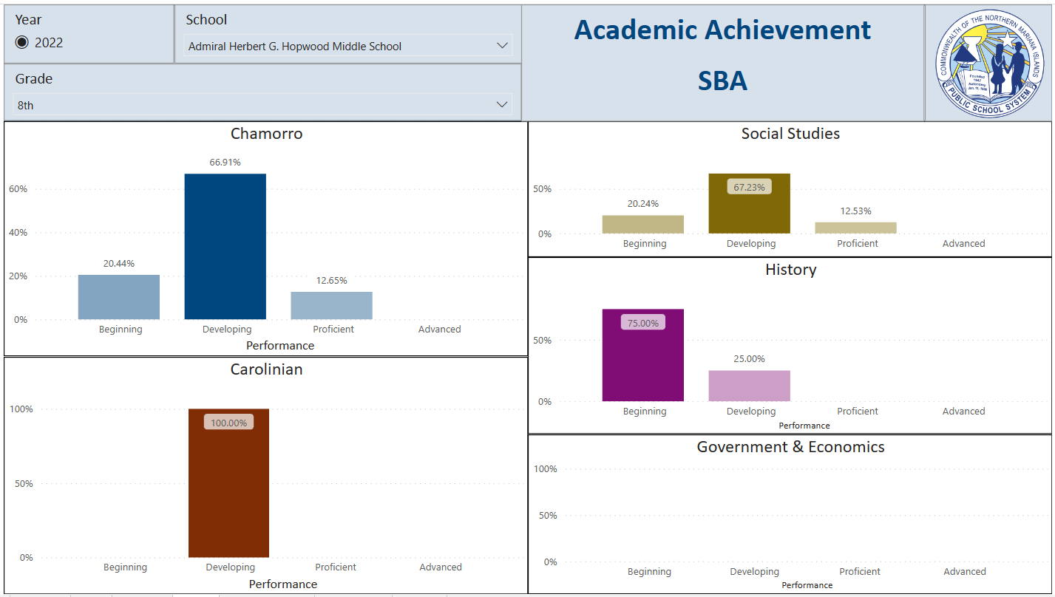
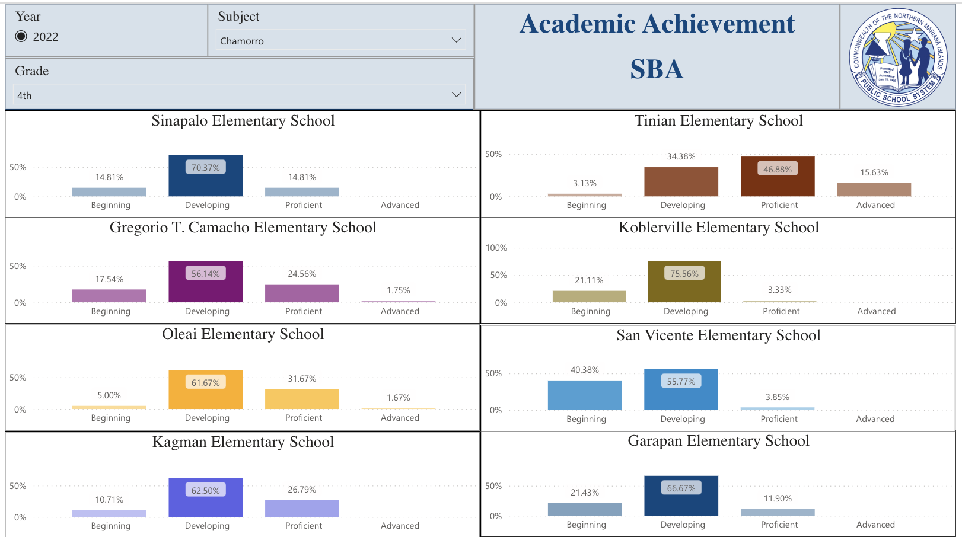
Academic Achievement

Slide 66
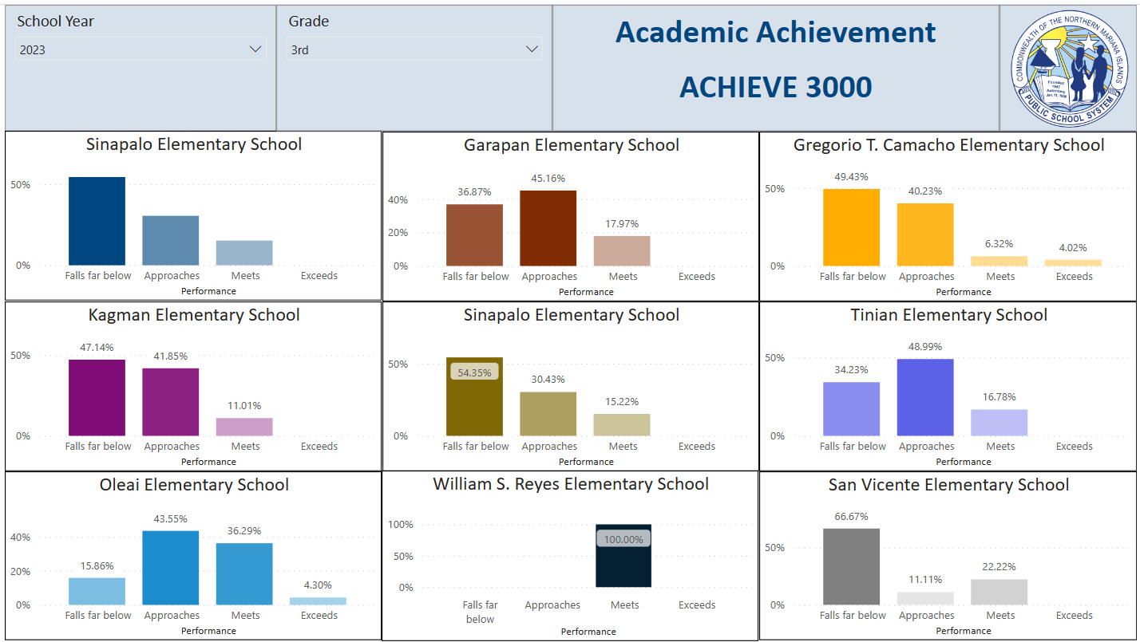
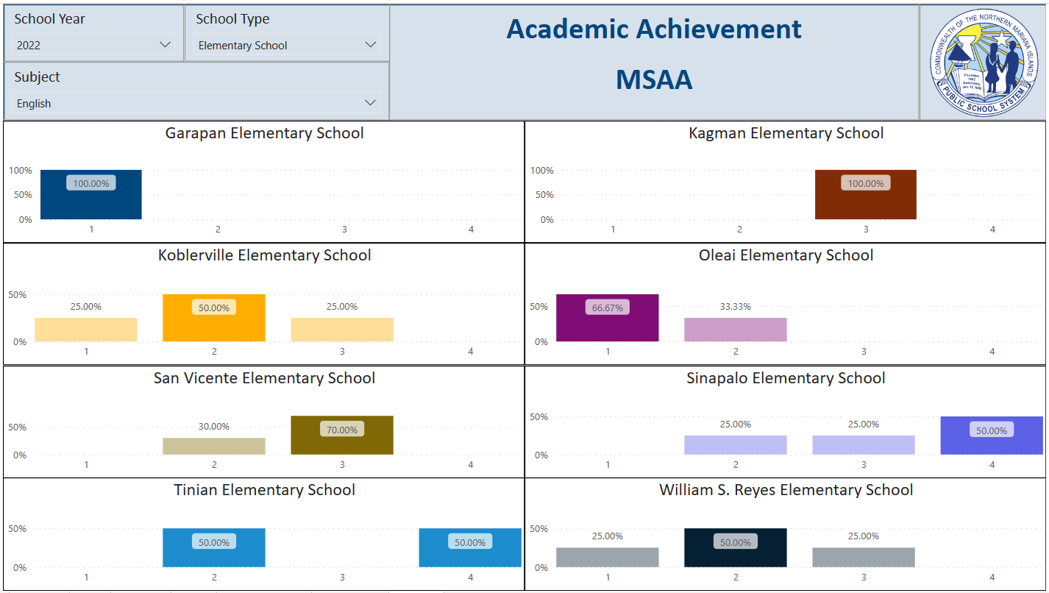
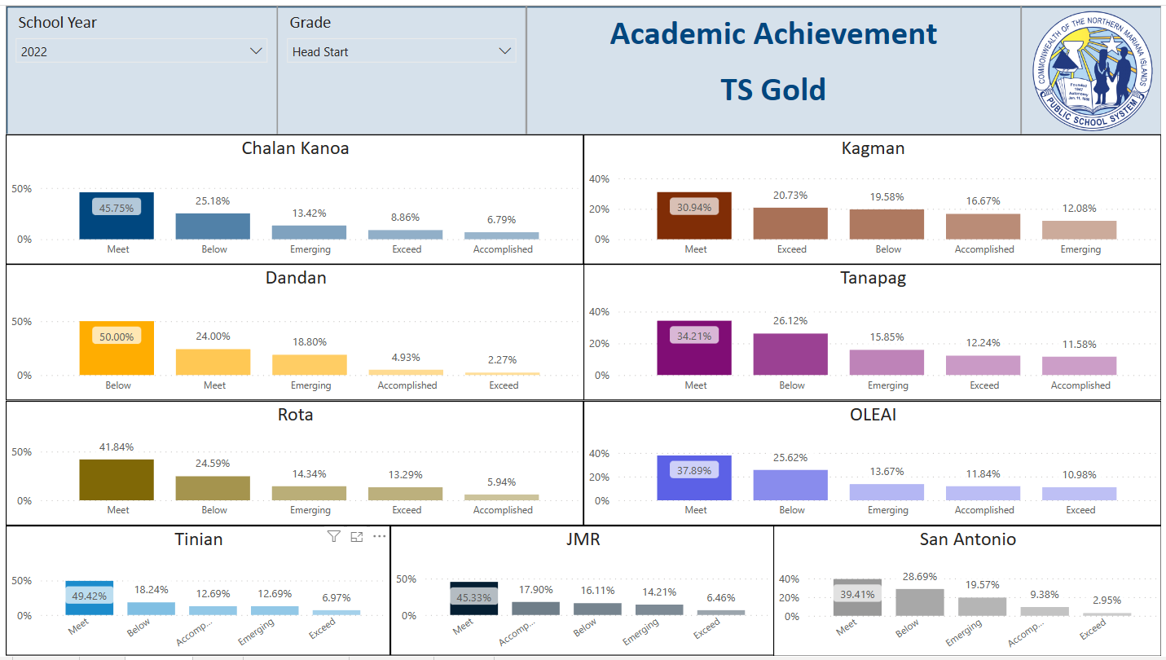
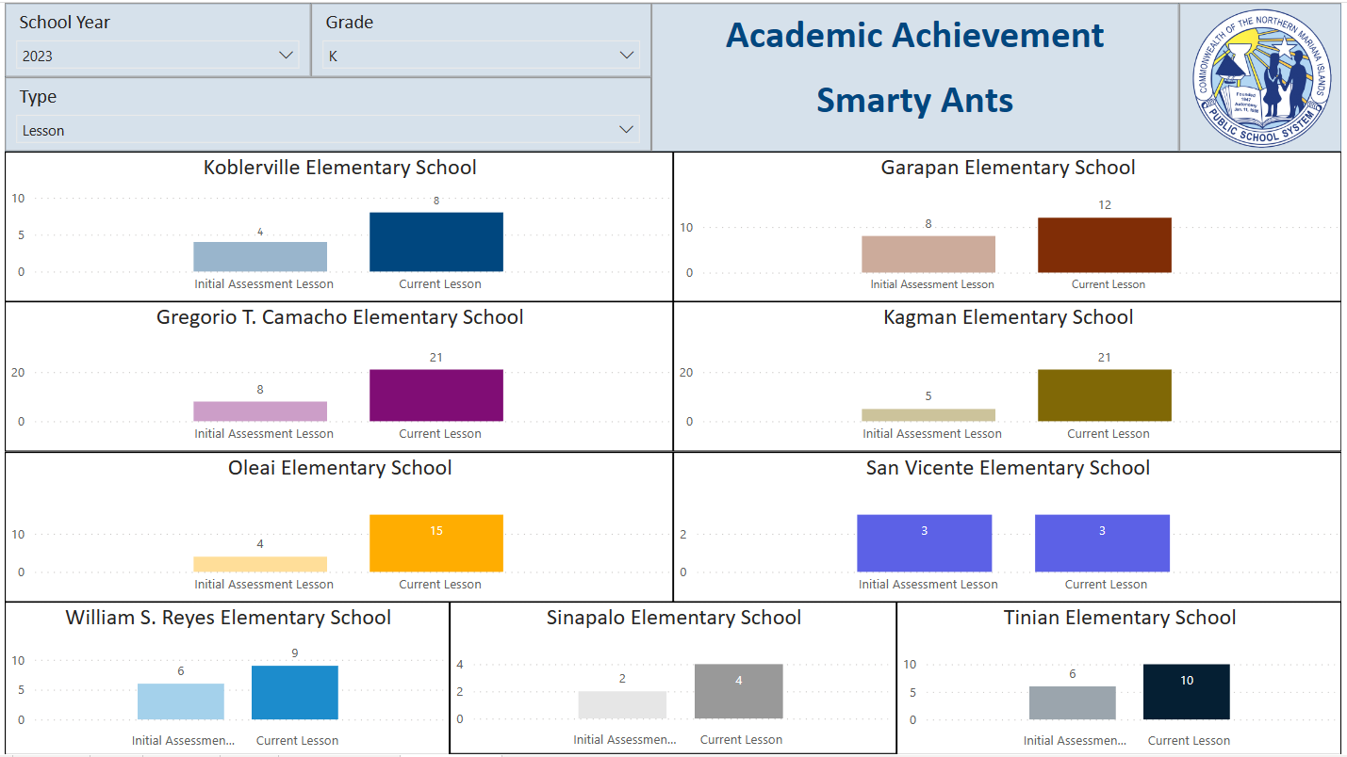
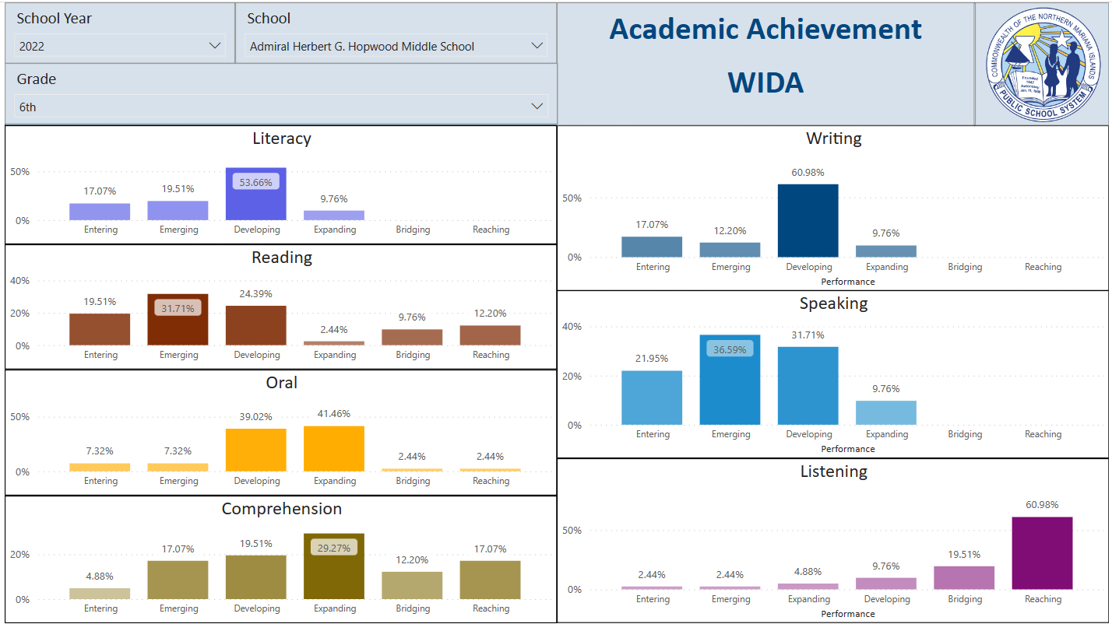
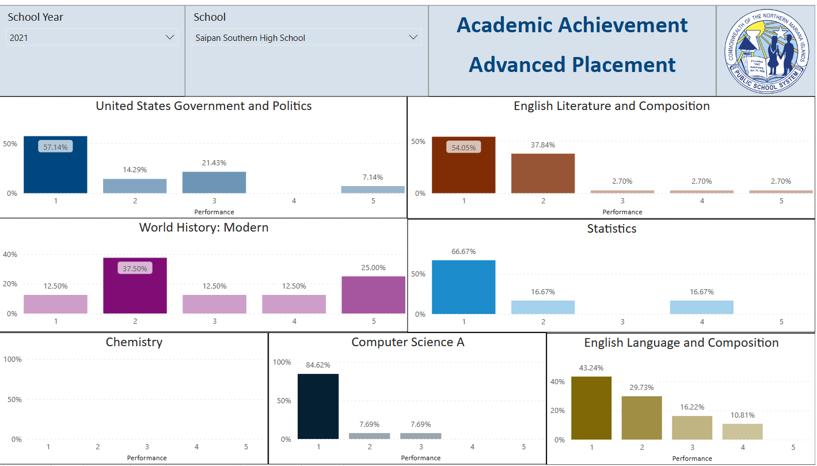
Academic Achievement

Slide 67
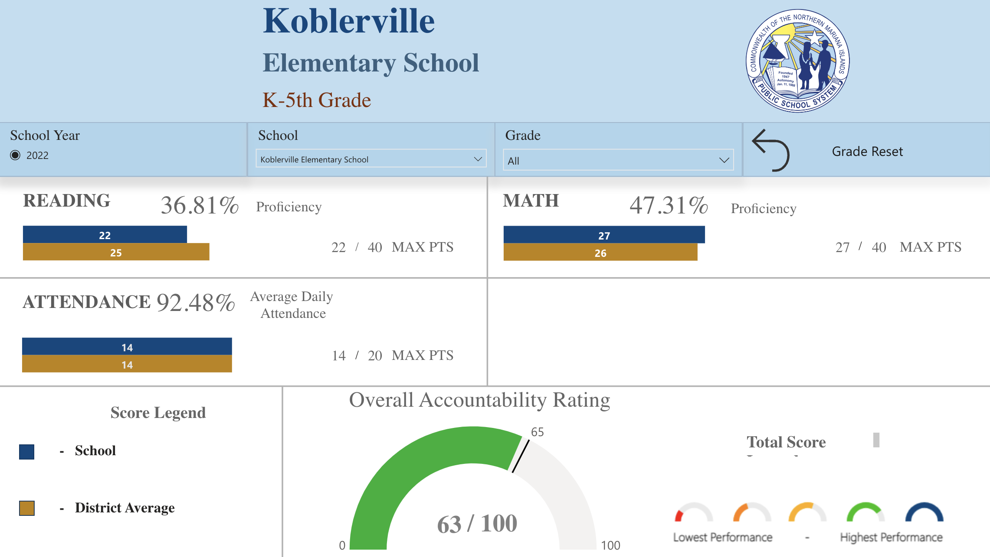
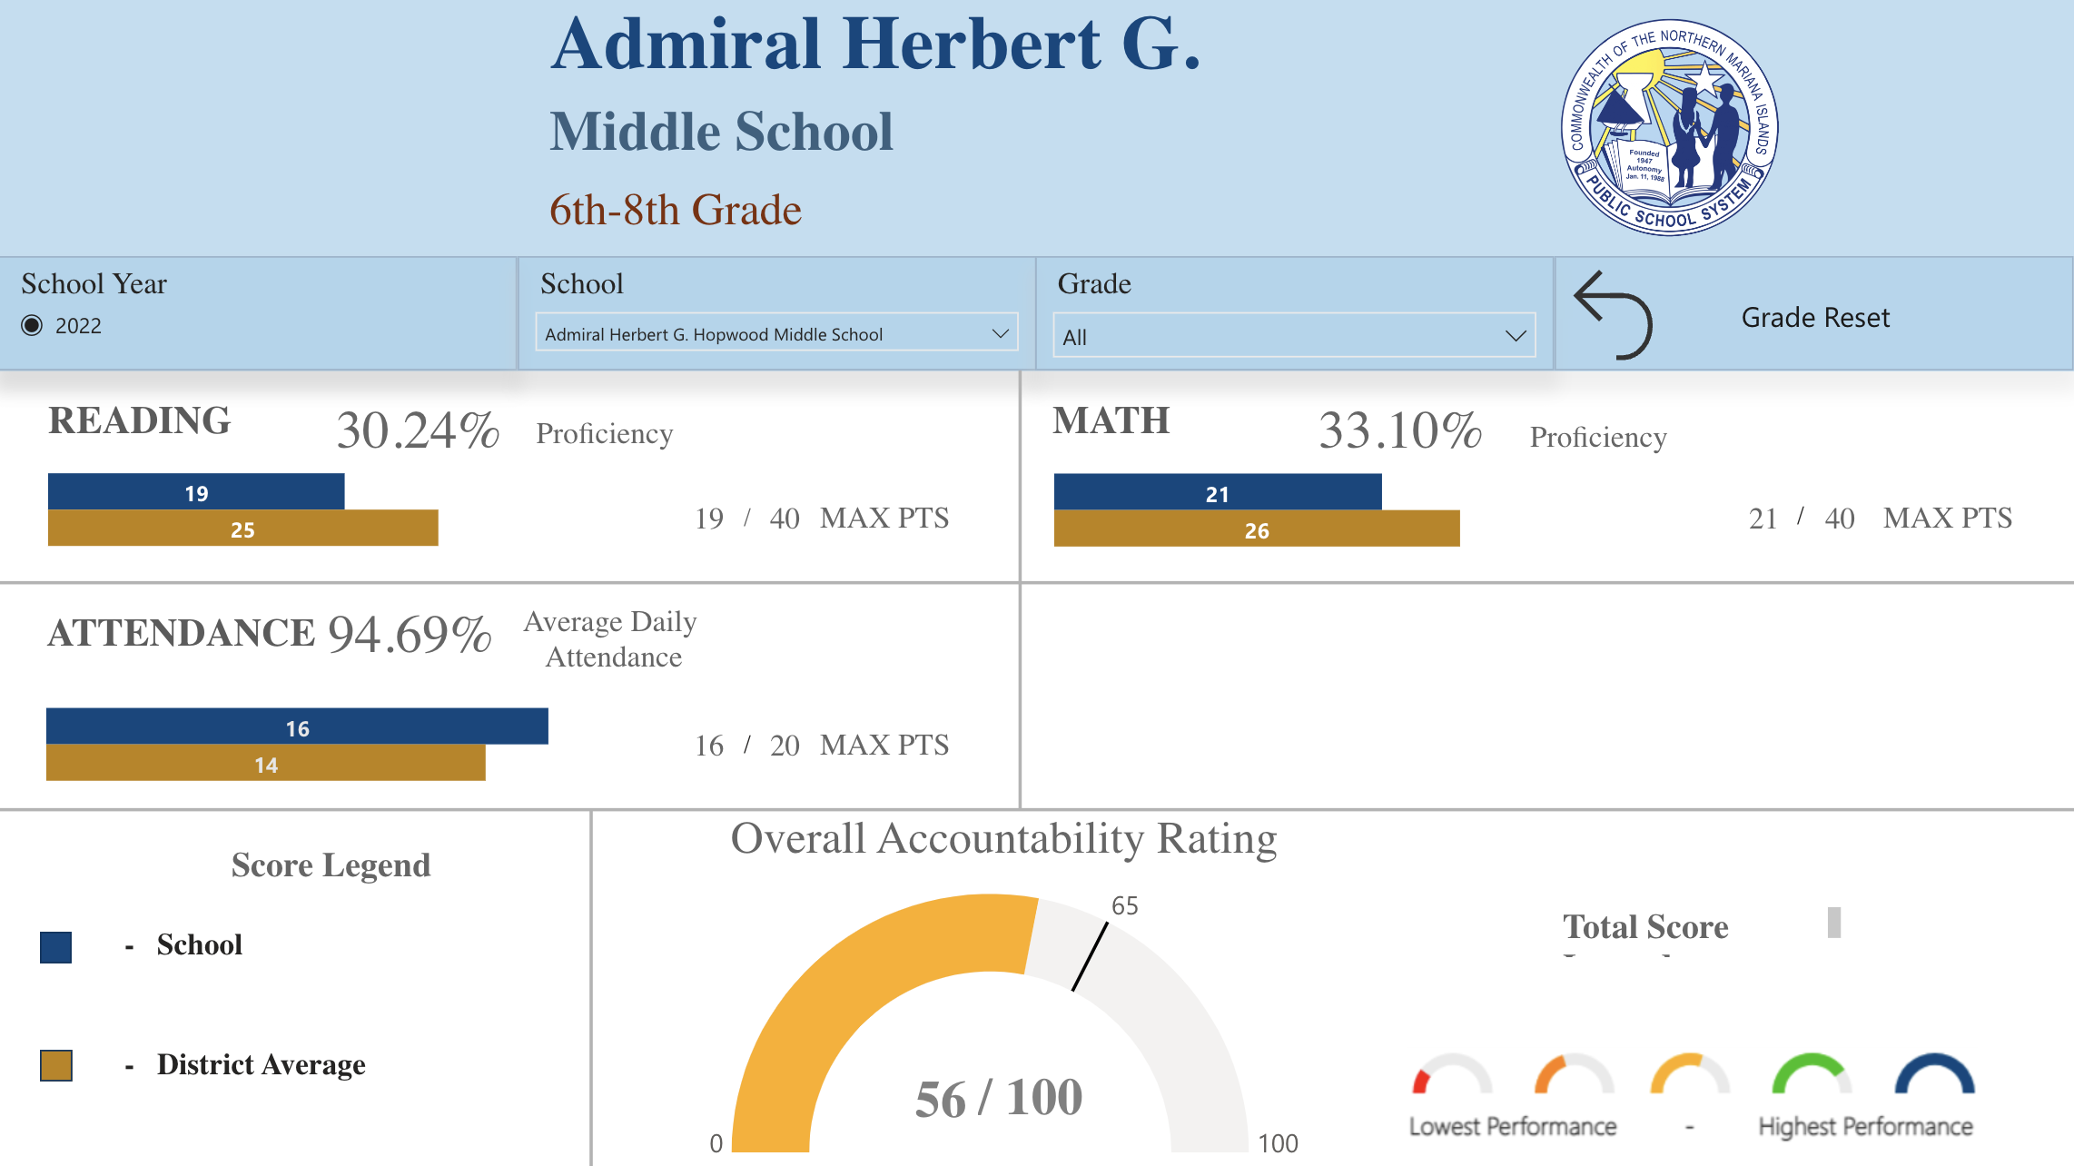
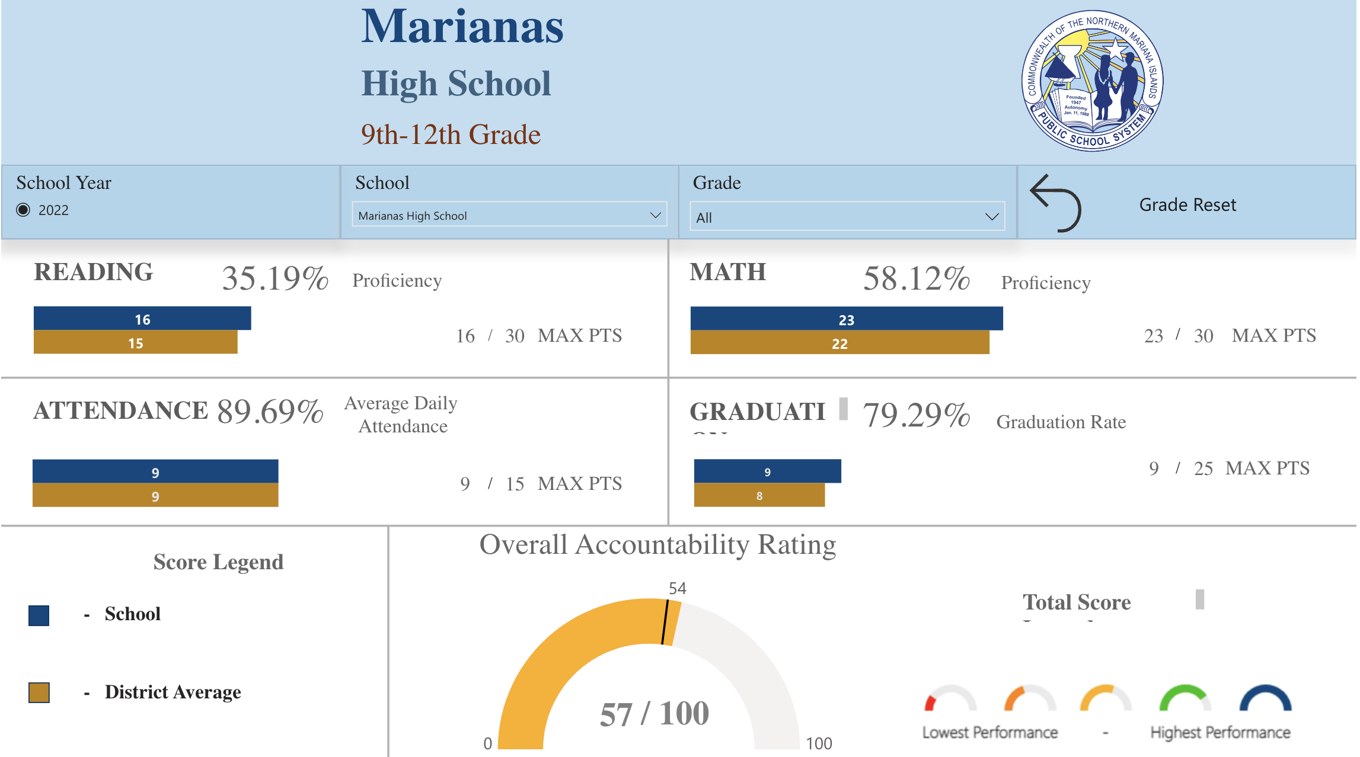
School Accountability Report Card
Elementary
Middle
High

Slide 68
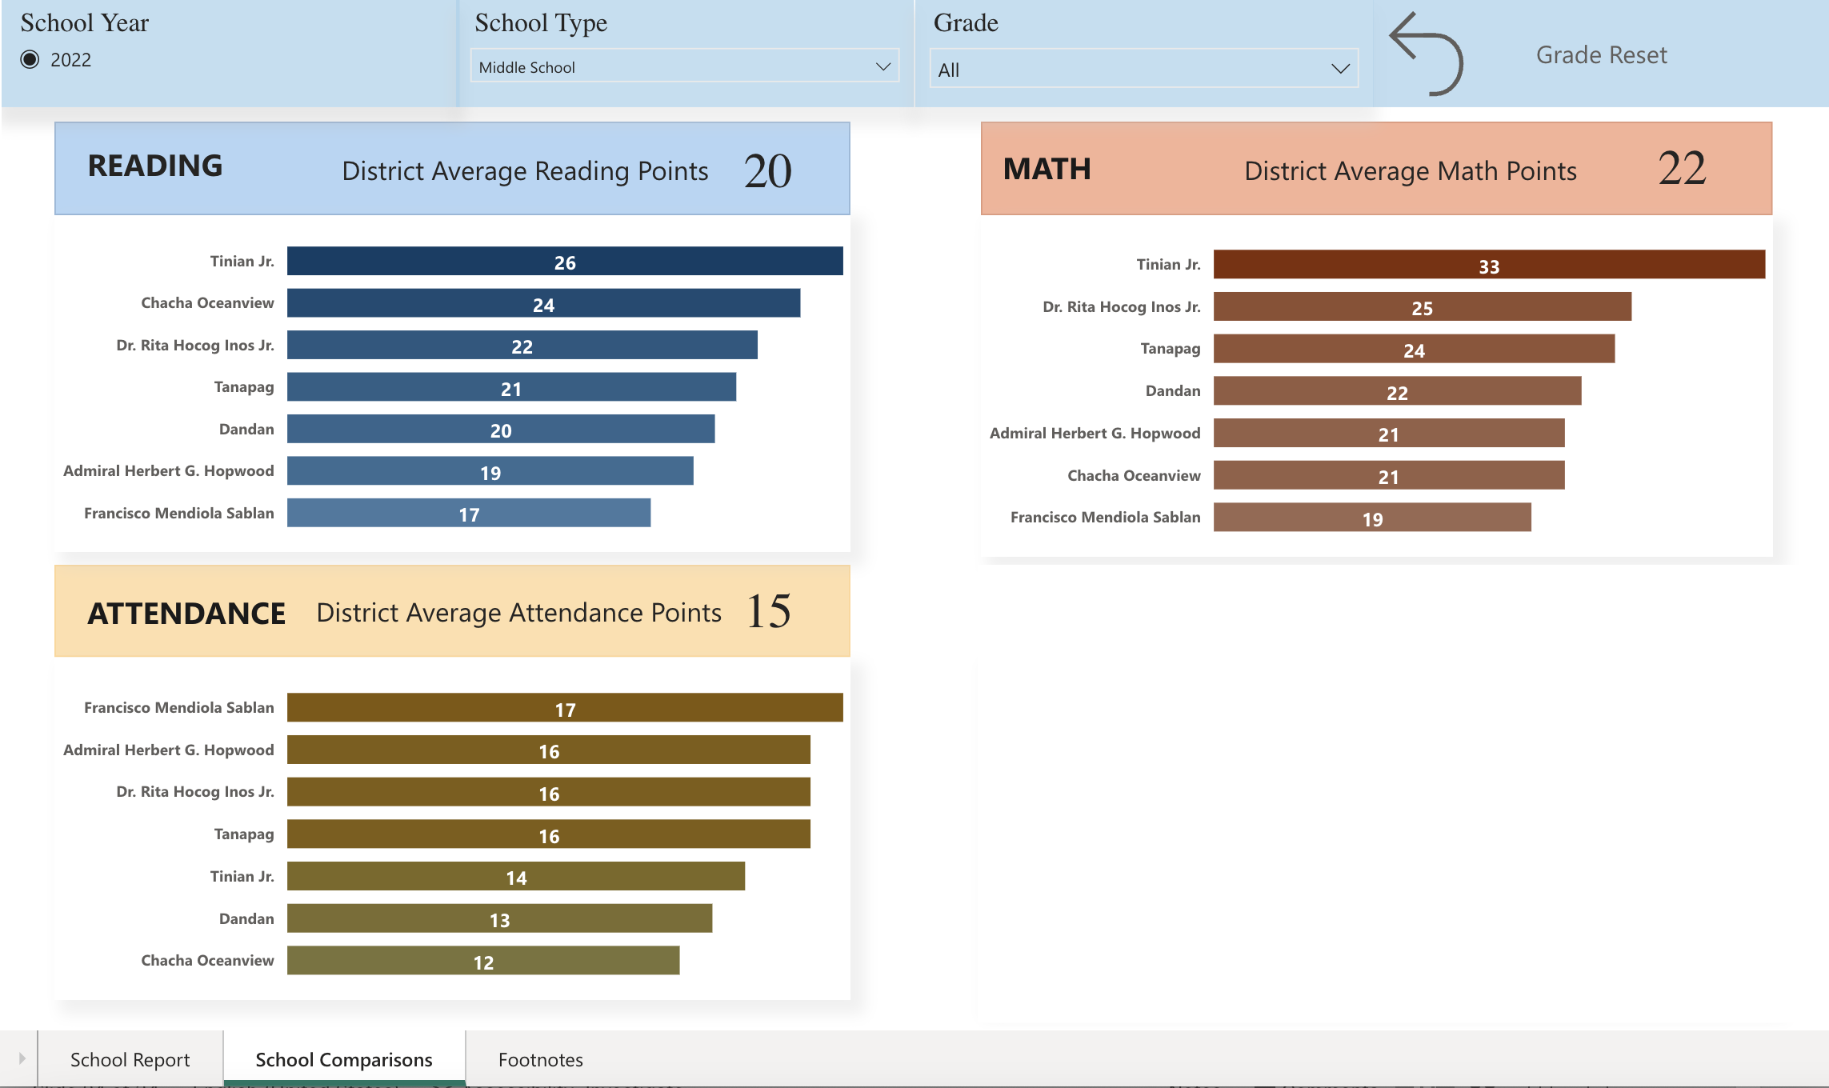
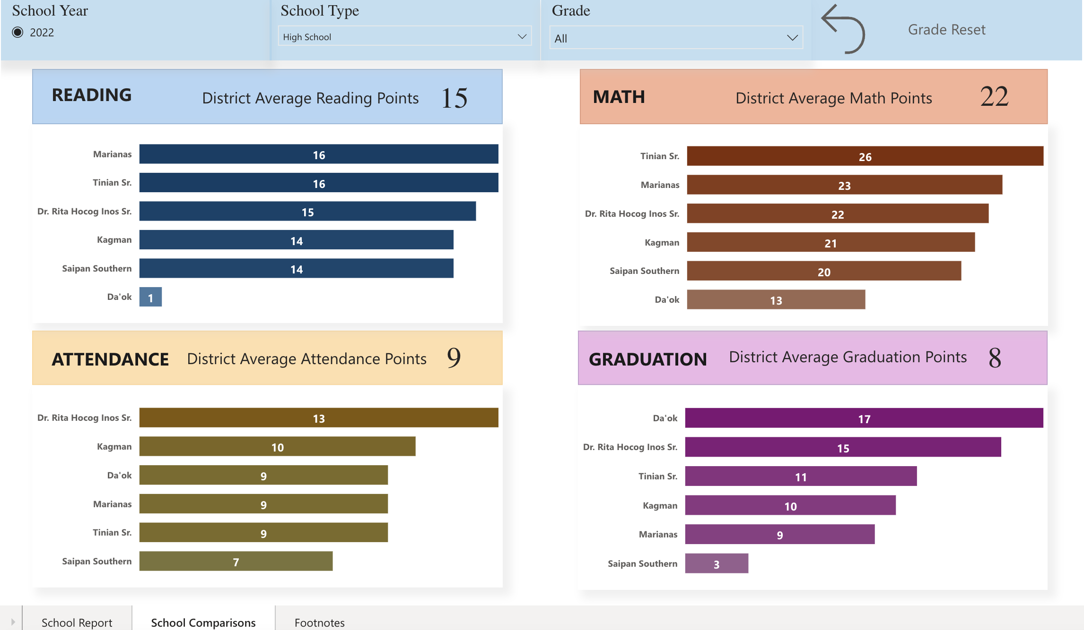
School Report Card - Comparison
Middle
Elementary
High

Slide 69
School Report Card - Footnotes

Slide 71
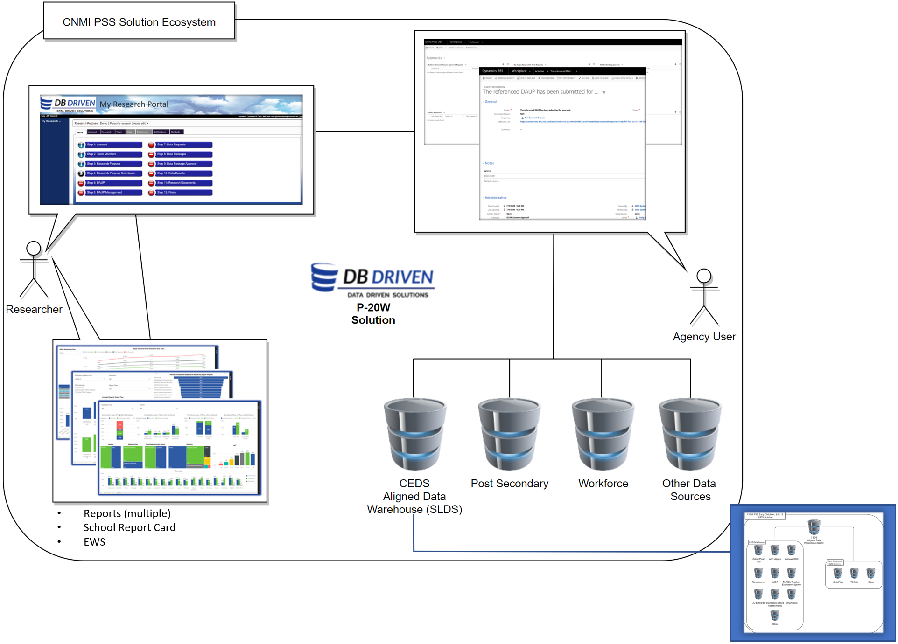
P-20W Solution is a…
Web based portal to access agency data (e.g. education, workforce, services, etc), which
Retrieves and matches agency data (SLDS, P-20W, other) while,
Ensuring agencies maintain complete control of their data, while
Maintaining the confidentiality of an individual, to be
Used for reporting and research purposes
71
Notes:
Let’s dive into the solution. The Proposed CNMI PSS P-20W Solution is
-Web based portal to access agency data, which
-Retrieves and matches agency data (SLDS, P20W, other) while
-Ensuring agencies manage complete control of their data while
-Maintaining the confidentiality of an individual, to be
-Used for reporting and research purposes.
Access to Agency Data is controlled by Agency Users. Agency Users approve or reject Researcher access to Agency Data. Researchers request access through the Researcher Portal and use the Agency Data approved by the Agency User to conduct research, create reports, etc:

Slide 72
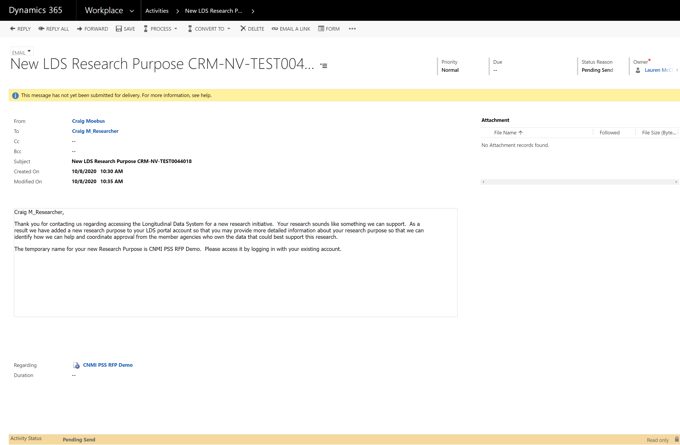
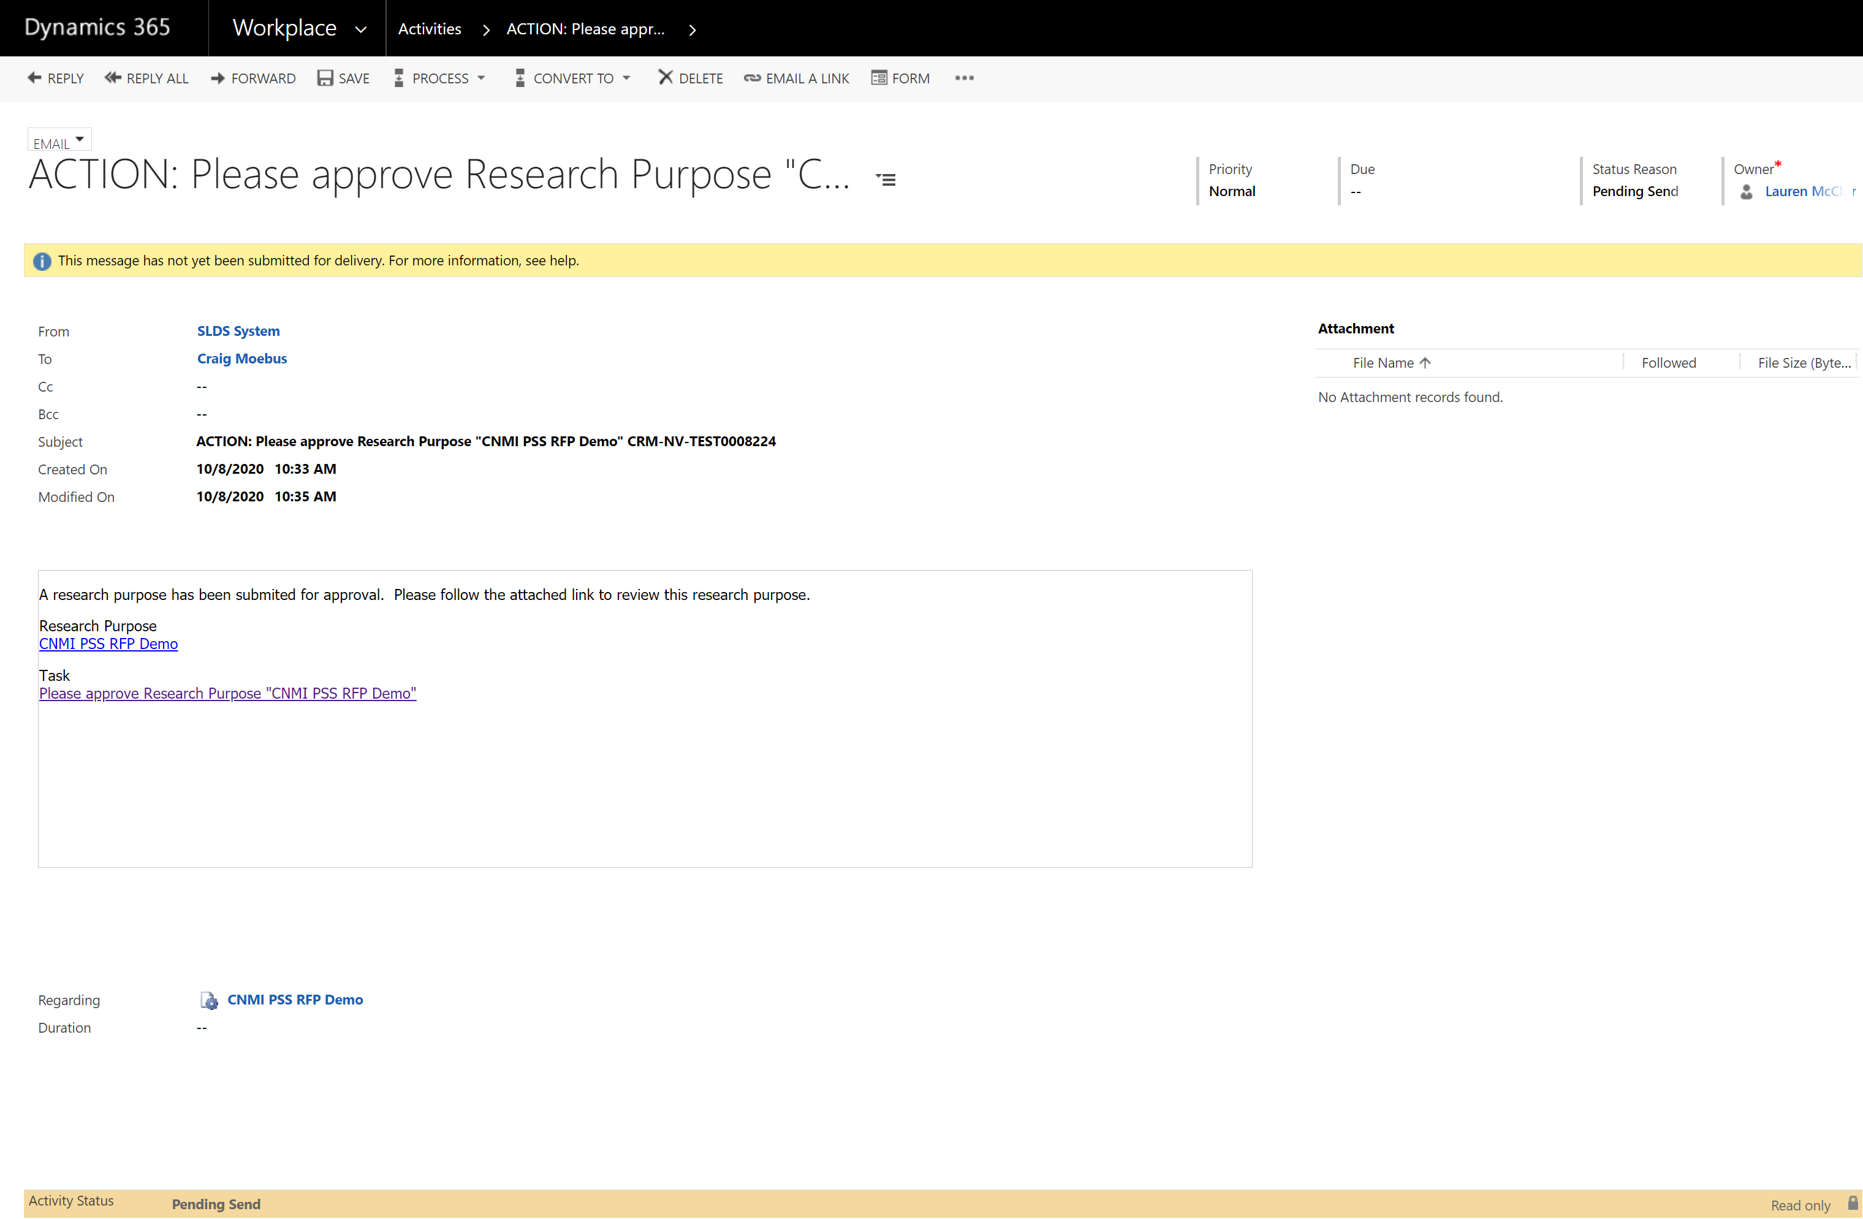
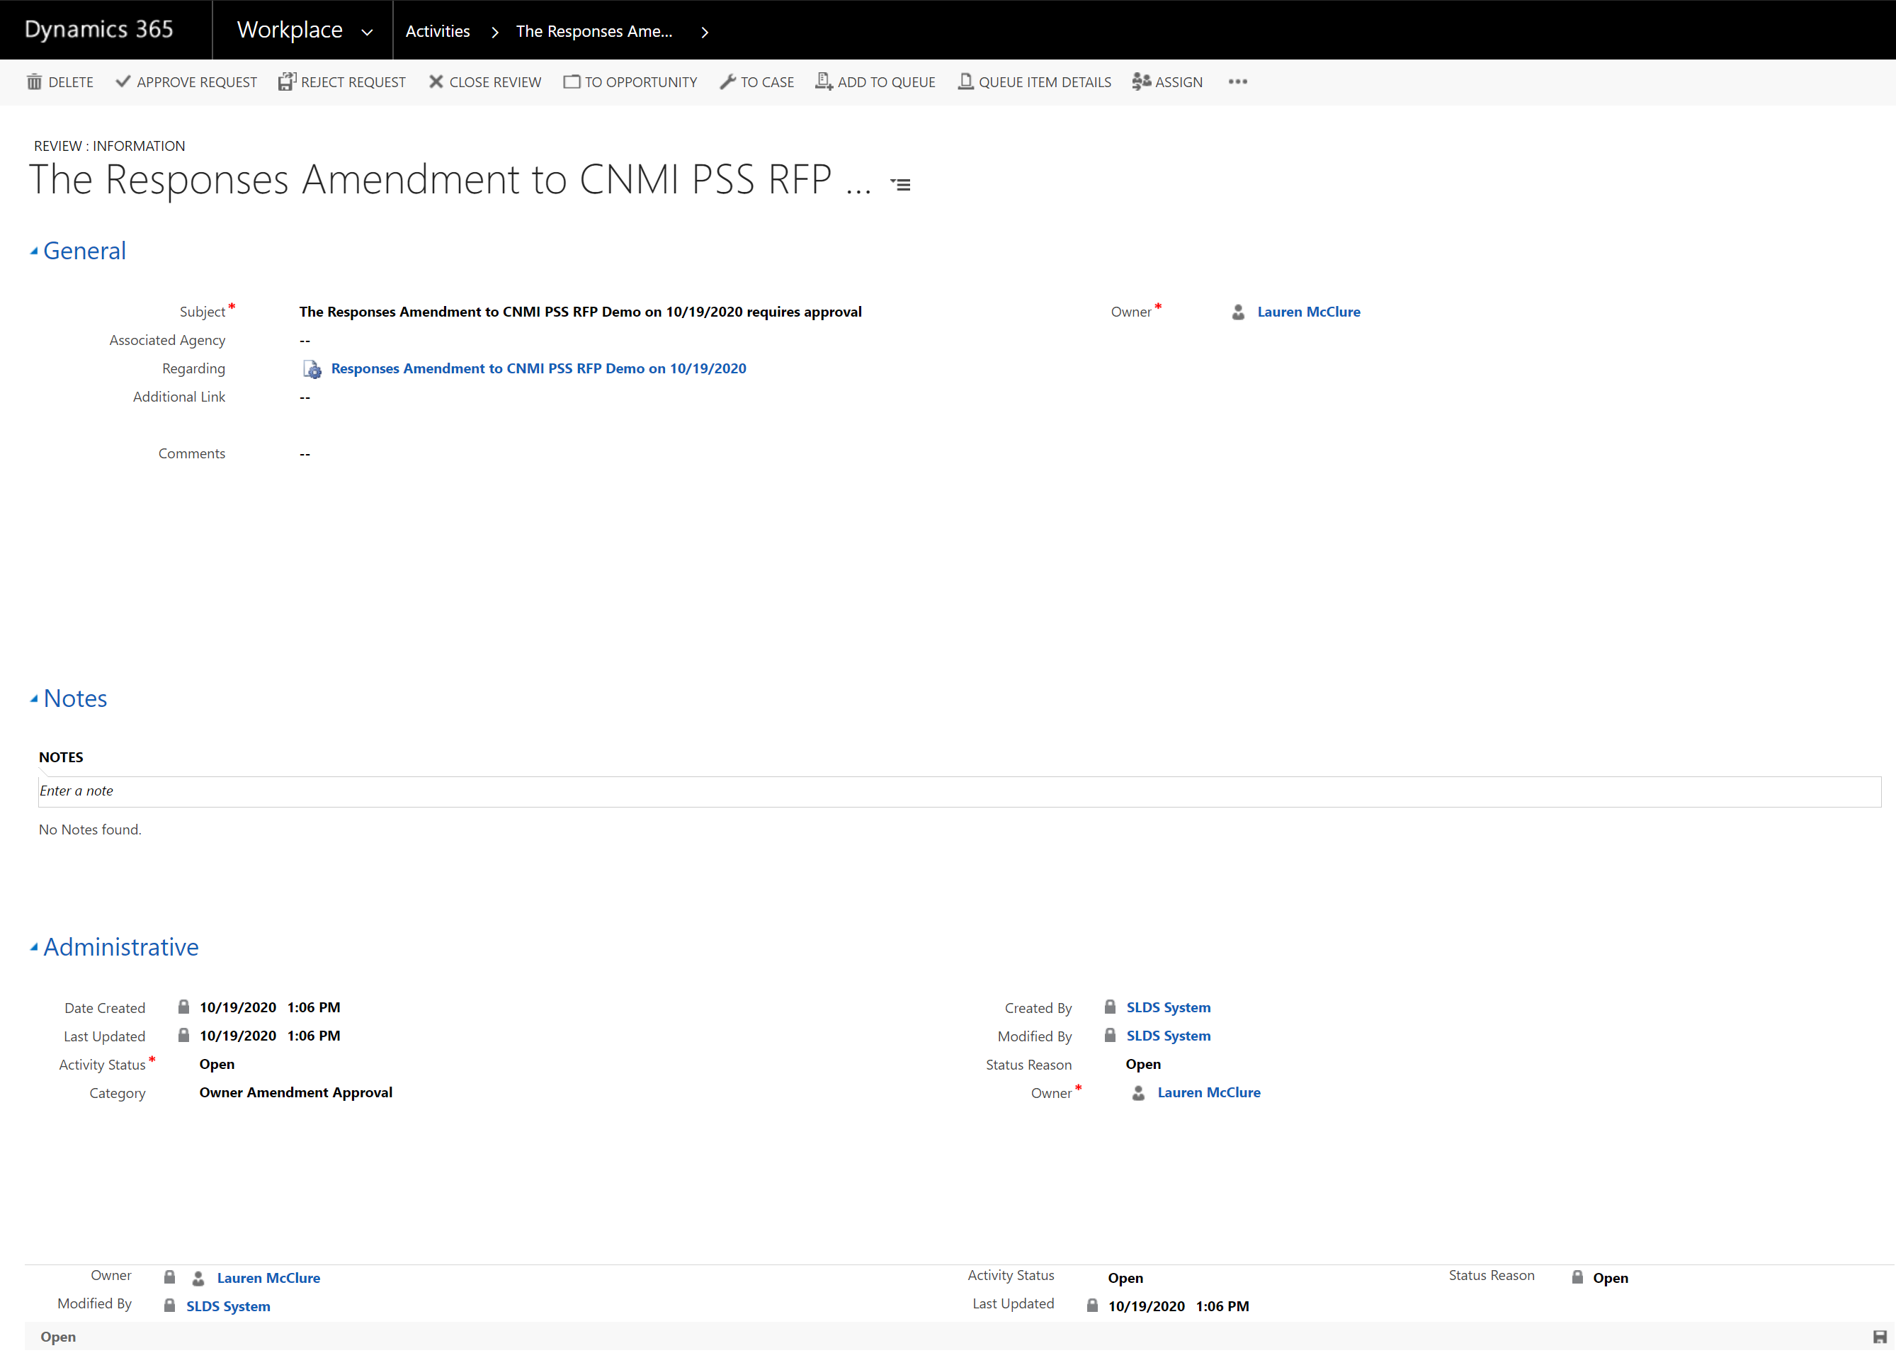
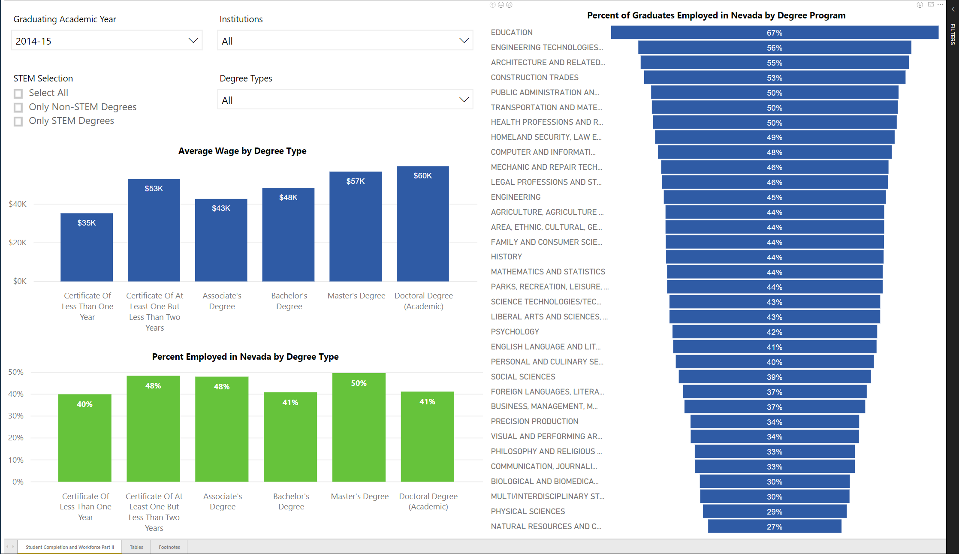
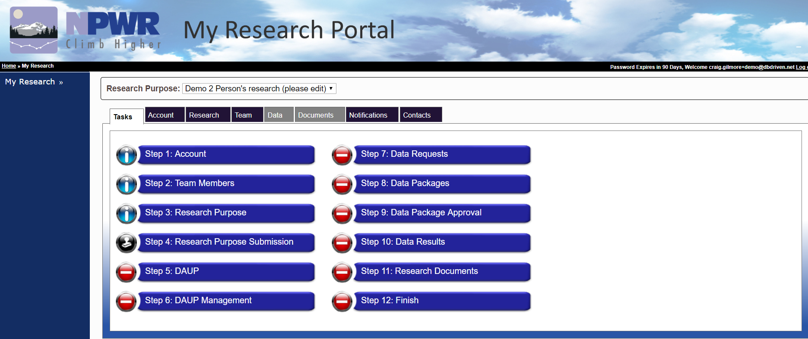
Solution Major Components
Data
Controlled Access
Reports
Research Portal
72
Notes:
At a high level, there are four major components to the solution.
Data
Controlled Access
Researcher Portal
Reports

Slide 73
Difference Between Centralized and Federated
Maintain Agency’s data standard (no need to conform)
Agencies maintain complete control and can ‘cut the cord’ at any time because Agencies’ maintain full security protocols
PII and detail data may be stored separately.
Random identifiers are used each time data is requested
Reduced schedule and cost for implementation
Eliminates scalability problems associated with the traditional data warehouse (centralized)
VLDS has 12 agencies and expect 14 by June 2022
Golden Record
Complex, expensive, lengthy and requires conformance
Challenges with adding new data
Issues in scaling
PII and detail data in the same location

Slide 74
P-20W Solution: Components
Data
Portal
Workflow
Data Dictionary and Selection Tool
Data Request Tool
Data Manager
Data Hub / Adapters
Security
74
Notes:
Taking a deeper dive, the solution is further divided into eight components.
Data
Includes the future state, CEDS aligned Early Childhood and K12 Data Warehouse, the CNMI PSS SLDS
Includes any future P20W data sources and any other identified data source to bring into the environment.
2. Researcher Portal, front door to the SLDS system
3. Workflow, facilitates the governance and controlled access process, also provides for automation, notifications, and more.
4. Data Dictionary and Selection Tool, data selection and metadata viewing
5. Data Request Tool, facilitates query building
6. Data Manager, which is a meta data management tool
7. Data Hub and Data Adapters, matching and results files and managing communications with the matching engine.
8. Security, baked in at every level and manages access, roles and permissions.

Slide 75
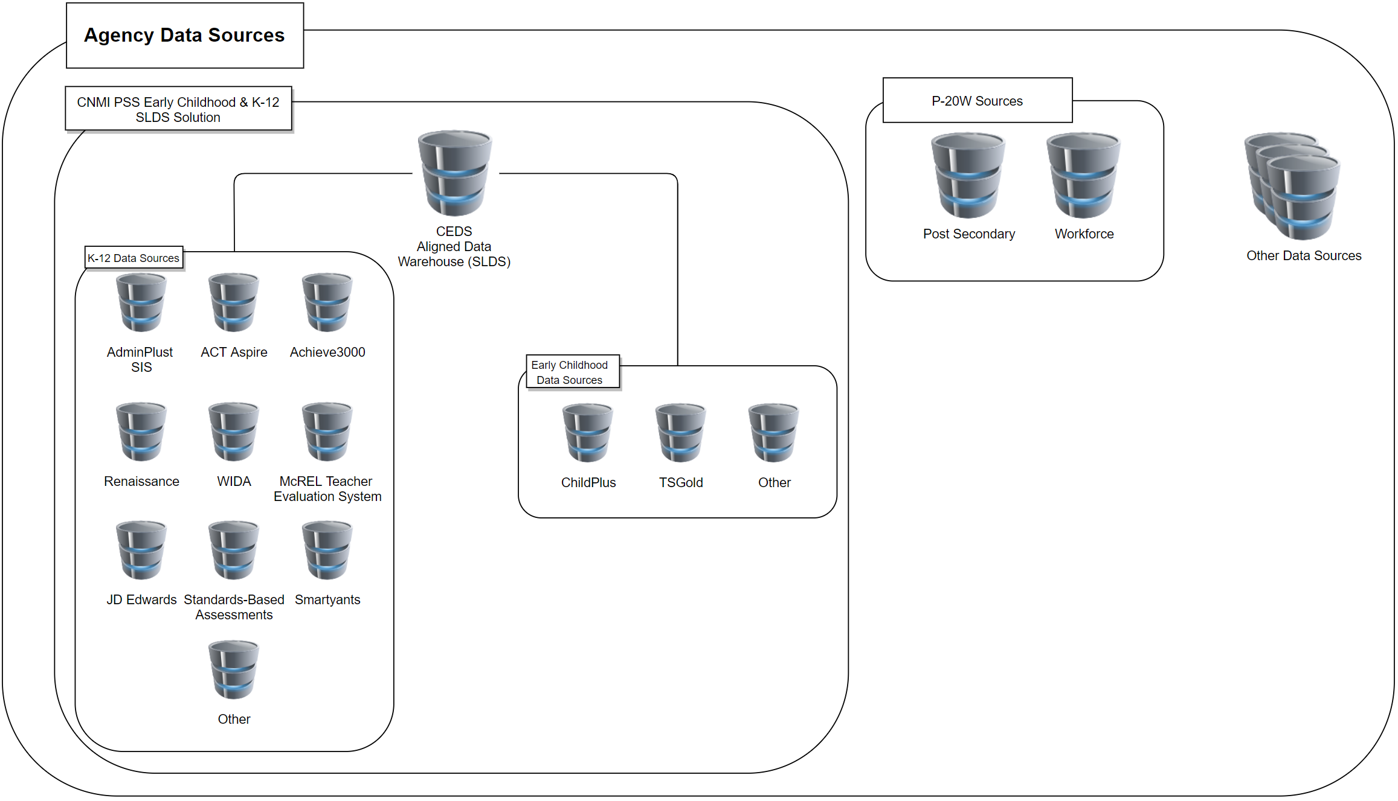
Fulfills the requirement for centralized K-12 & EC Data warehouse (SLDS)
Supports Federated and Centralized models
Centralized: K-12 & EC Data Warehouse (SLDS)
Federated: Future P-20W data sets
Location agnostic
Cloud
P-20W Sol’n Component: Agency Data
75
Notes:
Agency data represents both the Early Childhoold and K-12 CEDS aligned Data Warehouse (SLDS) and future state data sources, federated or centralized. The SLDS will be delivered in phase one of this project. Our solution is ‘location and model’ agnostic and able to connect to data where it is located (e.g. SLDS, on-premise, cloud, etc).
For future onboarding of data sets, specifically P-20W data sets (e.g. Higher Education, Workforce, Health, Social Services, Corrections, etc) we recommend leveraging a federated model for each domain. Please note, P-20W data sets are distinctly different and exclusive of the SLDS. The federated model ensures all PII and transactional data are always under the control of the data owner. Benefits of the federated model include:
Agency retains control of all their data and can ‘cut the cord’ at any time
All work is done ‘on behalf of and under the control of’ the Agency
All records are de-identified using random identifiers (each time data is requested)
Time, expense and effort (agency and contractor) is significantly reduced for implementation and new partners
Eliminates the need to standardize data across domains
Cross agency reporting is supported by a P-20W data mart

Slide 76
P-20W Component : Researcher Portal
Researcher Portal access is progressively permitted
Research information management (Who, What, Where, When, Why)
Data dictionary & selection tool
Data request and retrieval
Document management (NDAs, research papers, etc)
Ability to check status, modify or cancel account and/or data request
Help / Training
76
Notes:
The CNMI PSS Portal provides numerous functions for both public (anonymous) users and named users (authorized agency personnel and researchers). The front door into the CNMI LDS is through the portal for all researchers and the public.
The portal will be the gateway between the users and the CNMI PSS Solution and serves both public and named users. Named users gain access after they have requested an account, and their request has been approved by the appropriate agency (ies) at designated control points. The approval process incorporates procedures required to meet state and federal legal and regulatory requirements for access to restricted data.
Access is progressively permitted.
Allows a researcher to:
-build research purposes
-identify data they would like access to
-communicate with agency for research needs and data use
-query / retrieve approved data
-post research artifacts

Slide 77
P-20W Component : Researcher Portal Governance
Researcher Outreach
Researcher user Acct
Results Returned
Download Results
Agency Approve/Reject
Research Purpose Build & Submit
DAUP Build & Submit
Data Request, Package & Submit
Build Artifact & Submit
Close Research & Submit
Agency Approve / Reject
Legend
Outside System
Agency / Workflow
Researcher / Portal
Data Hub
77
Notes:
The Researcher portal supports a configurable governance process. DBDriven proposes extending the proven and highly successful governance process depicted here. This is the process employed in Virginia and Nevada.
Researcher requests an account
Agency user grants or denies access
Researcher builds and submits research purpose, agency approves/rejects
Researcher build and submits data usage policy or contract, agency approves/rejects
Researcher build and submits data request, agency approves/rejects
Researcher receives & downloads results
Researcher builds research findings, agency approves/rejects
Researchers requests to close research, agency approves/rejects

Slide 78
P-20W Component: Workflow
Central nervous system for P-20W solution
Provides account, data, document, and user management
Provides workflows (e.g. automation) and auditability
Email alerts & reminders
Ability to attach documents
Ability to log account activity (Security)
Backbone to the permissive governance model (researcher portal)
78
Notes:
The Workflow component serves as the central nervous system for the proposed solution. It manages the full spectrum of account, data, document and user management. It includes automated workflows and auditability. Workflow monitors and triggers actions such as query submission and maintains status of requests. Moreover, Workflow is the source of information about roles and permissions for authorized users. All business administration and governance of the system is executed through the CRM application. The system tracks all communication and activity within the system including all emails, approvals, data access and use policies, request for data and results downloads.
The workflow component provides automation and monitoring of user actions, including creation, submission transport, notification, approval or rejection of account and data requests. The workflow component provides email notifications for new, pending and completed requests.

Slide 79
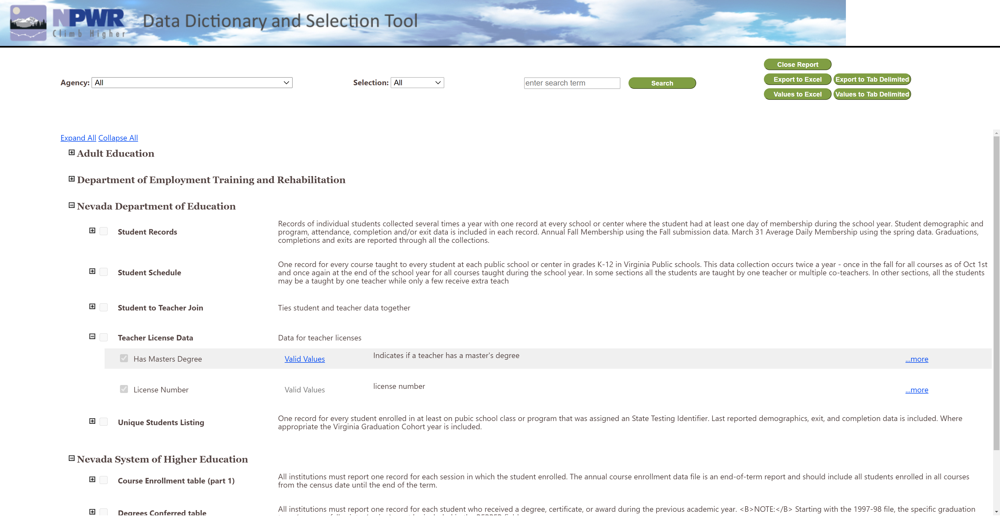
P-20W Component : Data Dictionary
& Selection Tool
Complete inventory of:
Available data
Data source
Data structure
Valid values
Allows researchers to select tables and columns of data to request access
79
Notes:
The Data Dictionary and Selection Tool is available to named users in the Researcher Portal. It provides a complete inventory of available data, data source (s), the structure of available data, the possible values and meanings of the information stored. It allows researchers to select the tables and columns of data they want access to as part of their research.

Slide 80
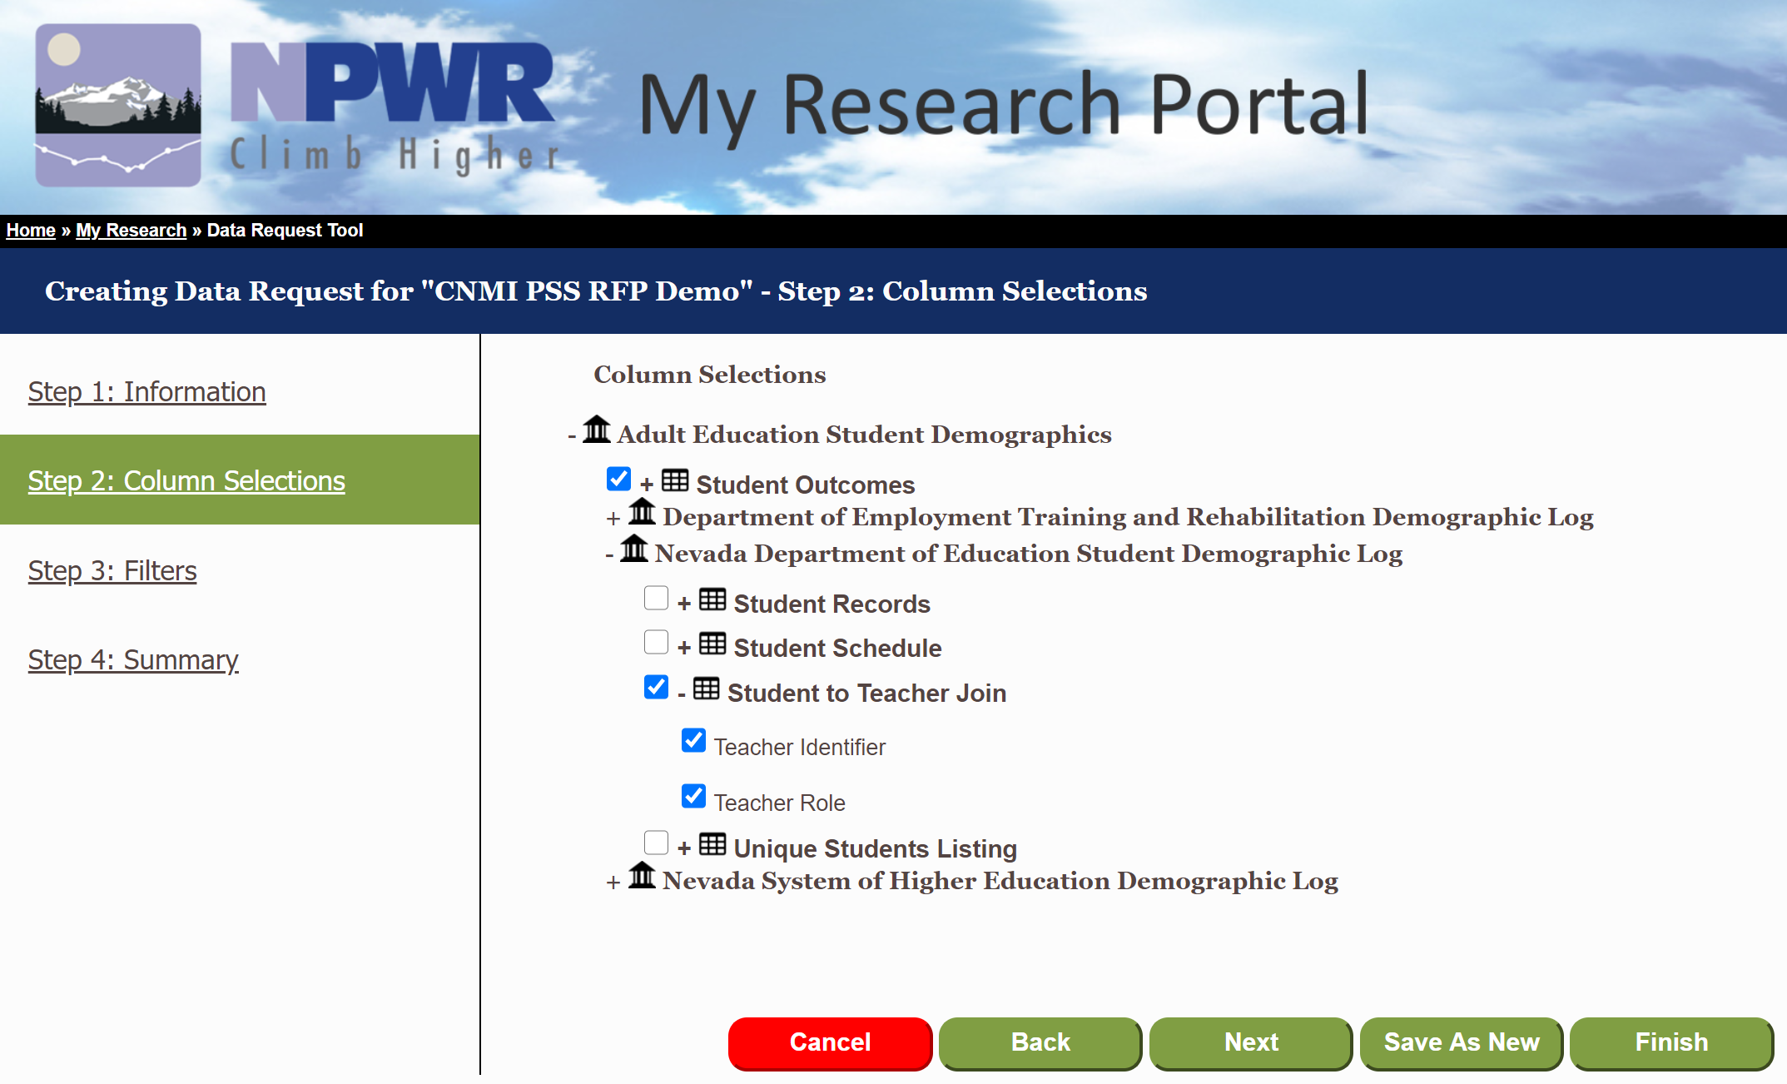
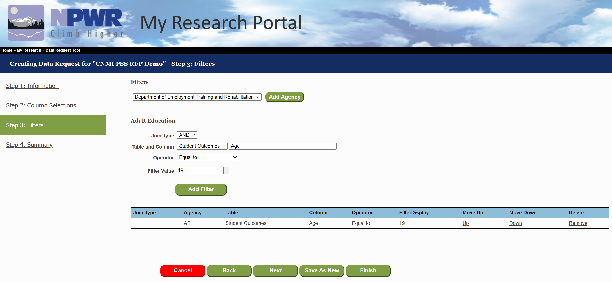
P-20W Component: Data Request Tool
Ad hoc query capability
Allows users (e.g. researchers, agency users, etc) to design develop and save data requests
80
Notes:
The Data Request Tool is an ad hoc query capability which allows users to design, develop and save data requests. The Data Request Tool is accessible to named users from within the Researcher portal. At the fundamental level, the DRT allows researcher to define the columns of the data they are requesting, the filters that apply to their requests, and whether the result (s) should or should not include matched or unmatched data.

Slide 81
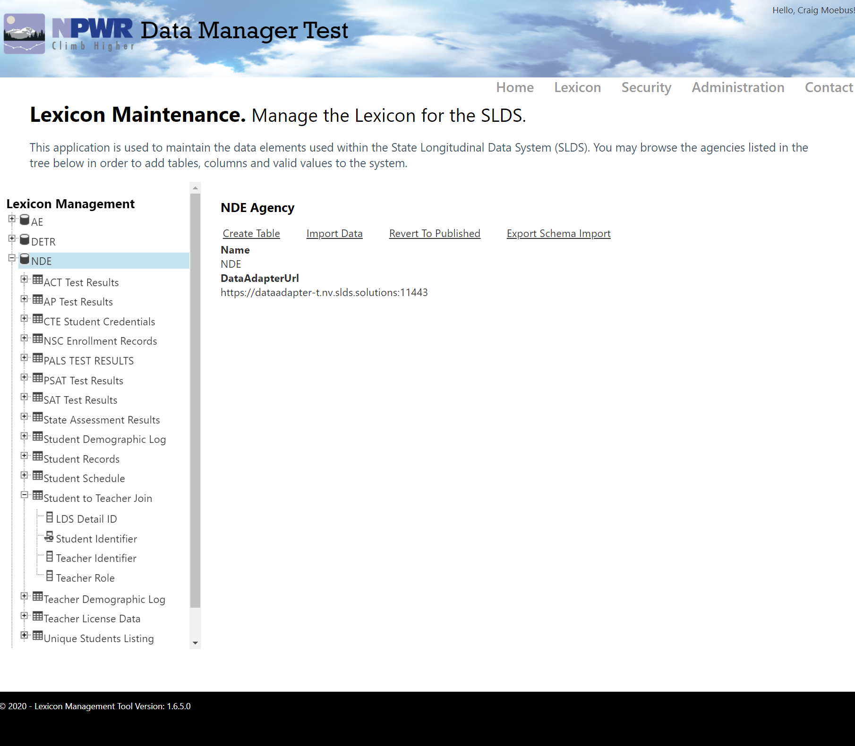
P-20W Component: Data Manager
Data Manager: inventory of every available data field in every available data source, structure of data storage, valid values
Web interface for this metadata management tool
81
Notes:
The Data Manager is an inventory of every available data field in every available data source, the structure of their storage, the possible values and meanings of the information stored. The Data manager provides a friendly web interface for adding/deleting/modifying agencies, tables, columns and valid values.

Slide 82
P-20W Component: Matching Engine
Commercial Off the Shelf (COTS) software
Provides probabilistic and deterministic matching
Creates the Universal State Personal Identifier (USPI)
Used to create the Data Hub crosswalk table
Advanced record linking to create data warehouses
82
Notes:
DBDriven proposes using the Data ladder DataMatch product to meet the need for probabilistic matching and the creation of the Universal State Personal Identifier (USPI). DataMatch is used throughout Fortune 500 companies and has been certified by independent analysis as a world-class data cleansing and data matching product at significantly lower cost than comparable competitors. DBDriven currently uses DataLadder in Virginia and Nevada with great success.
The Matching Engine component will fulfill the following business needs:
Ability to probabilistically match records
Ability to establish thresholds for probabilistic matching
Ability to create the Data hub crosswalk table

Slide 83
P-20W Component: Data Hub / Adapter
Data Hub: queries agency data sources, matches records in a di-identified manner, creates final de-identified data sets
Links & joins records
De-identifies records
Queries disparate databases
Data Adapters: bridge between data source and data hub
83
Notes:
The Data Hub is responsible for querying the agency data sources, matching the records in a de-identified
manner, creating final de-identified data sets, and communication with the Workflow solution. To execute these tasks successfully, the DH understands the structure of the data sources and the relationships between them.
The DH uses the Data Manager to obtain this structure and relationship information. In querying the agency data sources, the DH has responsibility for dividing the submitted query into smaller queries (sub-queries) and devising an optimized plan of execution that can be executed against each target data source.
For data results, the Data Hub is responsible for replacing the USPI with a non-identifiable ID before returning
results to the researcher. Upon successful record joining, the USPI is replaced with a hash of the USPI. This
hashed USPI cannot be traced back to the original data source(s). Upon successful creation of the de-identified
data set, Workflow is notified of the status and location of the file. All pertinent parties (e.g., researchers) are
then notified via email that the data is available for download via the researcher Portal or Workflow component.

Slide 84
P-20W Component: Security
Authentication and Authorization
Authentication: Verification of the identify of a user. Required for all named users (e.g. agency employee, agency approved researchers, etc)
Authorization: Defines user roles and permissions
User Level Security: named users authenticated against trusted source (e.g. active directory)
Data Level Security: Enforce by all components
Progressively permitted
Agencies control access through data agreements and data package approvals
Data does not contain Personally Identifiable Information
Random Unique Identifiers are created for each Data package
Data Results removed after 10 days (configurable)
84
Notes:
Security is foundational to proposed solution, The sensitivity of the information and policies regarding who and how data are handled is managed through a cohesive security model. The model used for the proposed solution incorporates authentication and authorization pieces for each component, integrated through web services.
Authentication, or verification of the identity of a user is required for all named users, including agency employees and agency-approved researchers. Researchers and agency employees will be authenticated as a precondition to gaining access to the named-user portions of the Portal. Additionally, agency employees with be authenticated before gaining access to the Workflow (CRM) component. In order for an agency employee to interact with the Workflow component, they need to authenticate via a directory service (e.g. Active Directory, etc).
Authorization defines user roles and permissions. For example, a researcher (role) will have access to view (permission) the Lexicon, while a data administrator (role) will have access to view and modify (permissions) the Lexicon. The Workflow component is the hub for managing the users’ roles and associated permissions.

Slide 85
LDS Experience: Virginia - VLDS
1st LDS implementation
3-year design, development & implementation process
Go-live 2013
First state level federated P-20W Solution
Primarily used for Research
Use to date:
11 Agencies
2711 Data Elements
150+ researchers
85
Notes:
Virginia Longitudinal Data System was the first LDS that DBDriven implemented. Virginia was one of 20 states to receive a 2010 Longitudinal Data Systems Grant which was funded through the American Recovery and Reinvestment Act of 2009, also known as ARRA.
Our personnel were integral in securing the grant for the development, operations and enhancements to the P20W LDS. We provided project management and senior technical support to the design, development and implementation of VLDS.
The technical architecture implemented in Virginia included a multi-component system that fused:
-XML based web services
-Customer Relationship Management system
-Business Intelligence
-data base technologies
To manage research projects involving education, higher education and workforce data.
The initial implementation included three agencies and took 3 years to design, develop and implement and the primary purpose of VLDS was for research.
VLDS went live in 2013 and was a $7 million project. This was the first state level federated P20W solution implemented.
It now consists of 11 agencies supplying data from social services, workforce training and correctional data and contains 2711 data elements with over 150+ researchers.
We continue to onboard agencies and support VLDS through operations and maintenance contracts. By the end of calendar year 2020, VLDS will consist of 13 agencies.

Slide 86
LDS Experience: VLDS Partner Agencies
86
Notes:
Here are the partner agencies, VLDS also includes Adult Education which is a department within the Virginia Department of Education. By the end of the year the Department for the Blind and Visually Impaired will be a partner agency and Medicaid data as well.

Slide 87
LDS Experience: Nevada - NPWR
2nd LDS implementation
Based off successful VLDS Design
14-month design, development & implementation process
Go-live 2015
Federated P-20W Solution
Primarily used for reports for Legislative/Policy use
Use to date:
4 Agencies
235 Data Elements
13 Public Reports
2 Private Reports
87
Notes:
Neavda’s Pre – K through Workforce Research Data System, commonly known as NPWr is our 2nd LDS implementation. The primary output of the project is for matching and reports for Legislative and Policy use.
NPWR was based on the VLDS design, as such NPWR was designed, developed, configured and implemented in 14 months and for $2.1 million dollars as compared to the 36 month, $7 million dollar VLDS implementation.
NPWR was funded by the US Department of Eudcation 2012 SLDS Grant and currently consists of 4 agencies, 235 data elements, and 15 reports, public and private.
DBDriven continues to support the P20W solution through operations and maintenance contracts.

Slide 88
LDS Experience: NPWR Partner Agencies
88
Notes:
The Department of Education, System of Higher Education and Department of Employment Training and Rehabilitation were the original partner agencies. We completed Adult Education onboarding this year in August.
Of note to CNMI PSS, the Adult Education onboarding is to provide the department with an easy way to retrieve and transform data for federal reporting requirements.

Slide 89
P-20W Data Visualization Outcomes
Career Earnings
Published on the Public Portal
Workforce performance measures
Economic Impact Studies
College and Career Planning
Student Benchmarks
Student Completion & Workforce
STEM Education Outcomes
89
Notes:
These are examples of dashboard, reports and visualizations that we manage for Nevada. We will work with CNMI PSS to define report requirements. The data visualization tool leveraged, Microsoft PowerBI, is an extremely powerful Business Intelligence and Reporting Tool. DBDriven will work with CNMI to define requirements and develop and deliver reports including:
School Report Card Reports
Facts and Figures
Early Warning System Reports
And others as defined at a future date.

Slide 90
Creates an environment of continuous improvement, ensuring the P-20W & LDS Solution is best in breed
Updates, enhancements and upgrades are available to all consortium members at no additional cost:
Example: Based on requirements of one consortium member, DBDriven developed a more robust and capable data adapter to bring significant improvements to the speed and scale of processing data packages. This enhanced data adapter is now being deployed all P-20W consortium members at no additional cost to them.
LDS Consortium
90
Notes:
The CEDS aligned K-12 & Early Childhood data warehouse (SLDS) is a data source for the P20W solution. The consortium described below is for the P20W solution, not for the individual SLDS.
A key factor to DBDriven’s proposed approach and solution is the P20W Consortium model. In implementing a DBDriven P20W solution, CNMI PSS will be part of a consortium of three P20W state/commonwealth users (15+ partner agencies, 100+ researchers). Being a part of this consortium means that updates, enhancements and upgrades to one system are administered to all systems in the consortium. This creates an environment of continuous system improvement and allows users to leverage lessons learned and development from other users while minimizing/eliminating the fiscal impact of new development.
For example:
Based on requirements and needs of one consortium member, DBDriven developed a more robust and capable data adapter to bring significant improvements to the speed and scale of processing data packages. This enhanced data adapter is now deployed to all P20W consortium members at no additional cost to them.
While all enhancements are available to consortium members, consortium members are not required to accept the enhancements. Our unique P20W solution is completely configurable for functionality and governance requirements dictated by the needs of our clients.
DBDriven continuously enhances the system within the means of the operations and maintenance contract. Clients maintain complete control over change requests and prioritization. DBDriven coordinates with each client to determine functionality and governance topics for enhancements which are prioritized by the client.

Slide 91
Example P-20W Report
NPWR.NV.gov/reports
91
Notes:
Let’s dive into the solution. The Proposed CNMI PSS P-20W Solution is
-Web based portal to access agency data, which
-Retrieves and matches agency data (SLDS, P20W, other) while
-Ensuring agencies manage complete control of their data while
-Maintaining the confidentiality of an individual, to be
-Used for reporting and research purposes.
Access to Agency Data is controlled by Agency Users. Agency Users approve or reject Researcher access to Agency Data. Researchers request access through the Researcher Portal and use the Agency Data approved by the Agency User to conduct research, create reports, etc:

Slide 92
bit.ly/sldsdataeval

