Slide 1


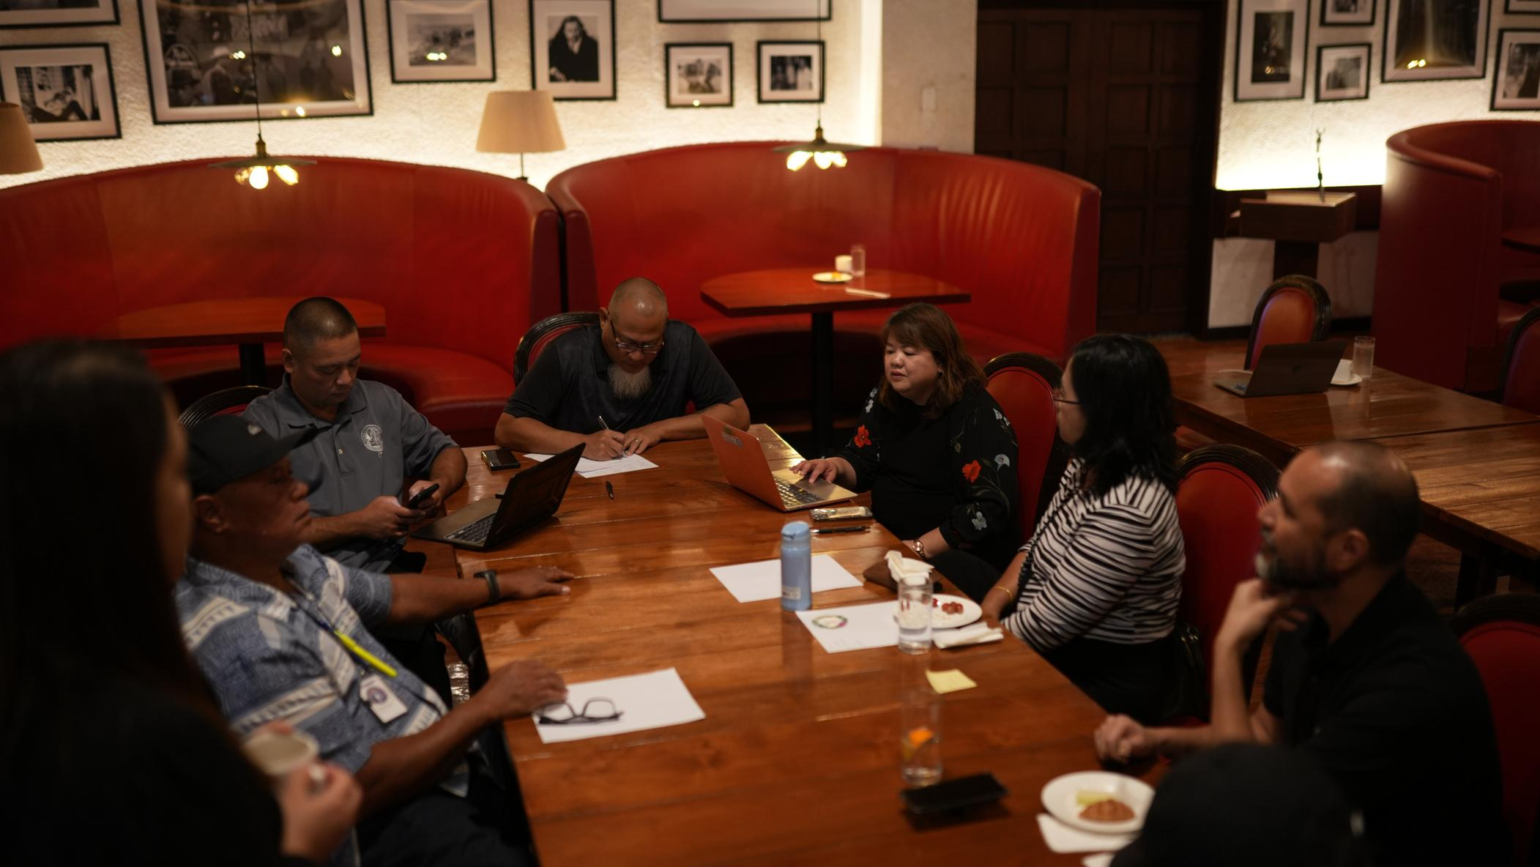

P-20W
DATA GOVERNANCE
DATA QUALITY STANDARDS
CNMI STATEWIDE LONGITUDINAL DATA SYSTEM
APRIL 17, 2024

Slide 2
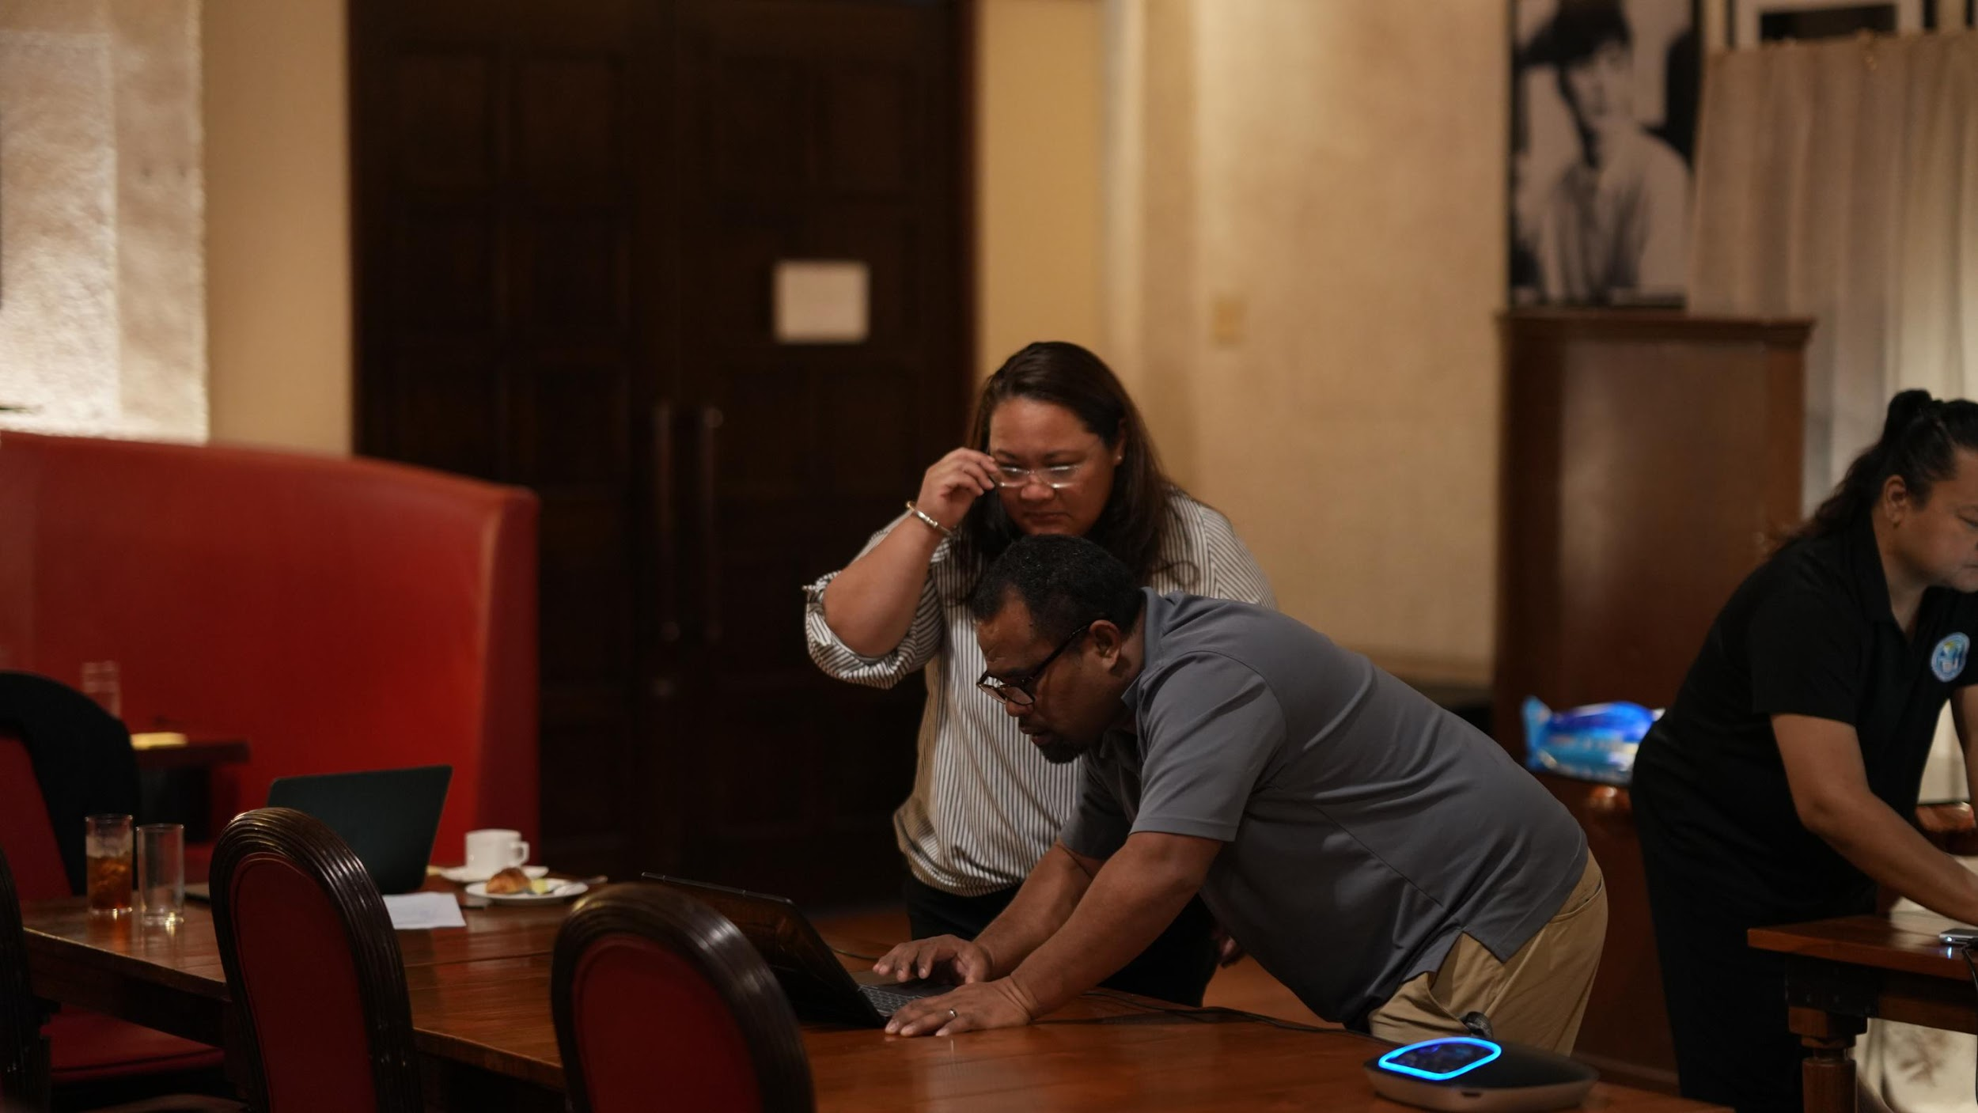
DATA QUALITY STANDARDS
Involves measuring data based on a characteristic, aspect, or feature that provides a way to classify information and data quality needs.

Slide 3

ACTIVITY

Slide 4



DATA
QUALITY
STANDARDS
ACCURATE
COMPLETE
CONSISTENT
Values reflect the data element definition and correctly capture “real life” object it intended to model.
All required fields contain values.
The same data across the orgnaization are in sync with one another and over time.

Slide 5



DATA
QUALITY
STANDARDS
RELEVANT
TIMELY
TRUSTED
The definition and business rules are aligned with the intended use(s).
The data are collected and available when needed to fulfill their intended uses.
Data users believe that the data are of sufficient quality and appropriate for the intended use(s).

Slide 6



DATA
QUALITY
STANDARDS
SECURE
ACCESSIBILITY
VALIDITY
Data is protected from unauthorized access, corruption, and destruction.
Authorized users can readily view and retrieve the data they need, in the form they need it.
The measurements reflect what they are supposed to measure.

Slide 7

DATA
STANDARDS
ACCURATE
RELEVANT
SECURE
COMPLETE
TIMELY
ACCESSIBILITY
CONSISTENT
TRUSTED
VALIDITY

Slide 8
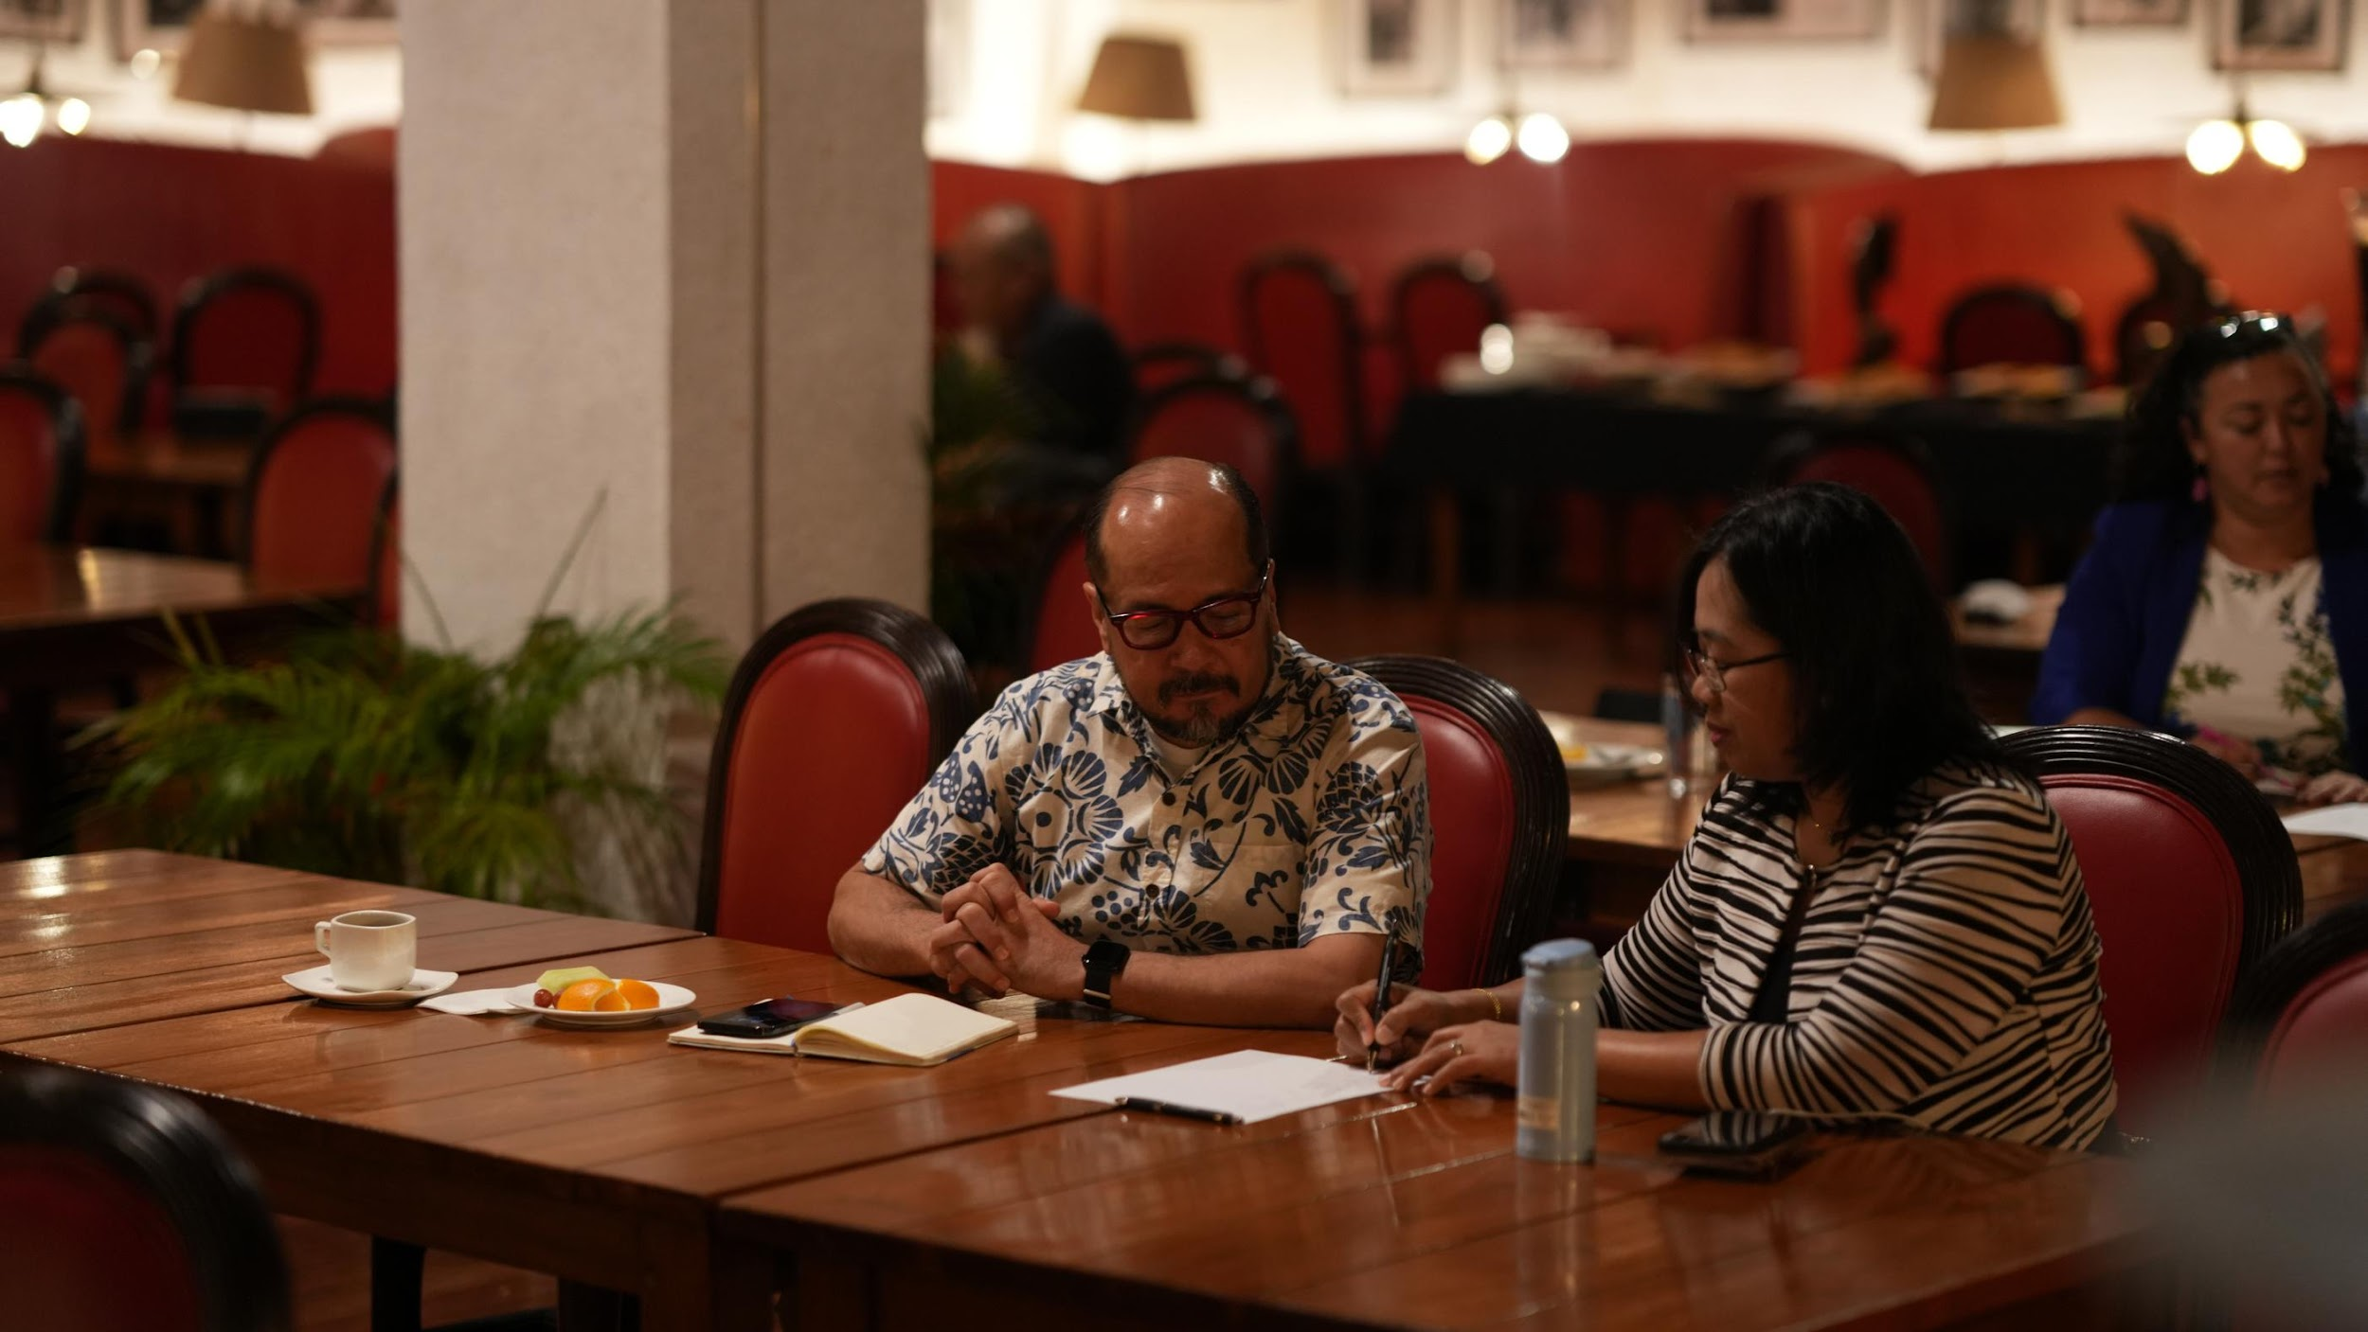
WHERE ARE WE NOW?
Self-assessment of our agency data systems

Slide 9


BREAK

Slide 10


DATA TRANSFER REQUIREMENTS

Slide 11
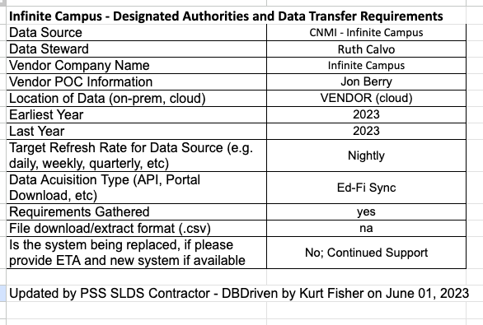

DATA TRANSFER
REQUIREMENTS

Slide 12
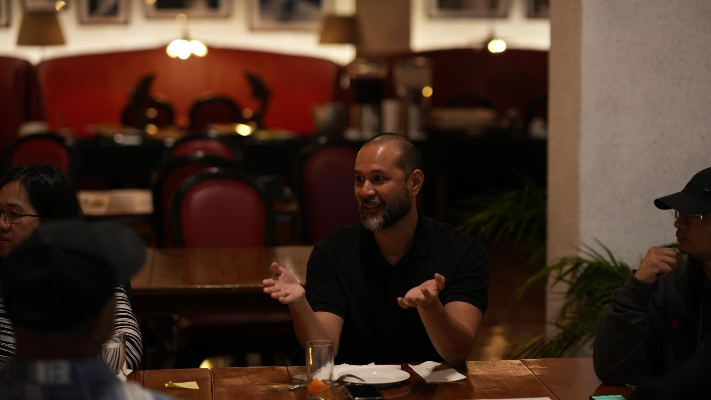
WHAT
NEXT?
  Next Meeting
    June 5, 2024 @ TBD
  Data Sharing Agreement
    Laws governing agency data

Slide 13
Disclaimer:
The research reported here was supported by the Institute of Education Sciences, U.S. Department of Education, through Grant Award R372A230018 to CNMI Public School System. The opinions expressed are those of the authors and do not represent the views of the Institute or the U.S. Department of Education.
Daniel Gallego

Slide 14
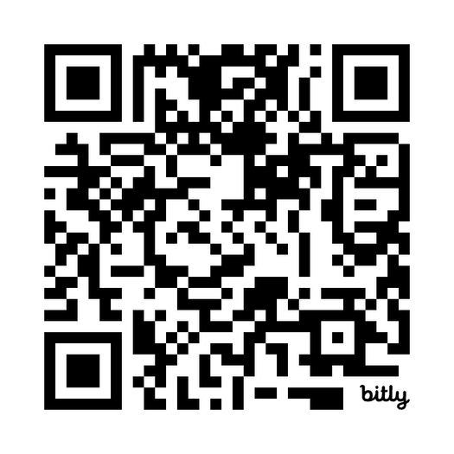
We appreciate your feedback

Slide 15
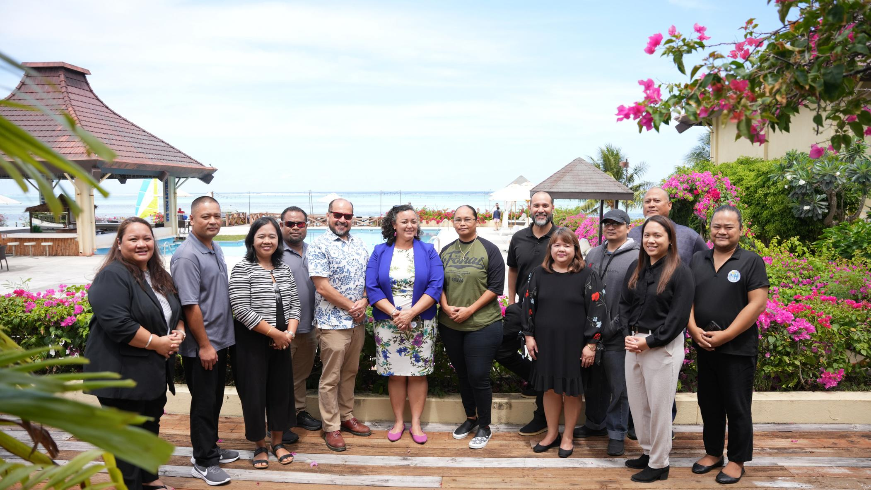
Thank You!
P-20W Executive Leadership & DGC:
Francisco Cabrera (Dept of Commerce)
Justin Andrew (Dept of Commerce)
Fermin Sakisat (Dept of Commerce)
Tracy Norita (Dept of Finance)
Ryan Camacho (Dept of Finance)
Frank Celis (Dept of Finance)
Leila Staffler (Dept of Labor)
Candy Feliciano (Dept of Labor)
Eugene Tebuteb (Dept of Labor)
Dr. Galvin Guerrero (NMC)
Vilma Reyes (NMC)
Jodina Attao (NMTech)
Leo Master (NMTech)
Stephen Sablan (NMTech)
Dr. Lawrence Camacho (PSS)
Dr. Rizalina Liwag (PSS)
Jesse Tenorio (PSS)
CNMI SLDS Program:
Dr. Annette Pladevega Sablan (Project Director)
Shawna Indalecio (Project Specialist)
Jeaniffer Cubangbang (SLDS Technical Manager)
Ferdinand Ngirmekur (Data Privacy Specialist)
Geri DelaCruz (Data Governance Manager)
Extended Gratitude to:
Donna Flores
Remedio Mafnas
Jerome Ortiz

