Slide 1

Please sign-in

Slide 2
Connections before content

Slide 3



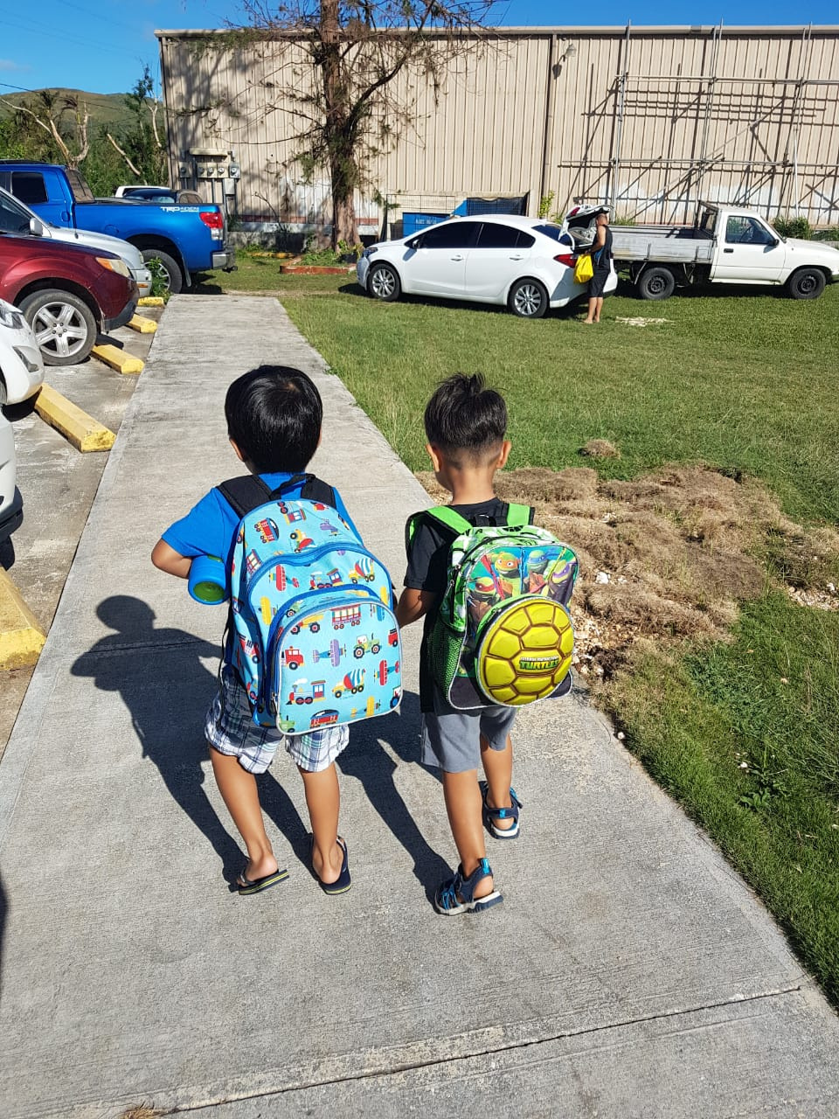



March 20, 2024
CNMI P-20W
Data Governance Convening
The CNMI SLDS Program

Slide 4
Welcome, Introductions and Meeting Objectives

Slide 5
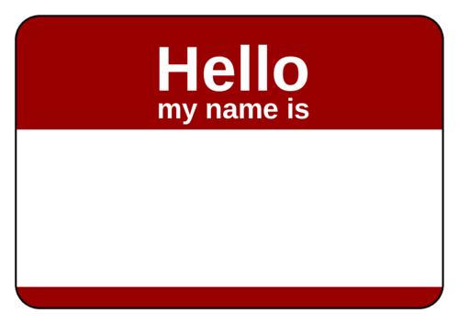
Introductions
Your name
Your role at your agency
Whether you are on Executive Leadership or Data Governance Committee
and
A memorable moment from our past week that brought us joy, laughter, or even a valuable lesson.

Slide 6
Meeting Objectives
Develop common understanding of the structure, expectations and operations of the P-20W data governance program
Identify a decision-making process for the Executive Leadership and Data Governance Committee
  Identify the role of proxies in decision-making
Identify next steps and timeline
  Establishing a meeting cadence of each P-20W data governance group

Slide 7

P-20W Data Governance Program
We are
here!
The Commitment
Standards Emerge
Improved Data Quality
Reports & Dashboards
Data for Decision-Making

Slide 8
P-20W Data Governance Overview

Slide 9
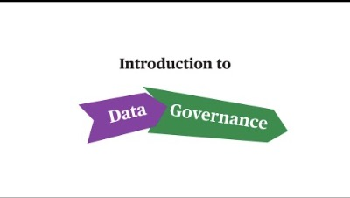

Slide 10
P-20W Data Governance Scope
The CNMI P-20W Data Governance Program oversees data management by CNMI Partner Agencies for the SLDS. Participating agencies, such as PSS, NMC, DOL, NMTech, Dept of Commerce, DOF and other agencies contribute data on education, workforce, and economic development.
Coordination and data sharing are defined in data-sharing agreements (DSAs), ensuring data availability, usability, integrity, and security, with policies, procedures, and standards in place.

Slide 11
Activity Slide – Whose Role is it anyway?

Slide 12
Executive Leadership
Appointing Data Stewards and IT Representatives from their respective agencies to serve on the Data Governance Committee.
Ensuring alignment of the Data Governance program with the overall strategic goals of the agency.
Approve or reject policy recommendations that are controversial, highly visible, or are at high risk.

Slide 13
DGC
Establishing, documenting, and enforcing P-20W data standards, policies, and processes, such as master data management and the data request policy and process.
Identifying, prioritizing, and supporting the resolution of critical data issues that affect the quality, availability, and use of data (e.g., if new legislation requires additional public reporting or the replacement of a source system).
Makes policy recommendations that may be controversial, highly visible, or are at high risk.

Slide 14
Both
Ensuring coordination and communication between their agency and the P-20W data governance program.

Slide 15
End of Activity

Slide 16

P-20W Data Governance Structure
Executive Leadership – will provide oversight, set priorities, and ensures the effective implementation of data governance, with a focus on demonstrating your agency's commitment and accountability (pp. 7-8)

Slide 17
P-20W Data Governance Structure: Executive Leadership Representatives
Agency | Executive Leadership
Dept of Commerce | Remedio Mafnas
Dept of Finance | Tracy Norita
Dept of Labor | Leila Staffler
NMC | Galvin Deleon Guerrero
NMTech | Jodina Attao
PSS | Lawrence Camacho

Slide 18
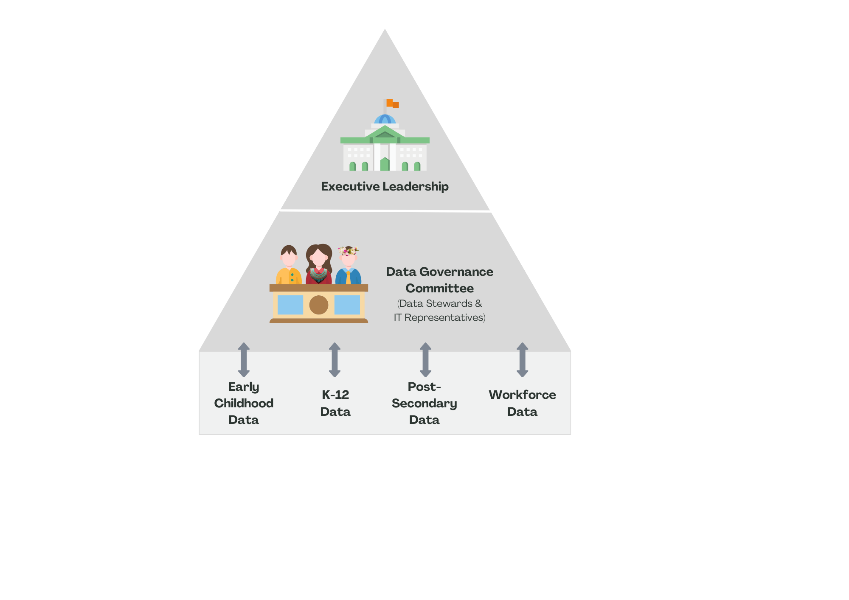
P-20W Data Governance Structure
Data Governance Committee – will establish and enforce interagency data standards, resolve critical data issues, authorize data releases, and facilitate communication among Data Stewards and IT Representatives, ensuring data quality, availability, and policy adherence (pp. 9-11)

Slide 19
P-20W Data Governance Structure: Data Governance Representatives
Agency | Data Steward | IT Representative
Dept of Commerce | Justin Andrew | Fermin Sakisat
Dept of Finance | Ryan Camacho | Frank Celis
Dept of Labor | Candy Feliciano | Eugene Tebuteb
NMC | Vilma Reyes | Jerome Ortiz
NMTech | Taylor Ada | Stephen Sablan
PSS | Rizalina Liwag | Jesse Tenorio

Slide 20
Two Distinct Groups
Coordinating and communicating with Data Governance Committee (DGC)
  Ex: When CNMI or agency-level policies are created that may affect the P-20W they inform the DGC
Establishing P-20W policy priorities
Approving data policies and major data-related decisions proposed by the DGC
Resolving issues escalated by the DGC
Coordinating and communicating with Executive Leadership
  Ex: When Data Governance policy priorities are identified, they get promoted to the Executive Leadership for approval or resolution
Stalemate in DGC or a pending decision that are controversial, highly visible, or are at high risk, escalate it to the Executive Leadership
Notes:
Expectation to stay in coordination between the two groups

Slide 21
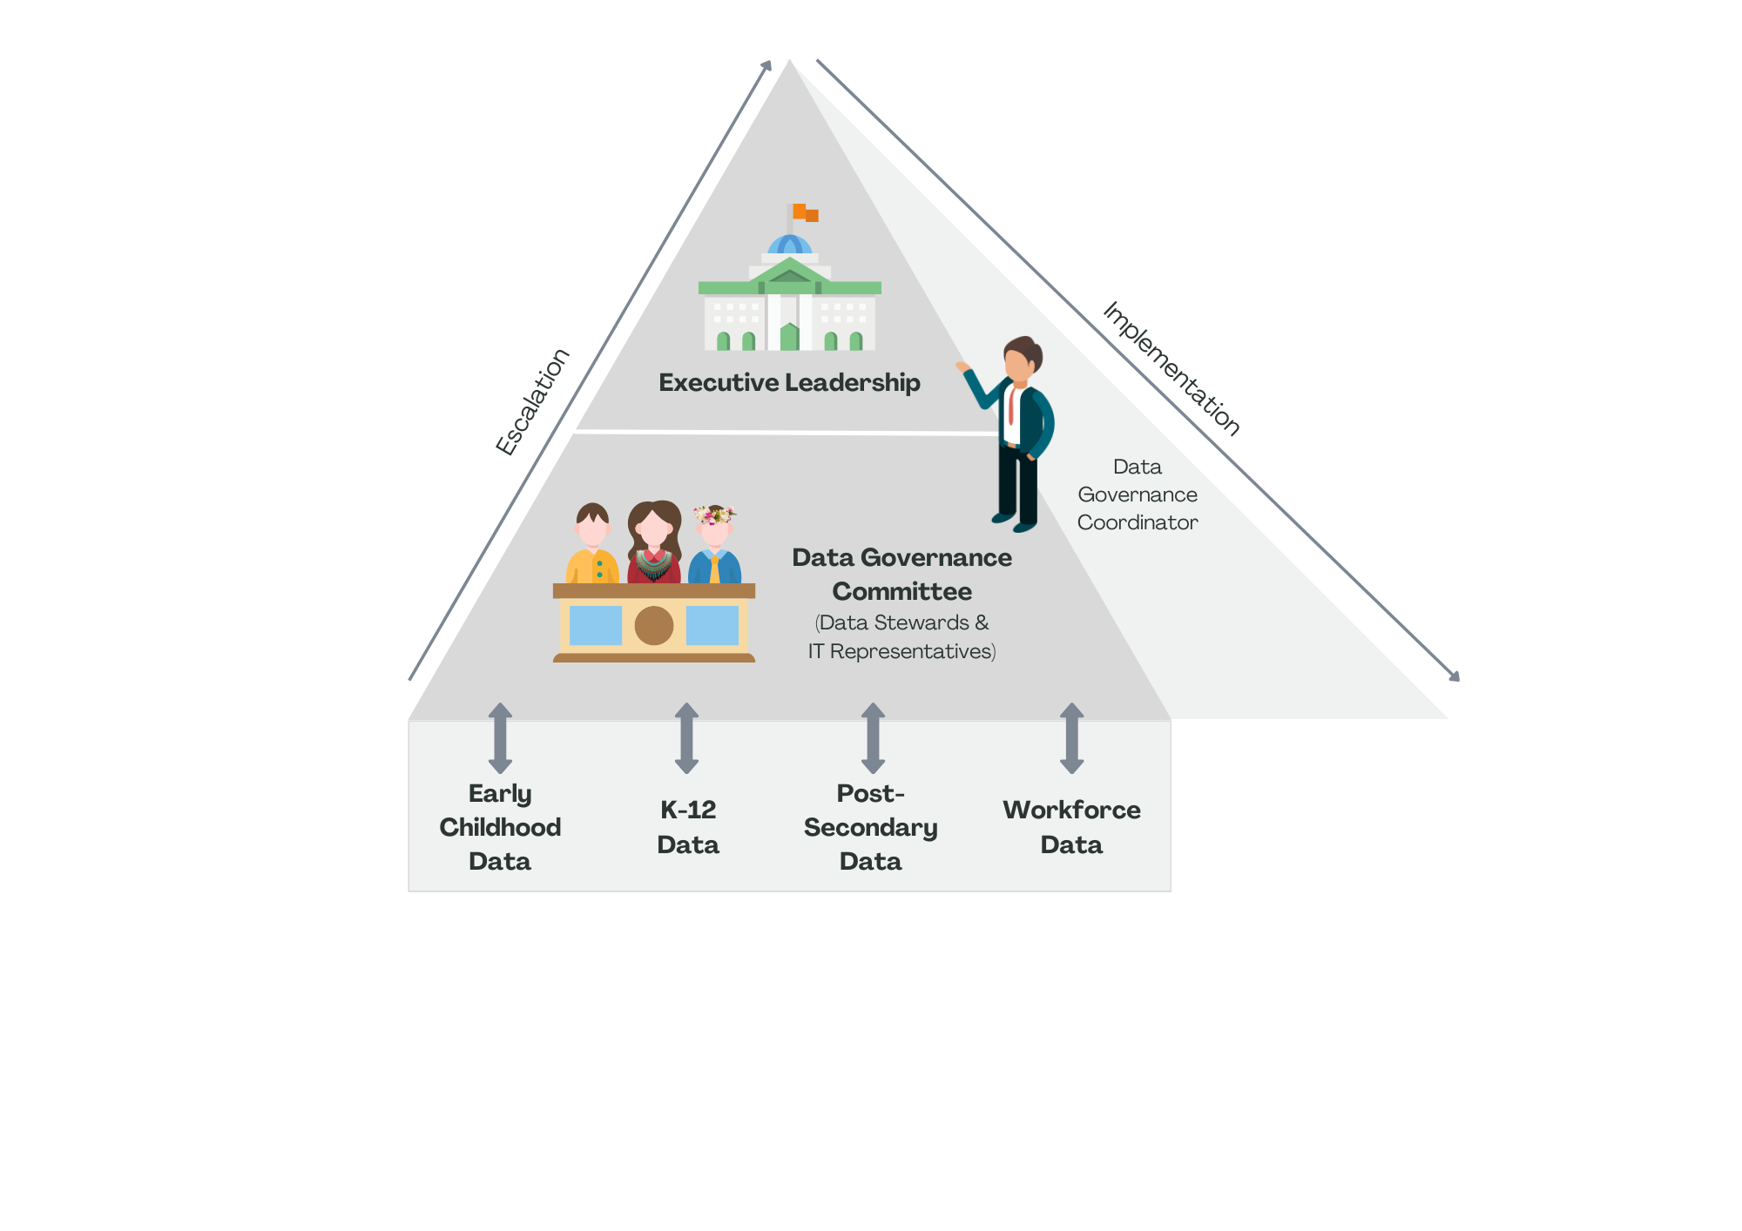
P-20W Data Governance Structure
Data Governance Coordinator – leads the overall direction and implementation of the data governance program, serving as the liaison among data governance groups to facilitate the escalation and resolution of issues (pp. 8-9)

Slide 22
Role of the CNMI SLDS Program
Data Governance Manager
Leads the overall direction and implementation of the data governance program
Data Privacy Specialist
ensures compliance with data privacy regulations and safeguards
Project Specialist
Supports project coordination and administration
SLDS Project Director
Oversees the implementation and management of the P-20W data governance program
Technical Manager
Responsible for the technical aspects of the P-20W data governance program, including data integration

Slide 23
Break

Slide 24
P-20W Data Governance Operations

Slide 25
Meeting Cadence, Management and Efficacy
Meeting Cadence
  Executive Leadership - Once a quarter
  DGC - Once a month
Standing Agenda items
  Each work session with have a defined agenda.
  Update of the action items for each group.
  Work sessions will end with a capture of the key decisions and next steps.

Slide 26
Activity Slide – Identifying a decision-making process

Slide 27

Majority Rules
The “Winner” is the proposal that receives more than half the votes
Pros: Its efficient, straightforward and the outcome is clear
Cons: Disregards minority viewpoints, and can be polarizing
This Photo by Unknown Author is licensed under CC BY

Slide 28

Consensus Decision-Making
Agreement is reached when all members are satisfied with the decision
Pros: Its inclusive, well-rounded outcomes, and has higher buy-in
Cons: Time-consuming, potential for stalemate, and there may be compromises on quality

Slide 29
Proxy Rules
In October 2023, the majority of agencies pre-identified proxies for several roles.
Proxy Rules:
Limit the # of times a proxy can serve.
Executive Leadership and Data Governance members are responsible for:
  Providing advanced notice to the Data Governance Manager
  Brining the proxy up to speed
  Proxy understands that this is a meeting were we get things done
Does a proxy have voting rights?

Slide 30
Agency Table Talk—
How will you agree to coordinate and communicate with each other

Slide 31


Shared Google Drive:
_P-20W Data Governance Committee
Not sure where to start? Go to the Start Guide:
0. START HERE: P-20W DGC Google Drive Guide

Slide 32
Commit to Next Steps and Timeline

Slide 33
Within 6-9 months…
We propose that the DGC produce for the Executive Leadership policy and related processes outlining how data is validated before moving from source system SLDS:
  Establish Data Quality Standards
  Agree on Data Transfer Requirements
  Develop and agreeing to a Data-Sharing Agreement
  Develop a Priority List for Data Use

Slide 34
Within 6-9 months…
Scheduling onboarding of all agency data with DBDriven:
  Dept of Commerce =
  Dept of Finance =
  Dept of Labor =
  NMTech =
  NMC =
  PSS = June (to review if additional data elements are needed)

Slide 35
Next Steps and Timeline
Proposed Next Meeting for the Data Governance Committee:
  April 23, 2024 (Tuesday) - the last Tuesday of every month
  Agenda:
    Identify and prioritize the first set of policies and procedures
    Establish work groups within the DGC
Proposed Next Meeting for the Executive Leadership:
  June 27, 2024 (Wednesday) - once a quarter
  Agenda:
    Review and approve the list of and prioritize the first set of policies and procedures

Slide 36
Disclaimer:
The research reported here was supported by the Institute of Education Sciences, U.S. Department of Education, through Grant Award 84.372A to CNMI Public School System. The opinions expressed are those of the authors and do not represent the views of the Institute or the U.S. Department of Education.

Slide 37
Additional Program Information (if needed)
Notes:
Education systems, in general, collect too much data.

Slide 38
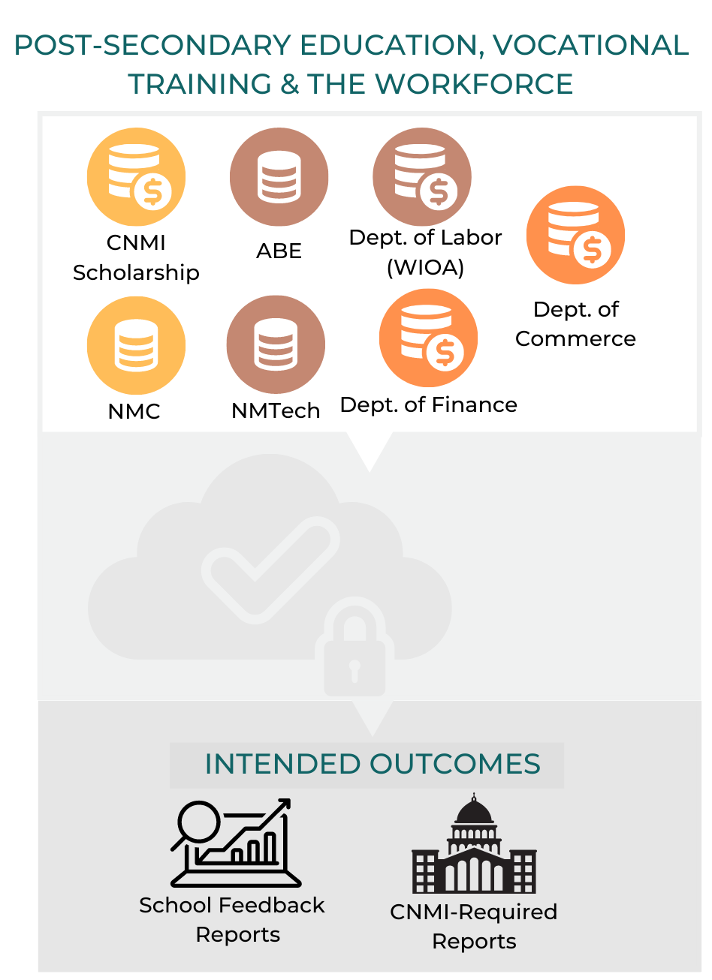
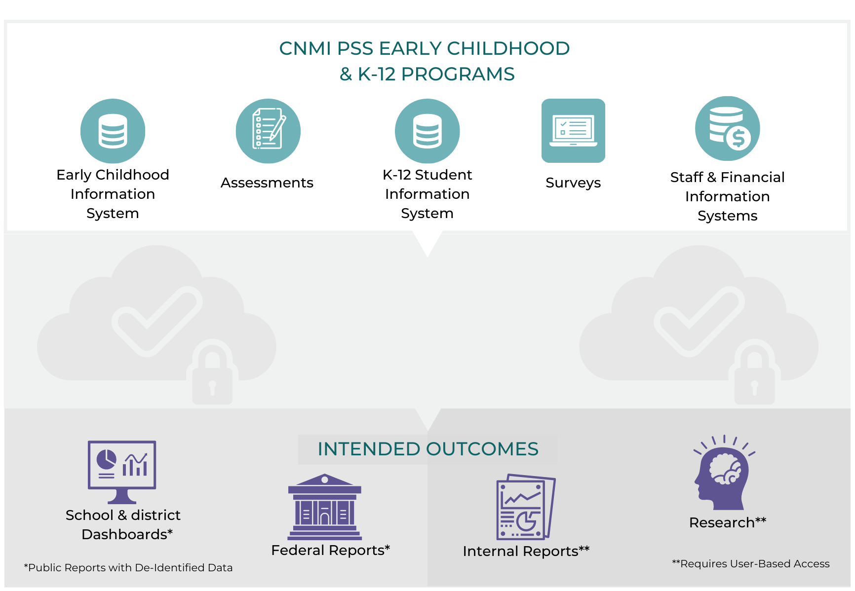

Planned Expansion (P20W)
Pre-School
K-12
Federated Data System

Slide 39
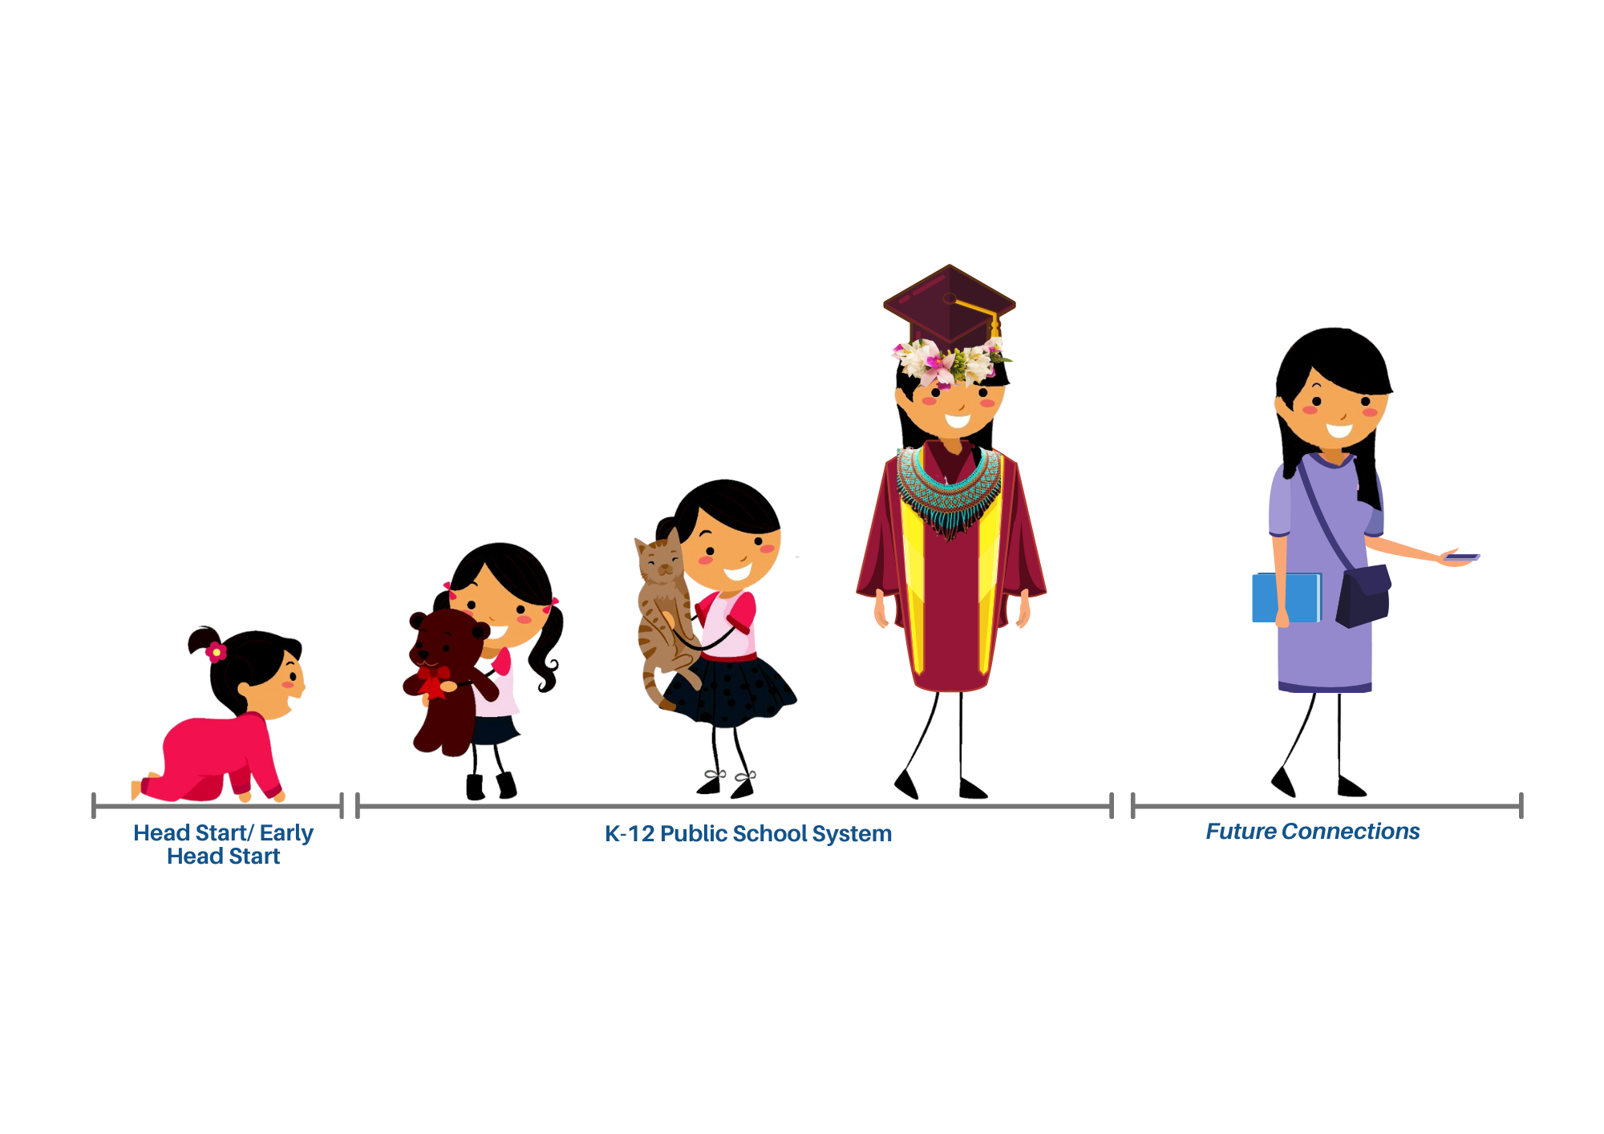
Pre-School
Post-Secondary
Voc Ed Training
Workforce
K-12

Slide 40
\
Pre-School
K-12
Post-Secondary
Voc Ed Training
Workforce
Goal 1:
  Scalable enterprise data architecture
  Data audit system (Quality, validity, and reliability)
  Secure data management
  Data-Sharing and Knowledge sharing
Goal 2:
  Student transitions from high school to college
  Streamline CNMI-required reporting
  Strengthen human capacity to leverage data

Slide 41

\
Pre-School
K-12
Post-Secondary
Voc Ed Training
Workforce
Student transitions from high school to college
Building off the work from CNMI Research Alliance
  REL Pacific, PSS, NMC, DOL
  Local definition for College & Career Readiness:
A CNMI student is college and career ready when he/she has achieved proficiency in academic standards, acquired essential skills for lifelong learning, and has the ability to transition into higher education and/or the workforce through an on-going process of wayfinding for meaningful engagement.

Slide 42
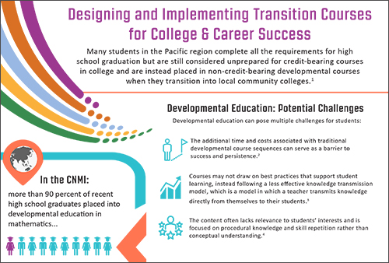
\
Pre-School
K-12
Post-Secondary
Voc Ed Training
Workforce

Slide 43
\
Pre-School
K-12
Post-Secondary
Voc Ed Training
Workforce
Student transitions from high school to college
Impact of the Math Transition Course
  How? Link PSS, NMC, and Workforce Data
  Why do we care?
    NMC Persistence (do students go on to graduate from NMC?)
    What were the students’ long-term educational and career outcomes?
    Curriculum alignment? How do we improve the course in high school?
    Is it working???

Slide 44
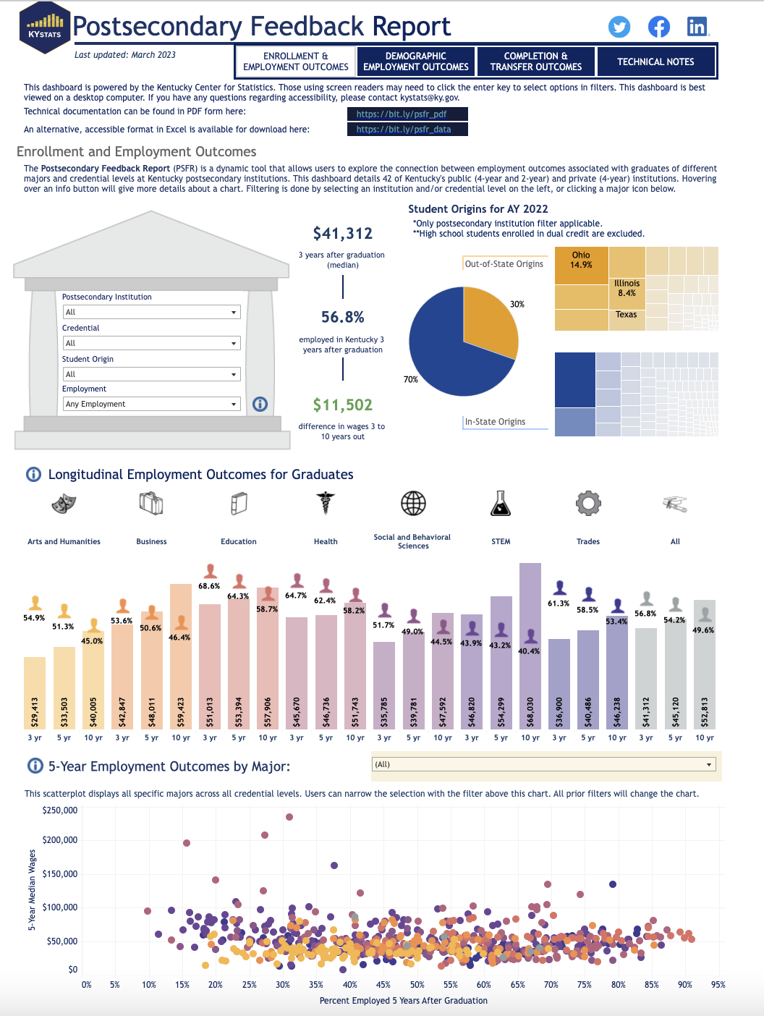
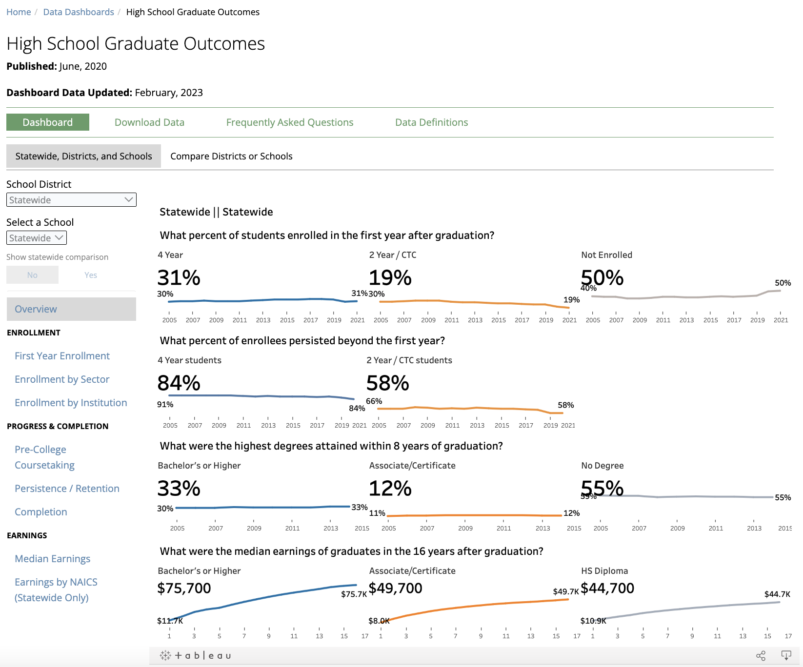
Wasington State
https://erdc.wa.gov/data-dashboards/high-school-graduate-outcomes

Slide 45
Kentucky
https://kystats.ky.gov/Latest/PSFR

Slide 46
\
Pre-School
K-12
Post-Secondary
Voc Ed Training
Workforce
Student transitions from high school to college & the workforce
What are the educational attainment and career placements of our students after they leave PSS?
  How? Link PSS, NMC, and Workforce Data
  Why do we care?
    Are they enrolling in NMC or a vocational training program?
    What are their wages 1 year, 5 years, and 10 years after high school graduation?
    Are PSS programs (high school courses, for example) helping students in their college and career pathways?

