Slide 1

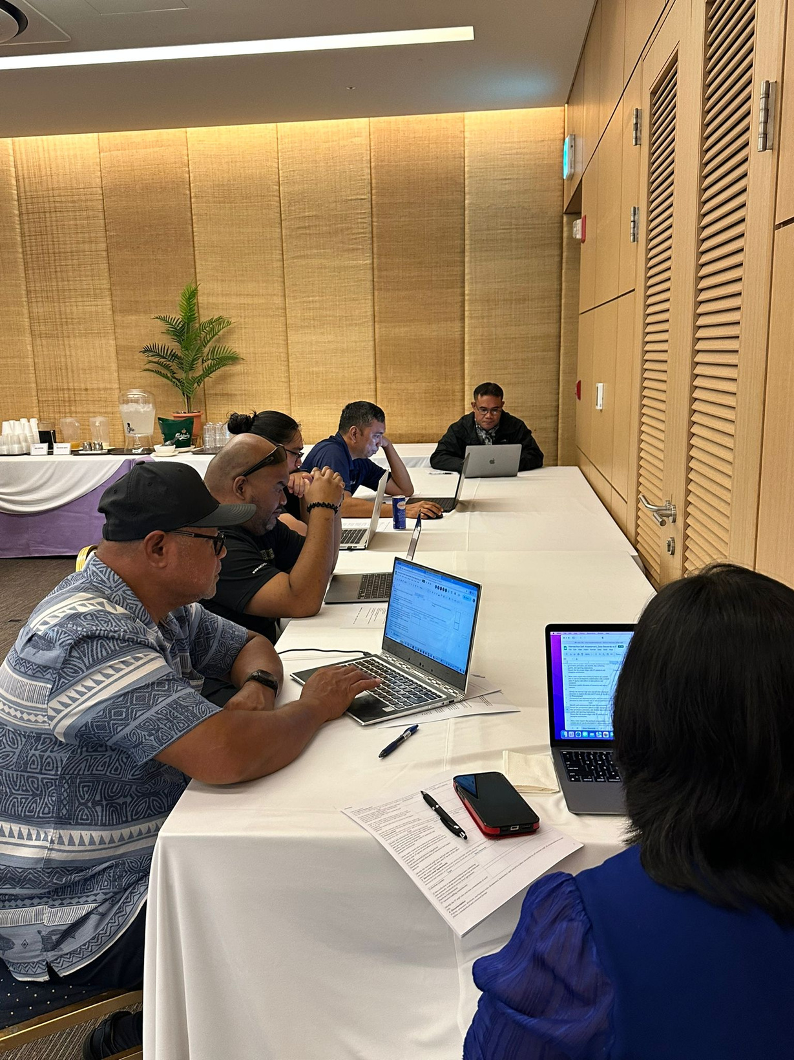

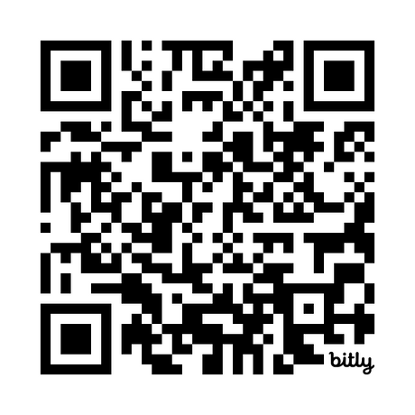
CNMI STATEWIDE LONGITUDINAL DATA SYSTEM
P20W
Data Governance
Committee
Work Session
July 3, 2024
bit.ly/signinp20w

Slide 2
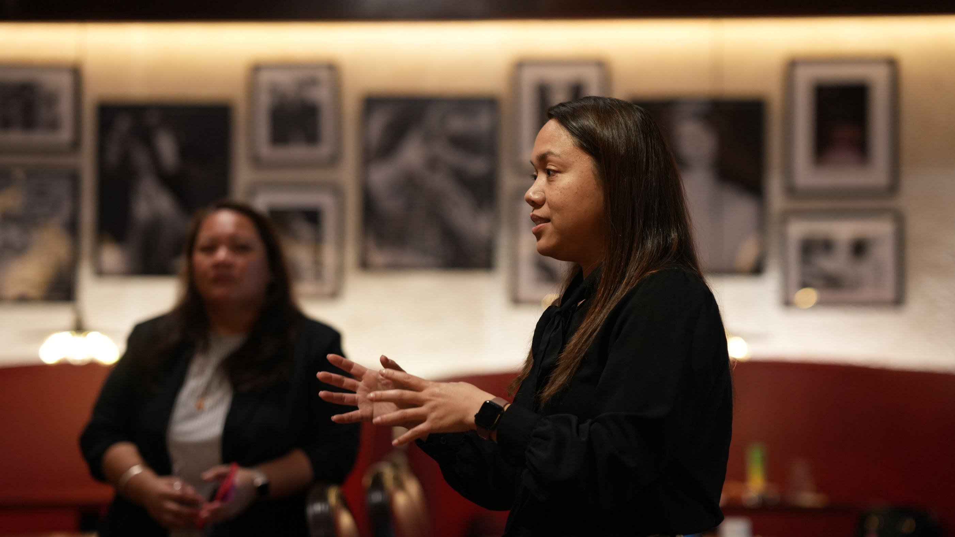
Welcome & Updates
REMINDER:
  Commitment Letters:
    Missing - NMC (1)
  Data Transfer Requirements
    Missing DOF, DOC, DOL, NMC

Slide 3


Intersection of Data Governance & IT Responsibilities
Self-Assessment
Side-by-Side Analysis
Summary of Findings - Presentation
Intersection of Data Governance & IT Responsibilities - Self Assessment

Slide 4
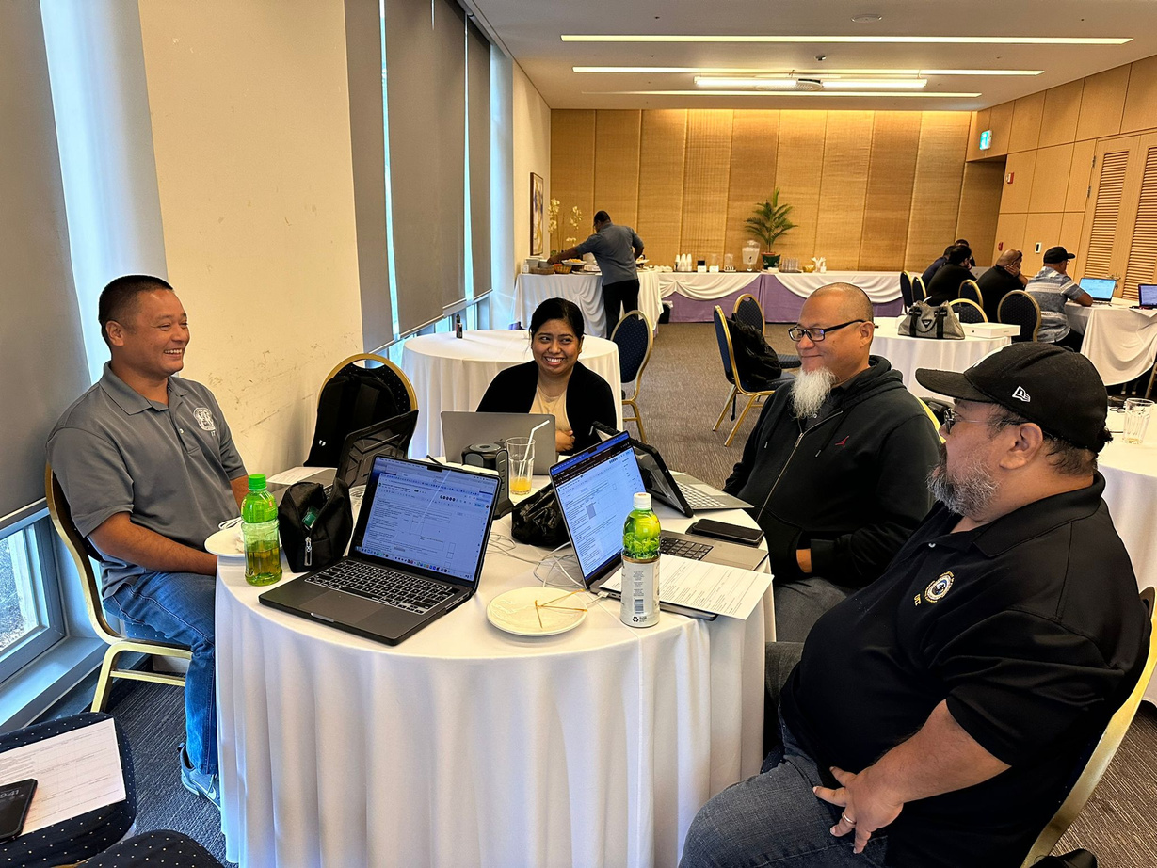
What Next?
  SLDS Data Governance Policy & Processes Workshop
    July 16-17, 2024
    Reston, VA
  Data Sharing Agreements
    Draft review

Slide 5
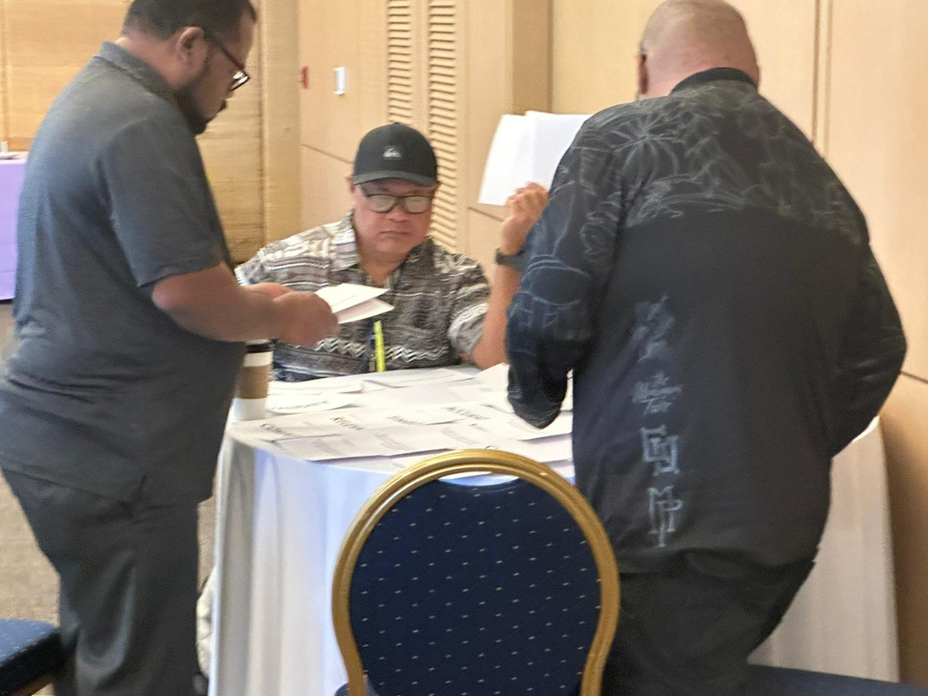
What Next?
  Next P20W DGC Work session
    August 7, 2024
    Caladium Hall, Laolao Bay Golf Resort
    Full Day work session?
  Executive Leadership Meeting
    September 18, 2024
    Venue: TBD
    Deliverables:
      Data Sharing Agreement
      Data Quality Policy

Slide 6

Disclaimer:
The research reported here was supported by the Institute of Education Sciences, U.S. Department of Education, through Grant Award R372A230018 to the CNMI Public School System. The opinions expressed are those of the authors and do not represent the views of the Institute or the U.S. Department of Education.

Slide 7
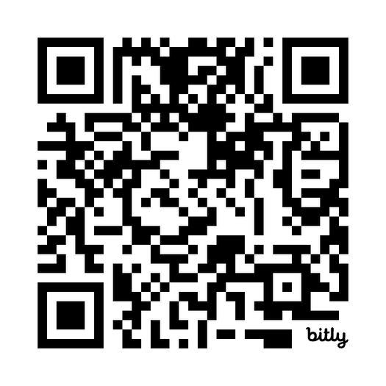
WE APPRECIATE
YOUR
FEEDBACK
Leave us a comment

Slide 8
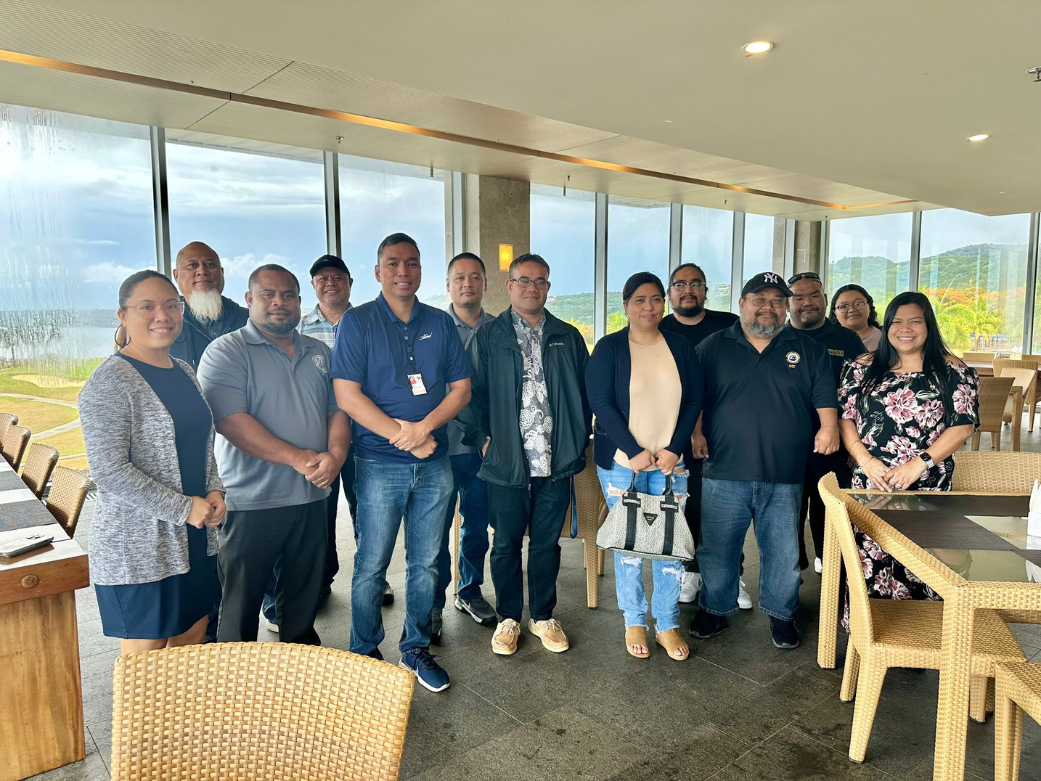
Thank You
P-20W Executive Leadership & DGC:
Remedio Mafnas(Dept of Commerce)
Justin Andrew (Dept of Commerce)
Tracy Norita (Dept of Finance)
Ryan Camacho (Dept of Finance)
Frank Celis (Dept of Finance)
Leila Staffler (Dept of Labor)
Candy Feliciano (Dept of Labor)
Eugene Tebuteb (Dept of Labor)
Dr. Galvin Guerrero (NMC)
Vilma Reyes (NMC)
Jodina Attao (NMTech)
Leo Master (NMTech)
Stephen Sablan (NMTech)
Dr. Lawrence Camacho (PSS)
Dr. Rizalina Liwag (PSS)
Jesse Tenorio (PSS)
CNMI SLDS Program:
Dr. Annette Pladevega Sablan (Project Director)
Shawna Indalecio (Project Specialist)
Jeaniffer Cubangbang (SLDS Technical Manager)
Ferdinand Ngirmekur (Data Privacy Specialist)
Geri DelaCruz (Data Governance Manager)
Extended Gratitude to:
Donna Flores
Francisco Cabrera
Jerome Ortiz
Fermin Sakisat

